Slide 1
Stranger in a Strange Land
Odysseus, The Other, and Greek Colonization

Slide 2
Greek Colonization
We don’t know whether a man named Odysseus ever existed, but we do know that the Greeks were colonizing the Mediterranean about the time The Odyssey was written.
So The Odyssey can be read as both an account of Greek contact with exotic, more ancient peoples and as a justification for Greek dominance of those peoples.

Slide 3
The Epic As Propaganda
Epic stories affirm the values of their culture and justify acts that otherwise contradict that culture’s deepest values: we tell ourselves stories that make us feel good about doing things that we otherwise believe to be wrong.
Generally, epics retell economic conflicts as a battle between good vs. evil or heroes and monsters, between “Us” and The Other.

Slide 4
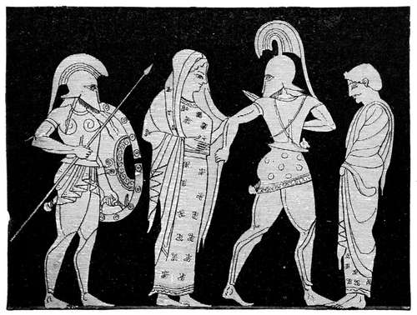
Helen And Troy
In this way, The Iliad refigures the historical battle over a strategic, economically valuable city – Troy – as an epic battle over love and honor.
Blame for the war falls on the victims: on the Trojans themselves, who’s city is invaded, and on a woman, Helen.
The story therefore justifies Greek aggression against the Trojans as well as the domination and enslavement of women.

Slide 5
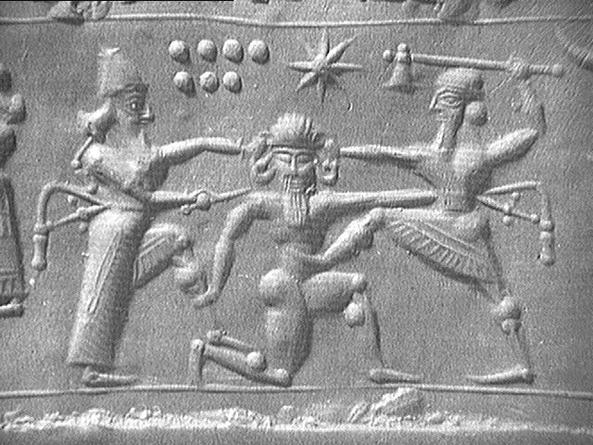
Gilgamesh and Humbaba
Even the oldest existing epic uses this technique: the story of Sumerians invading Lebanon to exploit its cedar forests is retold as an epic battle between the heroic Gilgamesh and the monster Humbaba.

Slide 6
The Other
Loosely defined, the “Other” refers to a person or group of people who are defined as different or even sub-human.
“Othering” a group consolidate one’s own group's identity.
“Othering” a group often justifies exploiting them or at least denying them the rights one takes for granted
Most commonly, epics justify conquest and moral transgression by “Othering” the enemy.

Slide 7
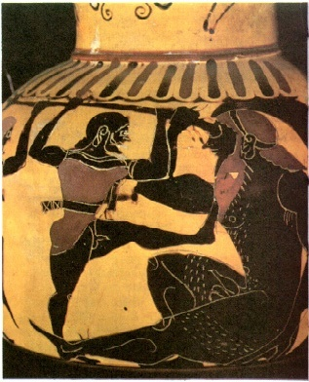
The Cyclops
Throughout The Odyssey we find a preoccupation with hospitality, and that Odysseus’ own home is threatened by the suitors violation.
Yet Odysseus proves himself more than willing to the codes of hospitality when he raids the Cyclops’, Polyphemus’, stores

Slide 8
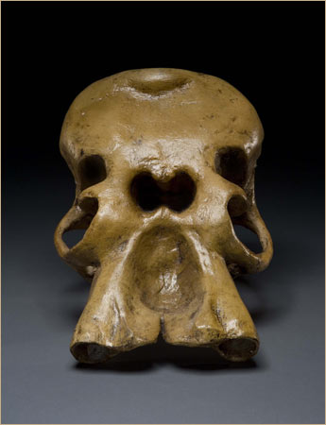
History As Fantasy
The Cyclops were believed to live in S.W. Sicily.
People in this part of Sicily did, in fact, often live in caves, as well as burying their dead in caves.
Until c. 8,000 BC pygmy elephants inhabited Sicily (and other Mediterranean islands).

Slide 9
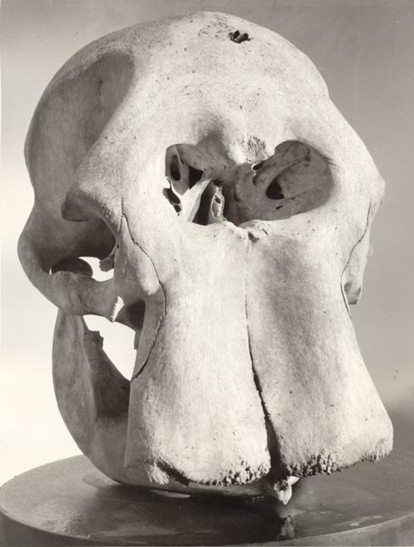

Slide 10
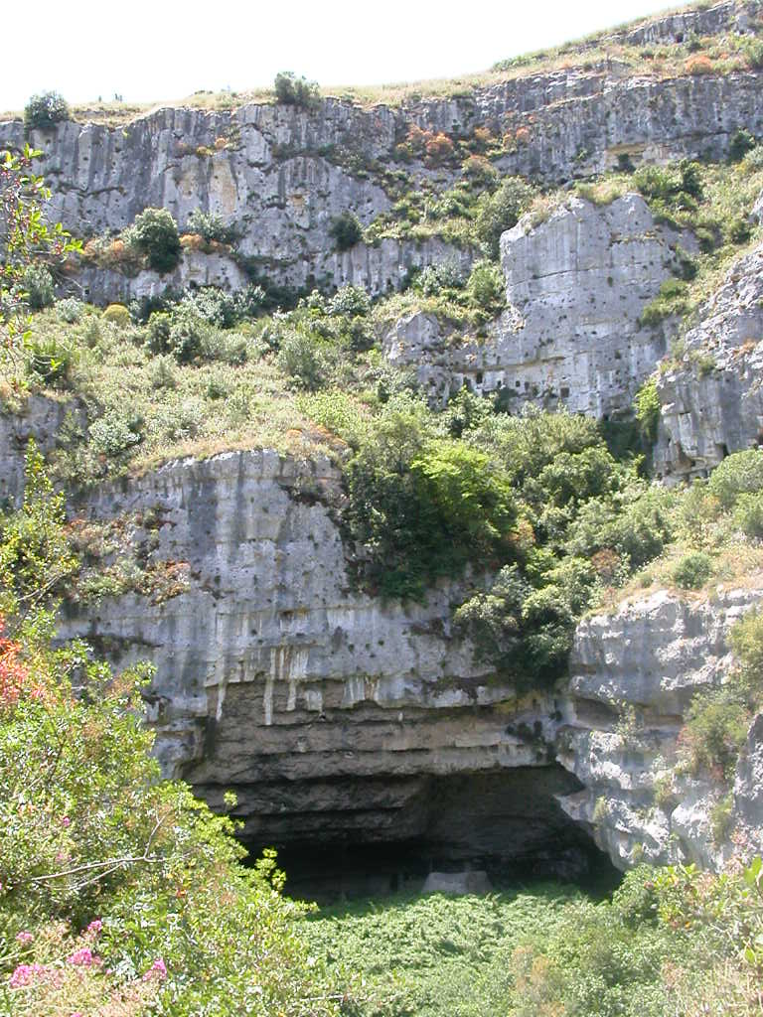
Necropolis, Pantalica, Sicily

Slide 11
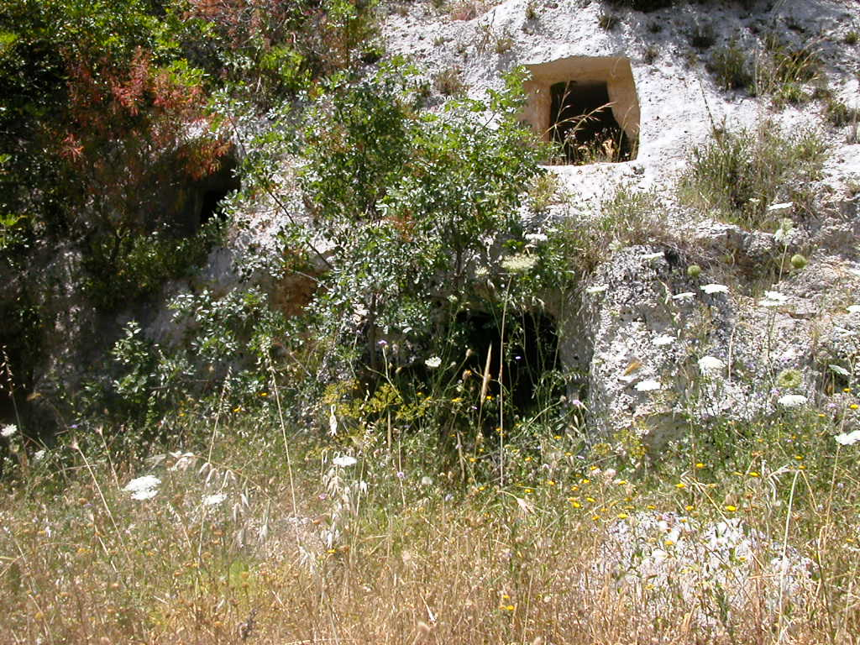

Slide 12
Calypso of Ogygia
Greek culture was blatantly, proudly patriarchical.
Pre-Greek ancient cultures, however, were probably either less patriarchical or even perhaps matriarchical.
They also worshipped fertility cults – related to Ishtar, Aphrodite etc. – which probably practiced sacred prostitution.

Slide 13
Homeric Patriarchies
Note that there are no other kings or men mentioned in the stories of either Calypso or Circe: both stories revolve around politically independent and powerful women.
In contrast, all of the Greek women mentioned throughout both epics are subservient to their men.

Slide 14
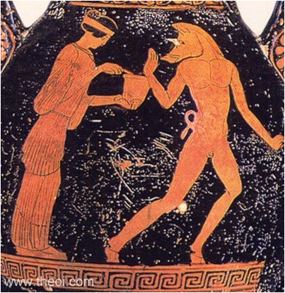
Circe of Aiaia: A Goddess Pharmakeia
Pharmakeia: named for a nymph of a poisonous well and the root of our word “pharmacy” or “pharmaceuticals”.
Ancient (but also Greek) cultures used hallucinogenic drugs in various religious rites.
Women were also charged with controlling natural pharmaceuticals .
Our term “witch” still Others these ancient female priestess-healers.

Slide 15
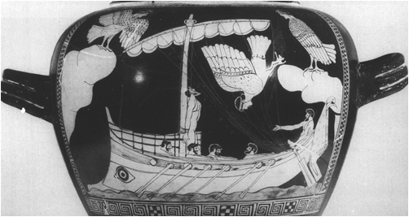
The Sirens
Further adventures in the lands where women don’t yet know their place.

Slide 16
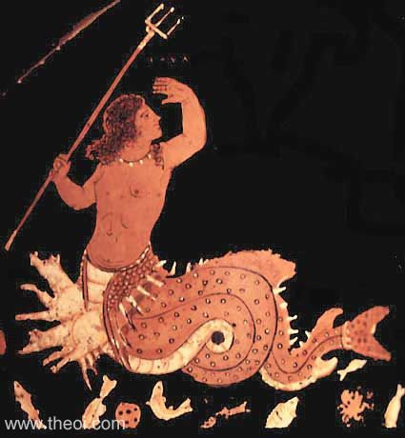
Scylla
A female sea monster located on the Sicilian side of the Straits of Messina.
As Homer was penning his epics, the Greeks were invading Sicily and replacing the islands goddesses with their own.

Slide 17
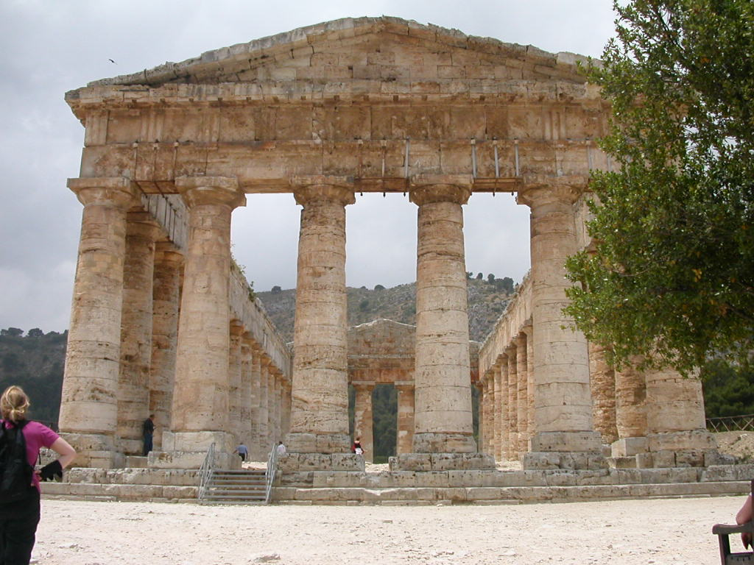
Segesta, Sicily 550 BC

Slide 18
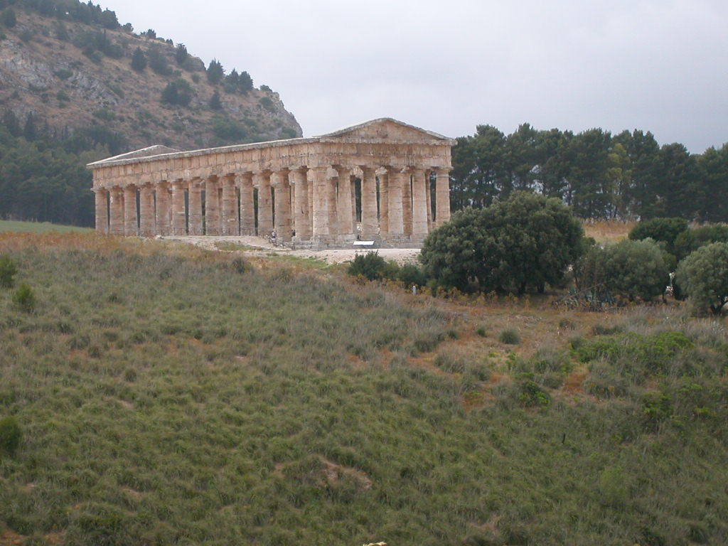

Slide 19
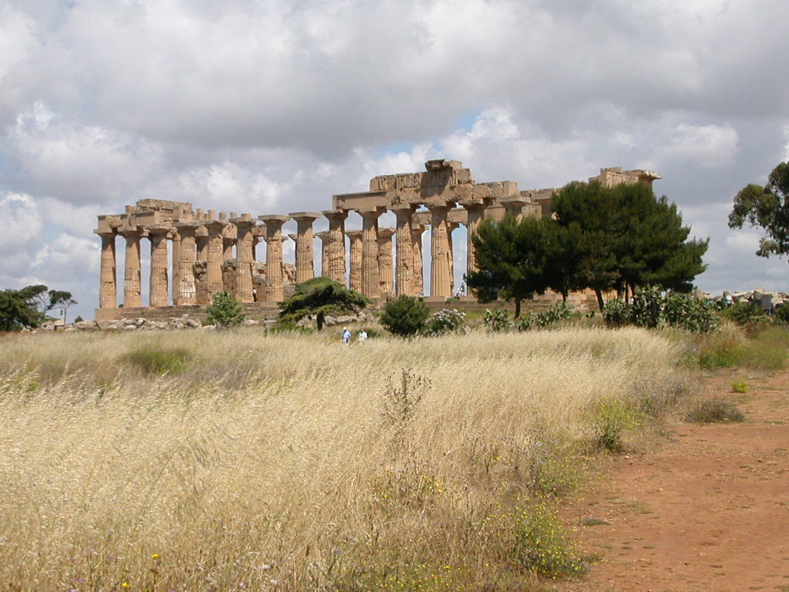
Temple of Hera/Aphrodite
Selinus, Sicily c. 500 BC

Slide 20
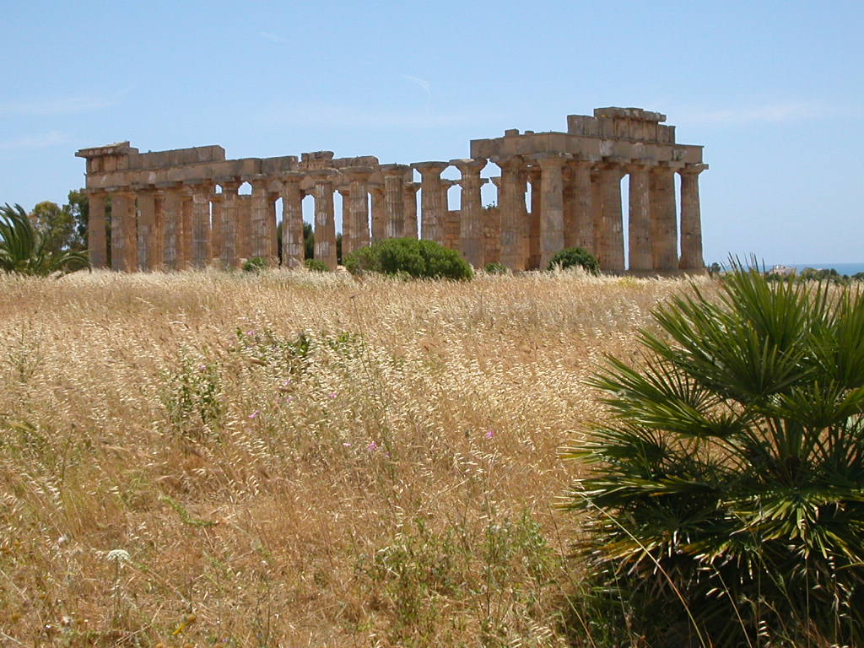

Slide 21
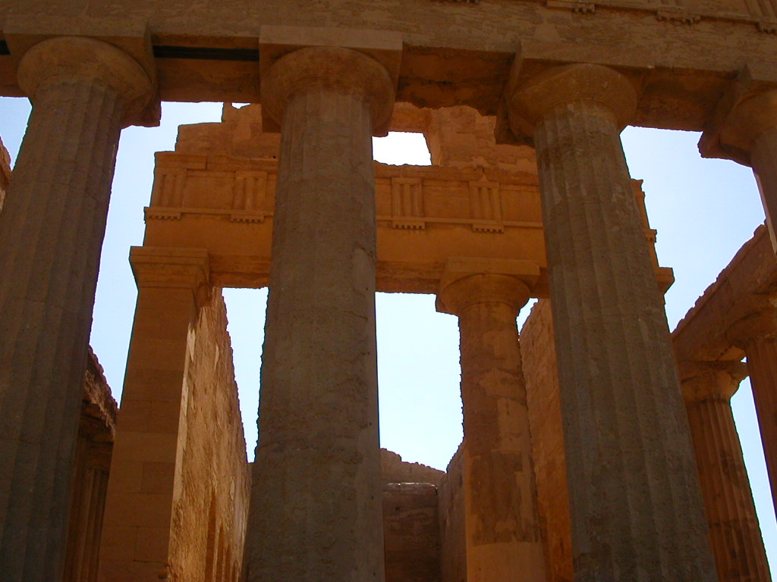
Temple of Concordia
Agrigento, Sicily c 430 BC

Slide 22
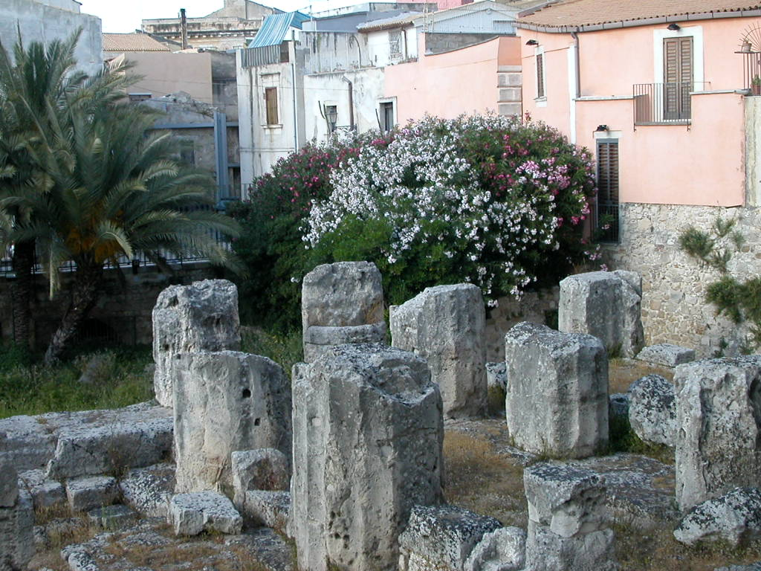
Temple of Apollo
Syracuse c. 600 BC

Slide 23
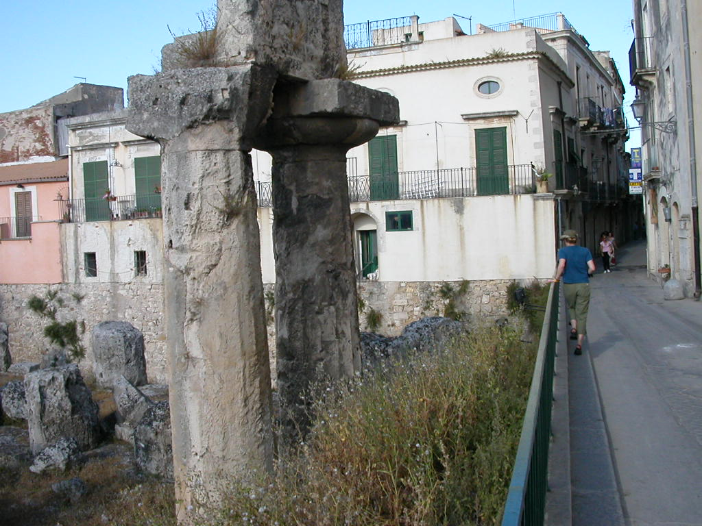

Slide 24
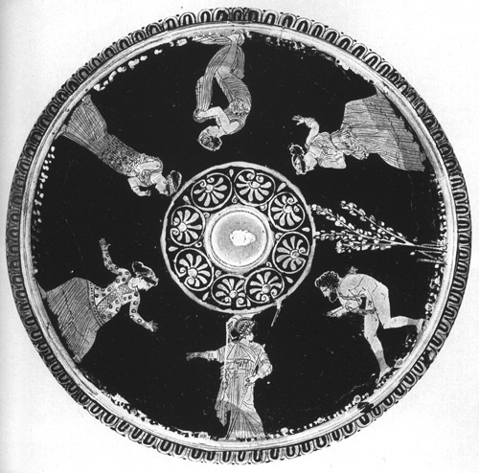
Nausicaa of Phaeacia
Nausicaa is the only foreign woman Odysseus encounters who is not Othered: she alone possesses entirely human attributes.
She is also the only woman subservient to a man – in this case, her father, King Alcinous and her relations with Odysseus are very carefully kept platonic and respectful.
Nausicaa is also the last woman Odysseus encounters before returning home, and her father’s aid finally returns him.

