Slide 1
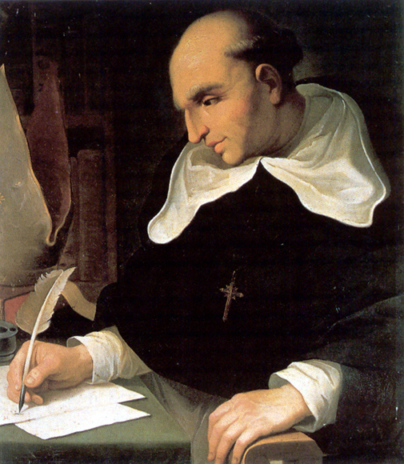
Bartolomé de las Casas 1474 (or 1484) – 1566

Slide 2
Background, Qualifications, Credibility
Perhaps uniquely qualified and positioned to understand and speak from an informed and educated position to the general condition of indigenous peoples.
Crossed the Atlantic ten times, met with emperors, popes, Cortez, sailed the Pacific, participated in the conquest of Cuba, preached to indigenous people, held slaves, personally profiting greatly from the encomienda system.
Important as an archivist, historian and collector – had, for example, access to Columbus’ journals, and de Casas’ summaries are the only extant copy.

Slide 3
Early Biographical Context
Raised in Seville. Descended from Jewish conversos on his father’s side. Highly educated.
1492 – Defeat of Moors in Granada. In his early life Spanish Christians were still battling Moors, and de las Casas may have helped suppress a Moorish revolt in Granada in 1497.
At 8 or 18 witnessed Columbus’ triumphant return to Seville, seeing the first seven Native Americans to ever set foot on European soil.
1493 – His father and three of his father’s brother’s accompanied Columbus on his second voyage to the New World.

Slide 4
Early Experiences In The New World
1502 – 1513 Accompanies father on mission to colonize Hispaniola. Bartoleme works as a doctrinero – lay teacher of scripture – or as a chaplain, positions which quickly allow him to amass a fair degree of wealth and to receive his own encomiendas – both in Hispaniola and Trinidad. Helps brutally suppress an Indian rebellion in Hispaniola.
1510 – Becomes an ordained priest.
Throughout these years, de las Casas travels widely throughout the Caribbean colonies, participating in, directly witnessing, and profiting greatly from the most brutal treatment of colonized Indians will serve to substantiate his ensuing arguments.

Slide 5
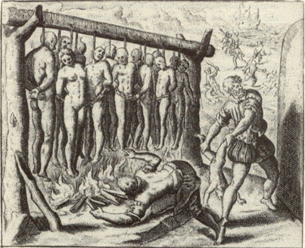
The Transition

Slide 6
1511 – Dominican priest Antonio de Montesinos preaches against colonial abuses and for the outright end to both the encomienda and repartimento of Indians. In the Dominican order these sermons are well received and strongly supported.
“Tell me, by what right or justice do you hold these Indians in such cruel and horrible slavery? By what right do you wage such detestable wars on these people who lived mildly and peacefully in their own lands…. Are they not men? Do they not have rational souls? Are you not bound to love them as you have loved yourselves?”
1514 – A wealthy man, de las Casas surrenders his recomienda (allotment of Indians)

Slide 7
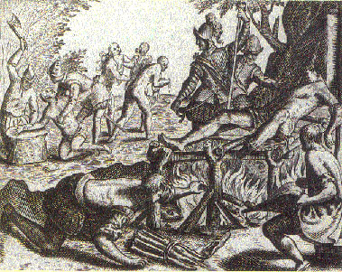
Theodore de Bry

Slide 8
“Protector Of The Indians”
1515 Begins travelling back and forth to the Spanish courts to plead the case of Indians.
1520 – Granted land in Venezuela by Emperor Charles V, to attempt an experimental, peaceful colony. The attempt is quickly abandoned.
1522 – Joins the Dominican order.
1526 – 1537 – Stationed at or travelling through missions throughout the Spanish colonies, writes him most influential letters to the court and Pope arguing for revision of laws.

Slide 9
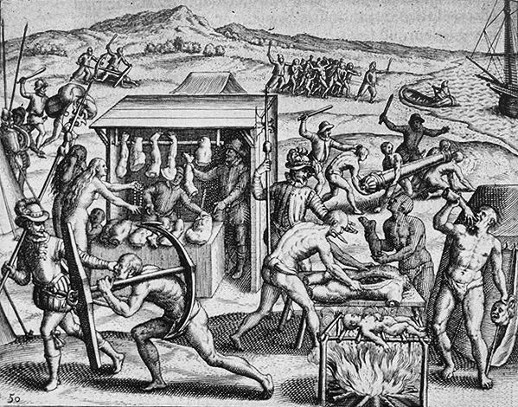
Theodore de Bry

Slide 10
De las Casas’ Arguments
His case is made as much from a legal as religious perspective and reveal the intertwining of Spanish religious and secular law: that slavery could only be justified under conditions (broadly) sanctioned in the Bible; one could justifiably enslave infidels (Muslims) or captives taken in war, but only if those wars were considered just, that is: while defending previously held lands.
In other words, Spanish law justified the Reconquista under the argument that Christians had held the Iberian peninsula before the Muslims, and these laws – and this mindset – continued to influenced court attitudes toward Indians.
His argument gains a fair degree of support among both the Dominican clergy and hierarchy as well as the Spanish court in Spain. They are, of course, highly unpopular among the colonists.

Slide 11
The Vallalodid Debate
Sepulveda argued the Indians were “barbarous, uncivilized, and inhuman people who are natural slaves, refusing to submit to the superiority of those who are more perfect than themselves. Their subordination would bring them tremendous benefits and would, besides, be a good thing by natural right.”
De las Casas essentially refuted the assumption that Europeans are inherently superior and goes so far as to argue to claim the Indian cultures were originally superior, only to be corrupted by the colonization experience itself.

Slide 12
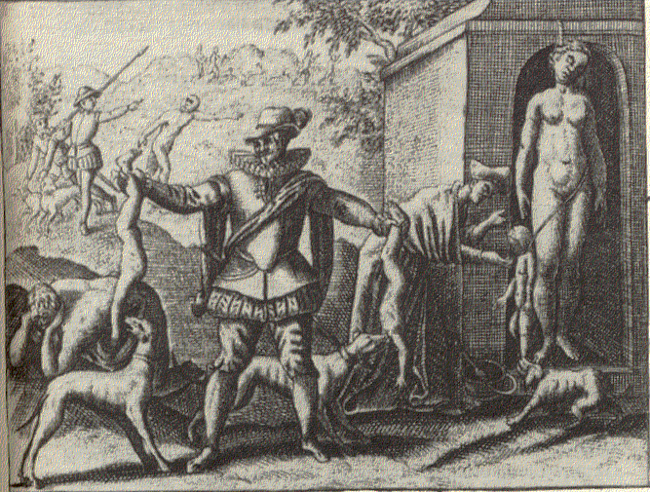
Theodore de Bry

Slide 13
Papal Bull Sublimis Deus
1537 – Under pressure from de las Casas and others, the Pope limits the causes for “just wars”, and recognizes the inherent sovereignty of the Indians (thereby banning their enslavement), as well as their rational agency, suggesting that they could and should be persuaded, rather than forced, toward conversion. Further, however, the colonialists had a responsibility to convert Indians to Catholicism, suggesting and maintaining Spanish Catholic dominion.

