Slide 1
What to expect during your time at MOSS

Slide 2
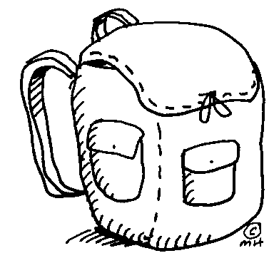
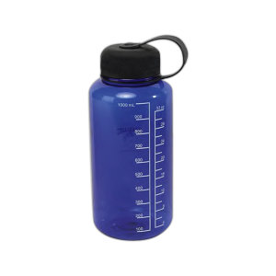
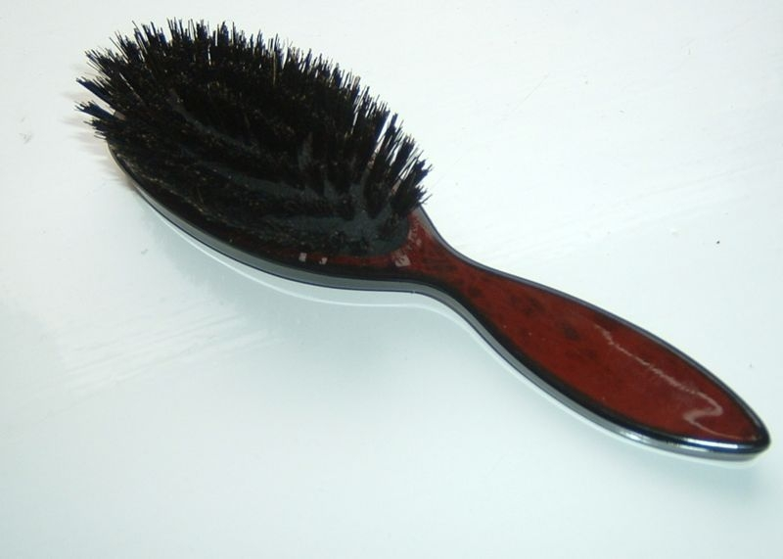
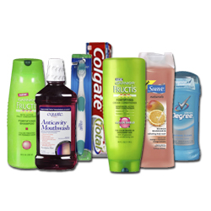
What to bring:

Slide 3
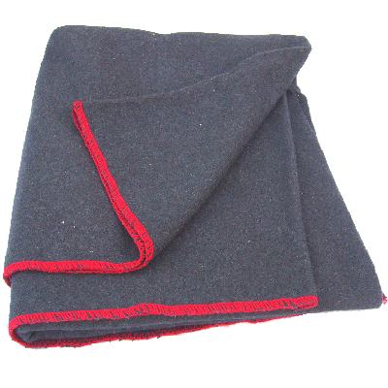
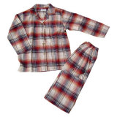
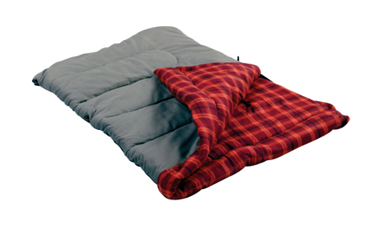
What to bring cont.:
MISC: • Flashlight (IMPORTANT!) • Pens, pencils, and a notebook • Personal reading material • Binoculars, field guides (optional) • Camera and film • Sunglasses

Slide 4
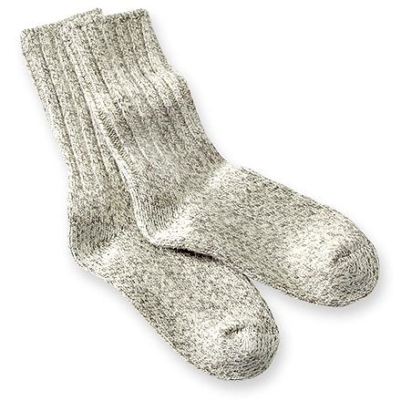
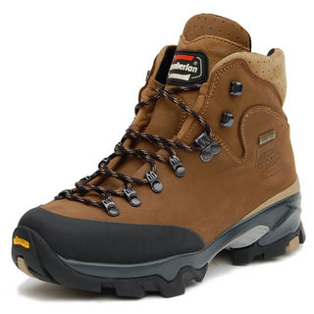
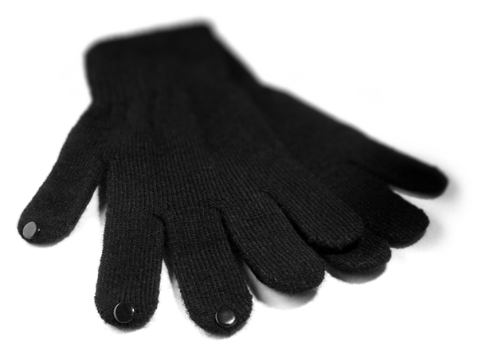
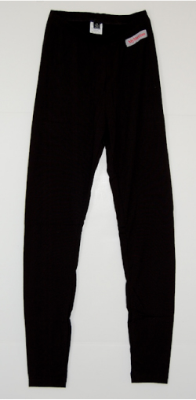
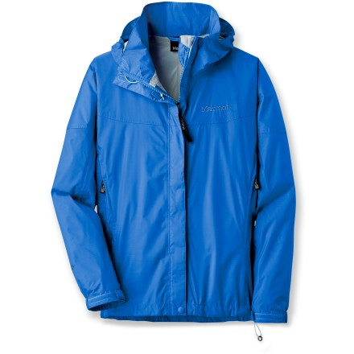
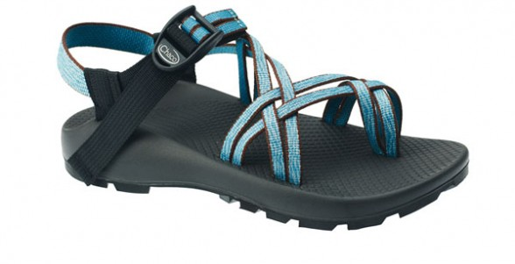
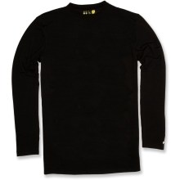
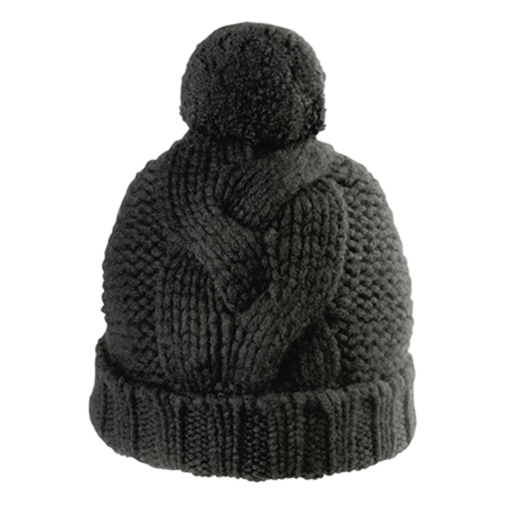
What to bring to wear:
Notes:
FEET: • Thick socks (wool or synthetic; three field days, two travel days) • 1 pair of closed- toe boots or sturdy shoes suitable for walking over rugged terrain; preferably waterproof • Light shoes or sandals to wear inside and around camp
LEGS: • Heavy wool, synthetic, or cotton pants (2-3 pairs) • Synthetic Long underwear (this is essential!)
UPPER-BODY: • Heavy weight insulated jacket, • Fleece, sweatshirt, wool sweater, flannel shirts • Waterproof rain jacket • Synthetic Long underwear top • Long or short sleeved T-shirts
HANDS: • Light gloves or mittens
UNDERWEAR: • Enough for five days (there are no laundry facilities at camp)
HEAD: • Insulated or wool hat which covers ears • Baseball or other cap that shields face from the sun Chap stick

Slide 5
What not to bring:
• Fire works, lighters, etc.
• Pocket knives, Leatherman® tools etc.
• Cell phones, radios, CD players, video games, personal computers, etc.
• Snack food, chips, etc. (no food in the cabins -wildlife control effort)
• Pets
• Tobacco, alcohol, or illegal drugs

Slide 6
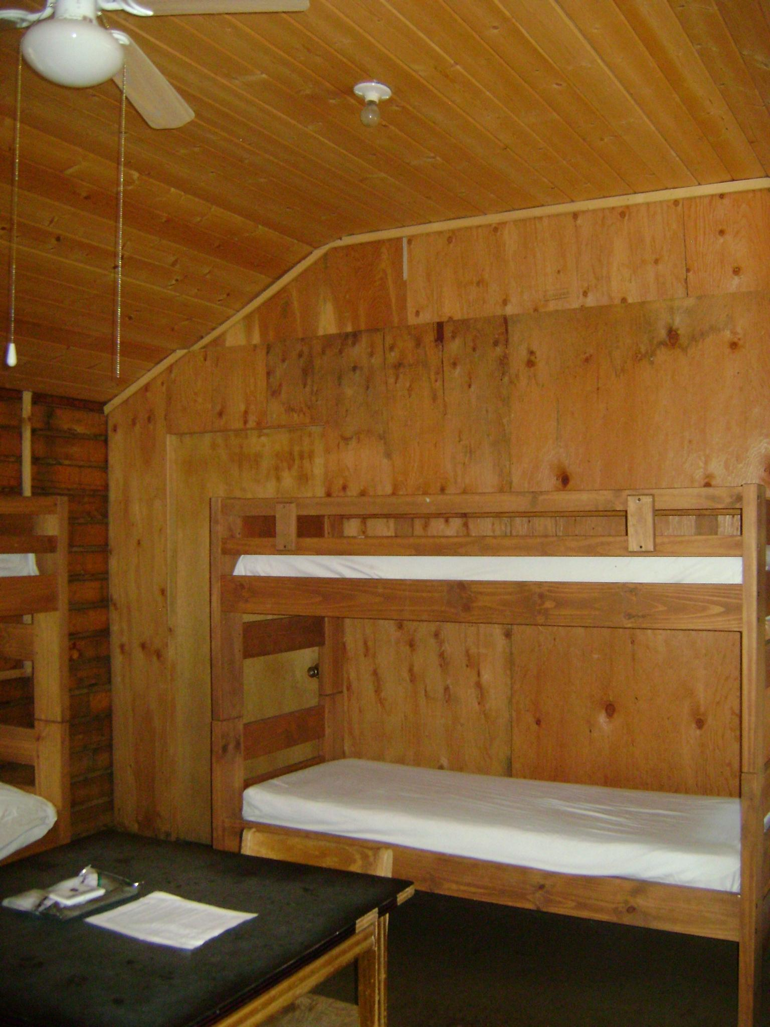
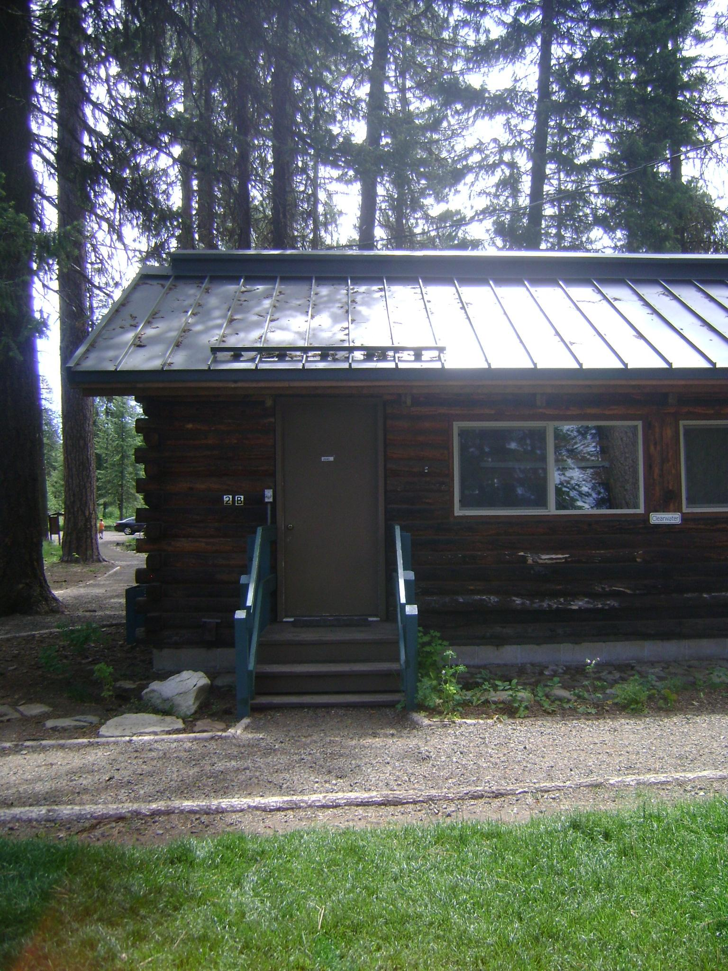
Where will you sleep?

Slide 7
What will you eat?
Some items you might expect to eat during your time at MOSS:
Breakfast:
Eggs, bacon, hash browns, pancakes, oatmeal, cereal
Lunch
Sandwich, fruit, trail mix, pretzels, cookie
Dinner
Pasta, Mac&Cheese, Pulled Pork, burritos, salad

Slide 8
What your days will look like:

Slide 9
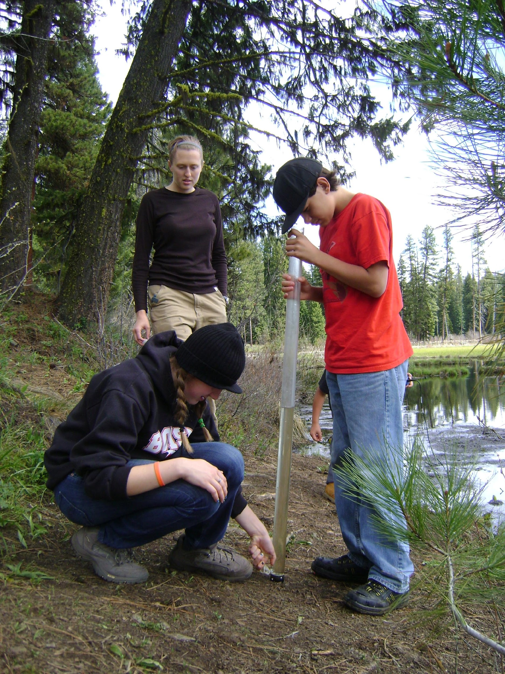
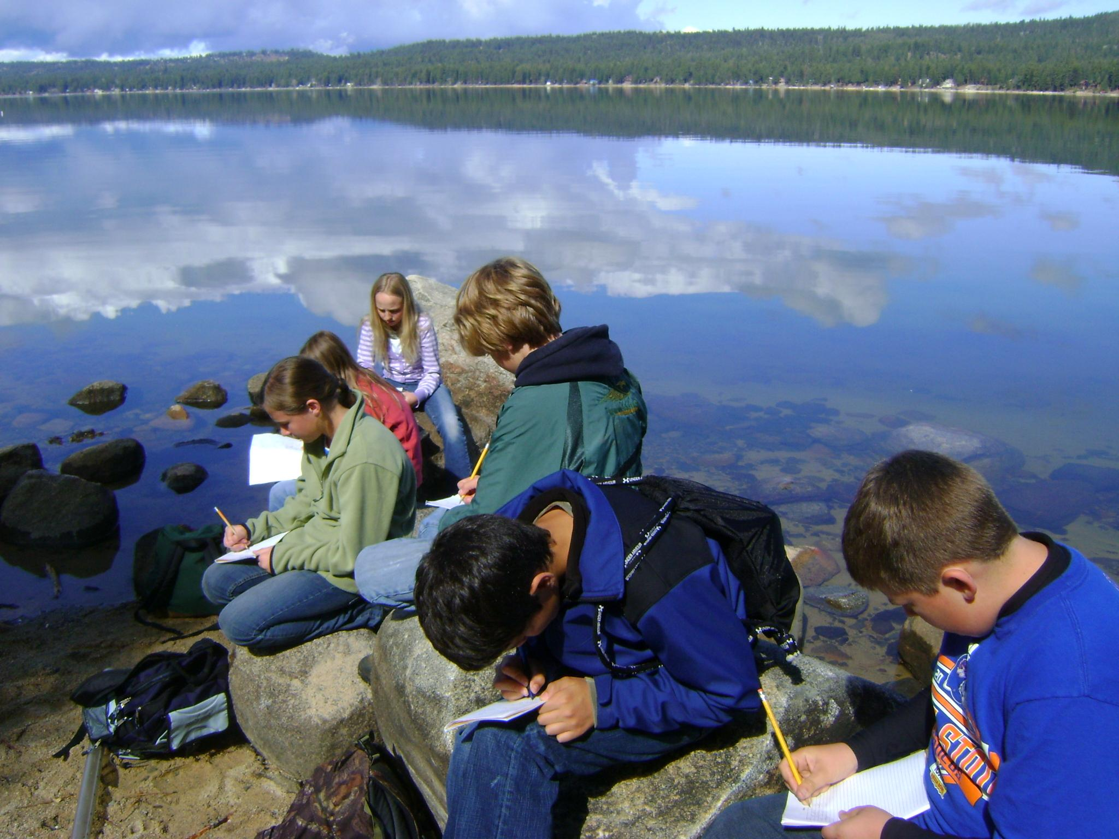
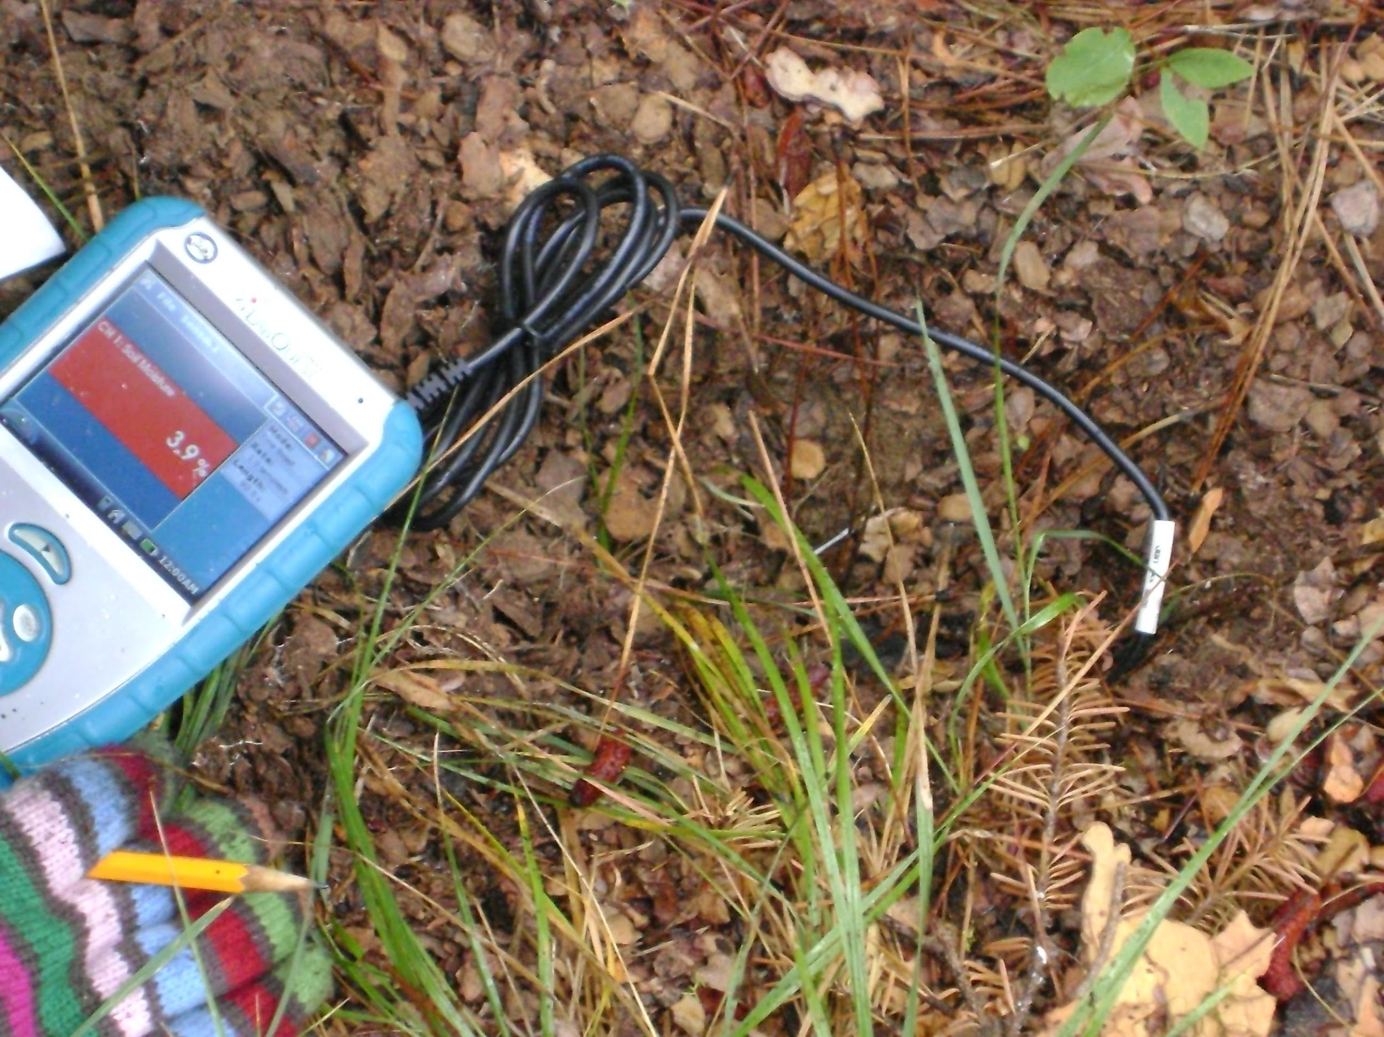
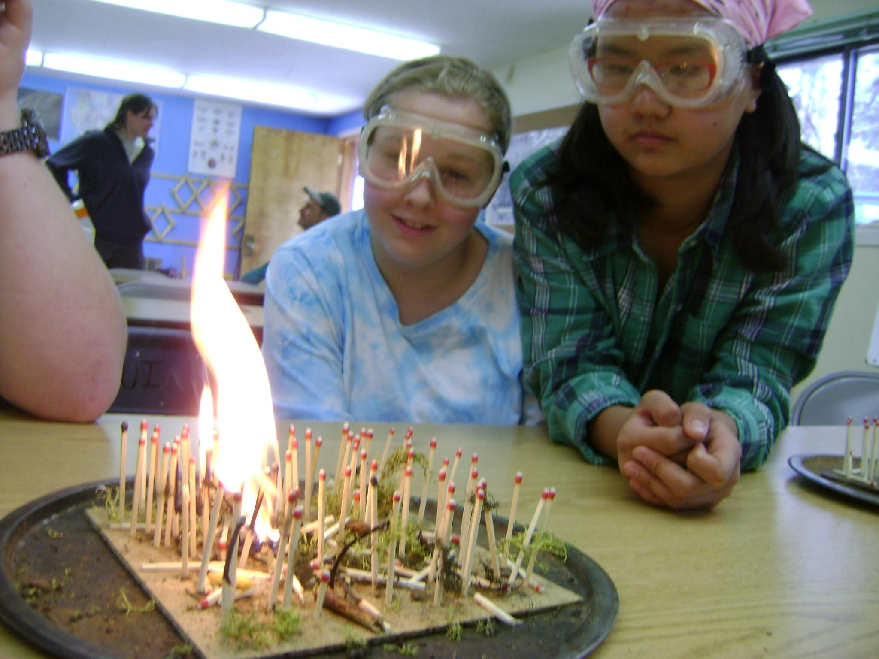
Field day at MOSS:

Slide 10
Scientific Process
During your week as MOSS we will be using the scientific process daily
Ask Question
Create Hypothesis
Reflect
Design Experiment
Draw Conclusion
Collect & Analyze Data

Slide 11
Some of the trees you will see during your visit at MOSS…..

Slide 12
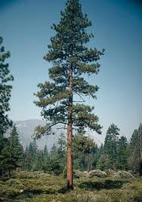
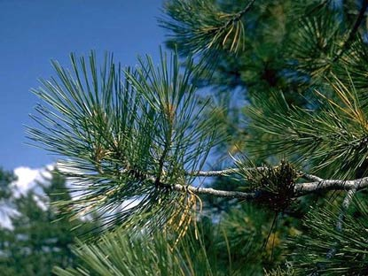
Ponderosa Pine
What characteristics do you see that could distinguish a Ponderosa from other trees?

Slide 13
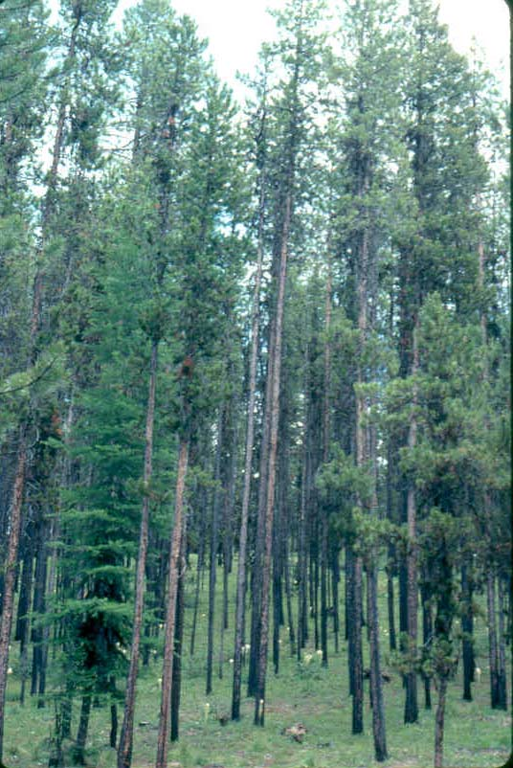
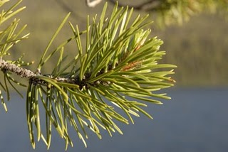
Lodgepole Pine
What characteristics do you see that could distinguish a Lodgepole from other trees?

Slide 14
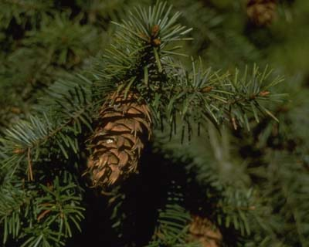
Douglas Fir
What characteristics do you see that could distinguish a Douglas Fir from other trees?

Slide 15
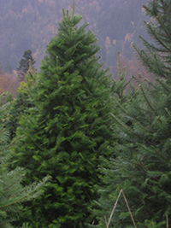
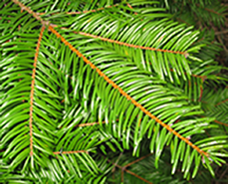
Grand Fir
What characteristics do you see that could distinguish a Grand Fir from other trees?

Slide 16
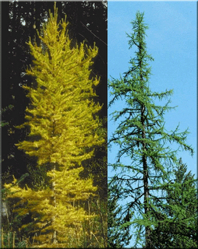
Western Larch
What characteristics do you see that could distinguish a Western Larch from other trees?

Slide 17
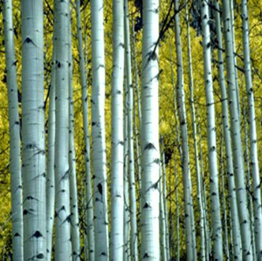
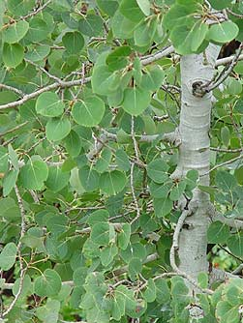
Aspen
What characteristics do you see that could distinguish an Aspen from other trees?

Slide 18
Major concepts that will be covered during your time at MOSS….

Slide 19
Watersheds
A watershed can be defined as a ridge of high land dividing two areas that are drained by different river systems.
A watershed can be thought of as a large bathtub. When a drop of water hits anywhere in the bathtub it eventually finds its way to the drain. The bathtub defines the watershed boundary. On land, that boundary is determined topographically by ridges, or high elevation points. Water flows downhill, so mountains and ridge tops define watershed boundaries.
What watershed do you live in, what are the boundaries?

Slide 20
Water Characteristics
During your time at MOSS we will be collecting water samples to measure the following water characteristics:
Turbidity- the amount of particulate matter that is suspended in the water
Conductivity- measures how well the water allows an electrical current to pass through it
Temperature
pH- the measure of the acidity or basicity of a water based solution
Dissolved oxygen- the amount of oxygen dissolved in water
What do you think can affect water characteristics?

Slide 21
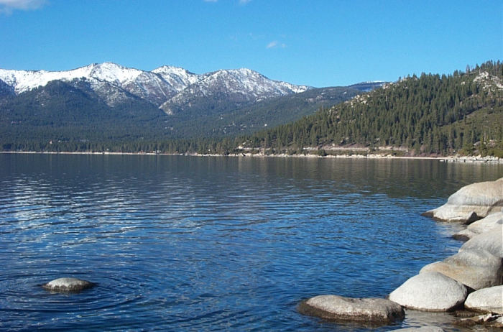
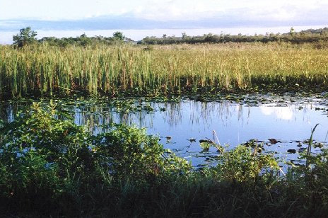
Turbidity
Turbidity is the amount of particulate matter that is suspended in the water
The ‘murkier’ the water the greater the turbidity
Which one of these would be more turbid?

Slide 22
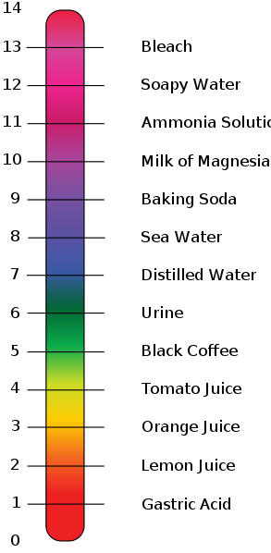
pH
pH (per hydrogen) is the measure of the acidity or basicity of a water based solution
The pH scale ranges from 0-14
7 is neutral
A pH greater than 7 is basic
A pH lower than 7 is acidic

Slide 23
Ecosystems
An ecosystem is a community of living (biotic) and non-living (abiotic) things that work together.
3 essential parts of an ecosystem
Producer- green plants that create their own food
Consumer-animals and they get their energy from the producers or from organisms that eat producers
Decomposer- plants and animals that break down dead plants and animals into organic materials that go back into the soil
What ecosystems can you think of?
What producers, consumers and decomposers live within that ecosystem?

Slide 24
See you soon!

