Slide 1
FEA Analysis of an Assembly with Bolt Fasteners
Ryan Clark, Daniel Kang, Nathaniel Randall

Slide 2
Objective
Utilize the FEA workbench in CATIA to analyze bolts and their interaction with plates that they are intended to attach.
Create a tutorial that illustrates how to perform an FEA analysis of a bolted assembly.

Slide 3
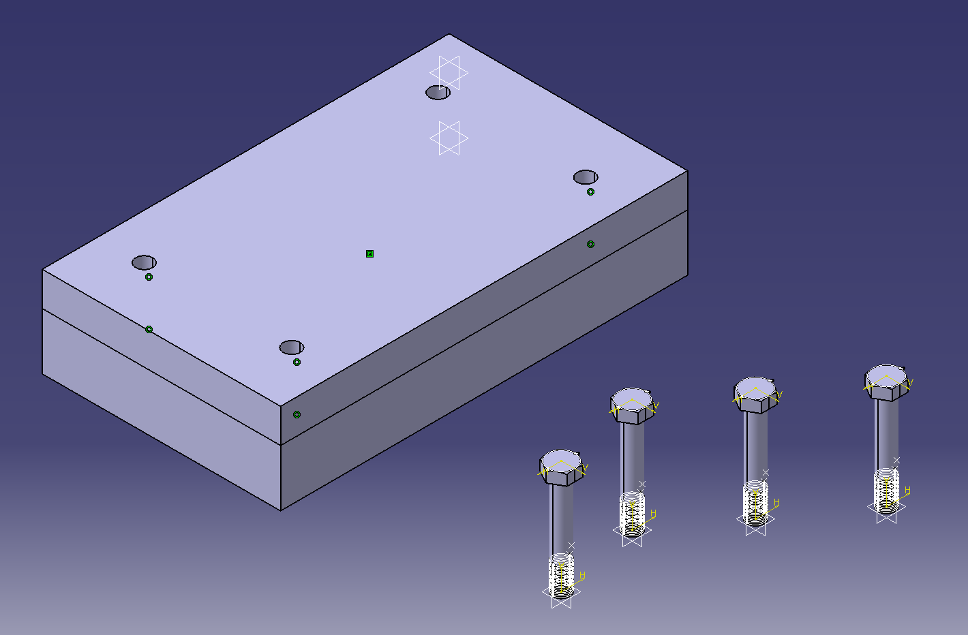
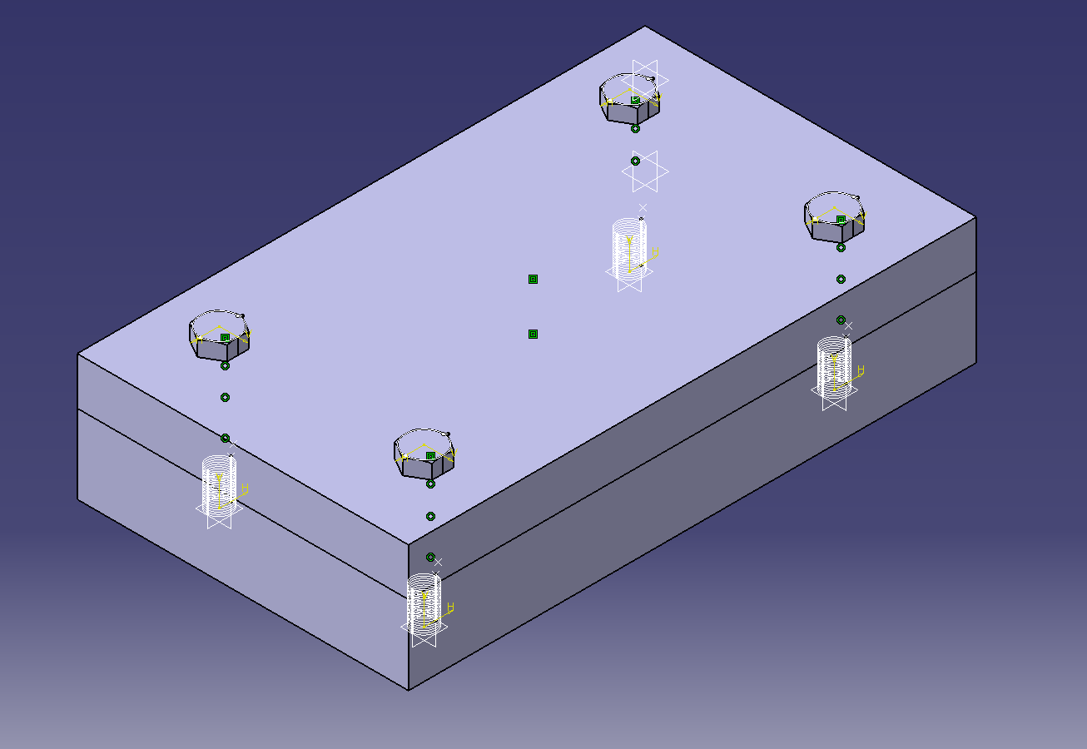
Base Plate and Bolts
1. Bring all required components into assembly workbench
2. Properly mate components

Slide 4
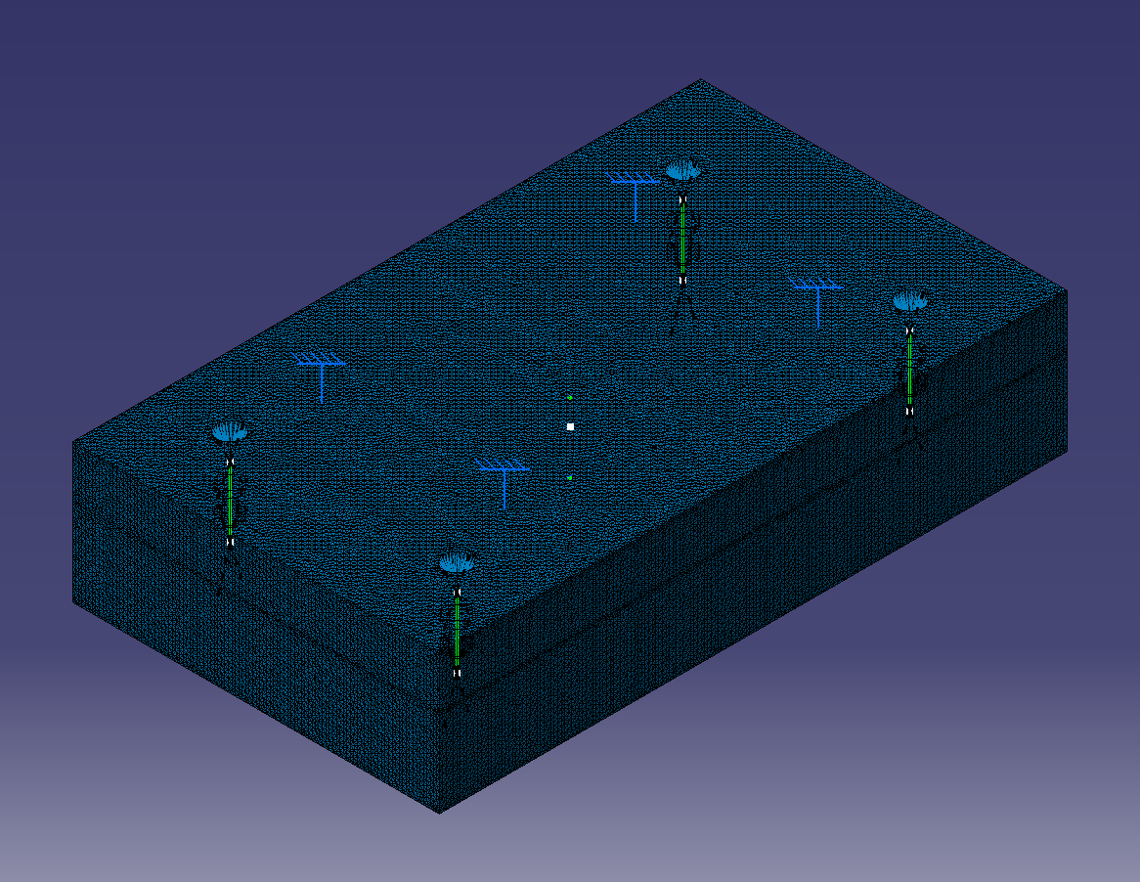
Mesh and Virtual Bolts
3. Enter FEA workbench, create mesh, constraints, and forces

Slide 5
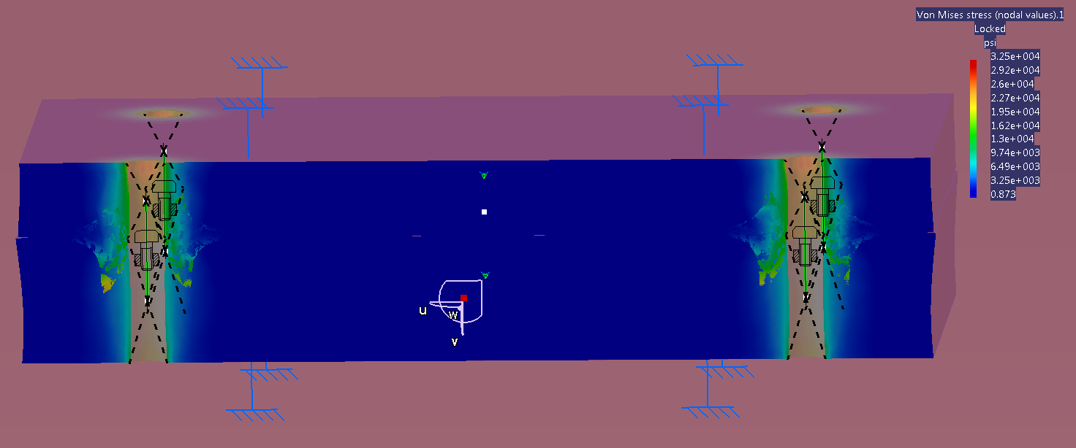
FEA Analysis (Von Mises Stress)
4. Perform FEA analysis with virtual bolt connection (will find stresses on the housing)

Slide 6
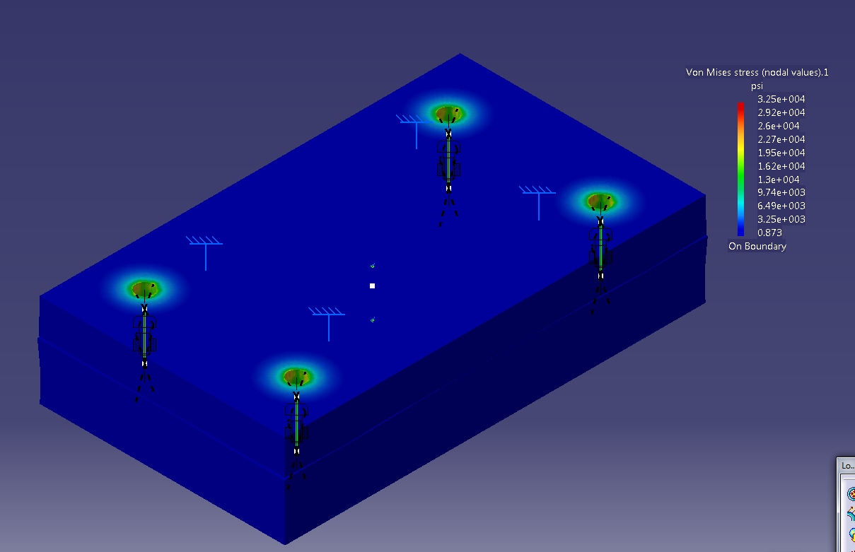
FEA Analysis (Von Mises Stress)

Slide 7
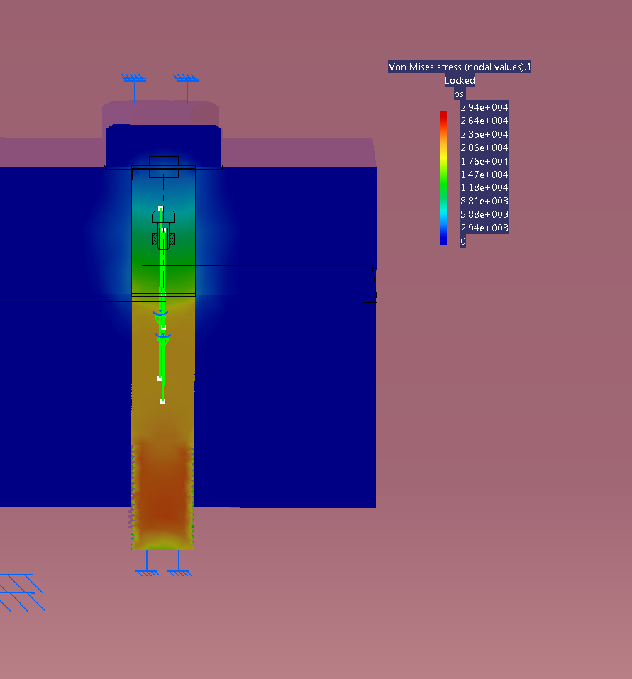
FEA of Bolt
5. Perform FEA on actual bolt to determine stresses on bolt.

