Slide 1
Application of the Generative Shape Design Workbench for Automobile Body Design
James Kast
Andrew Kuharske

Slide 2
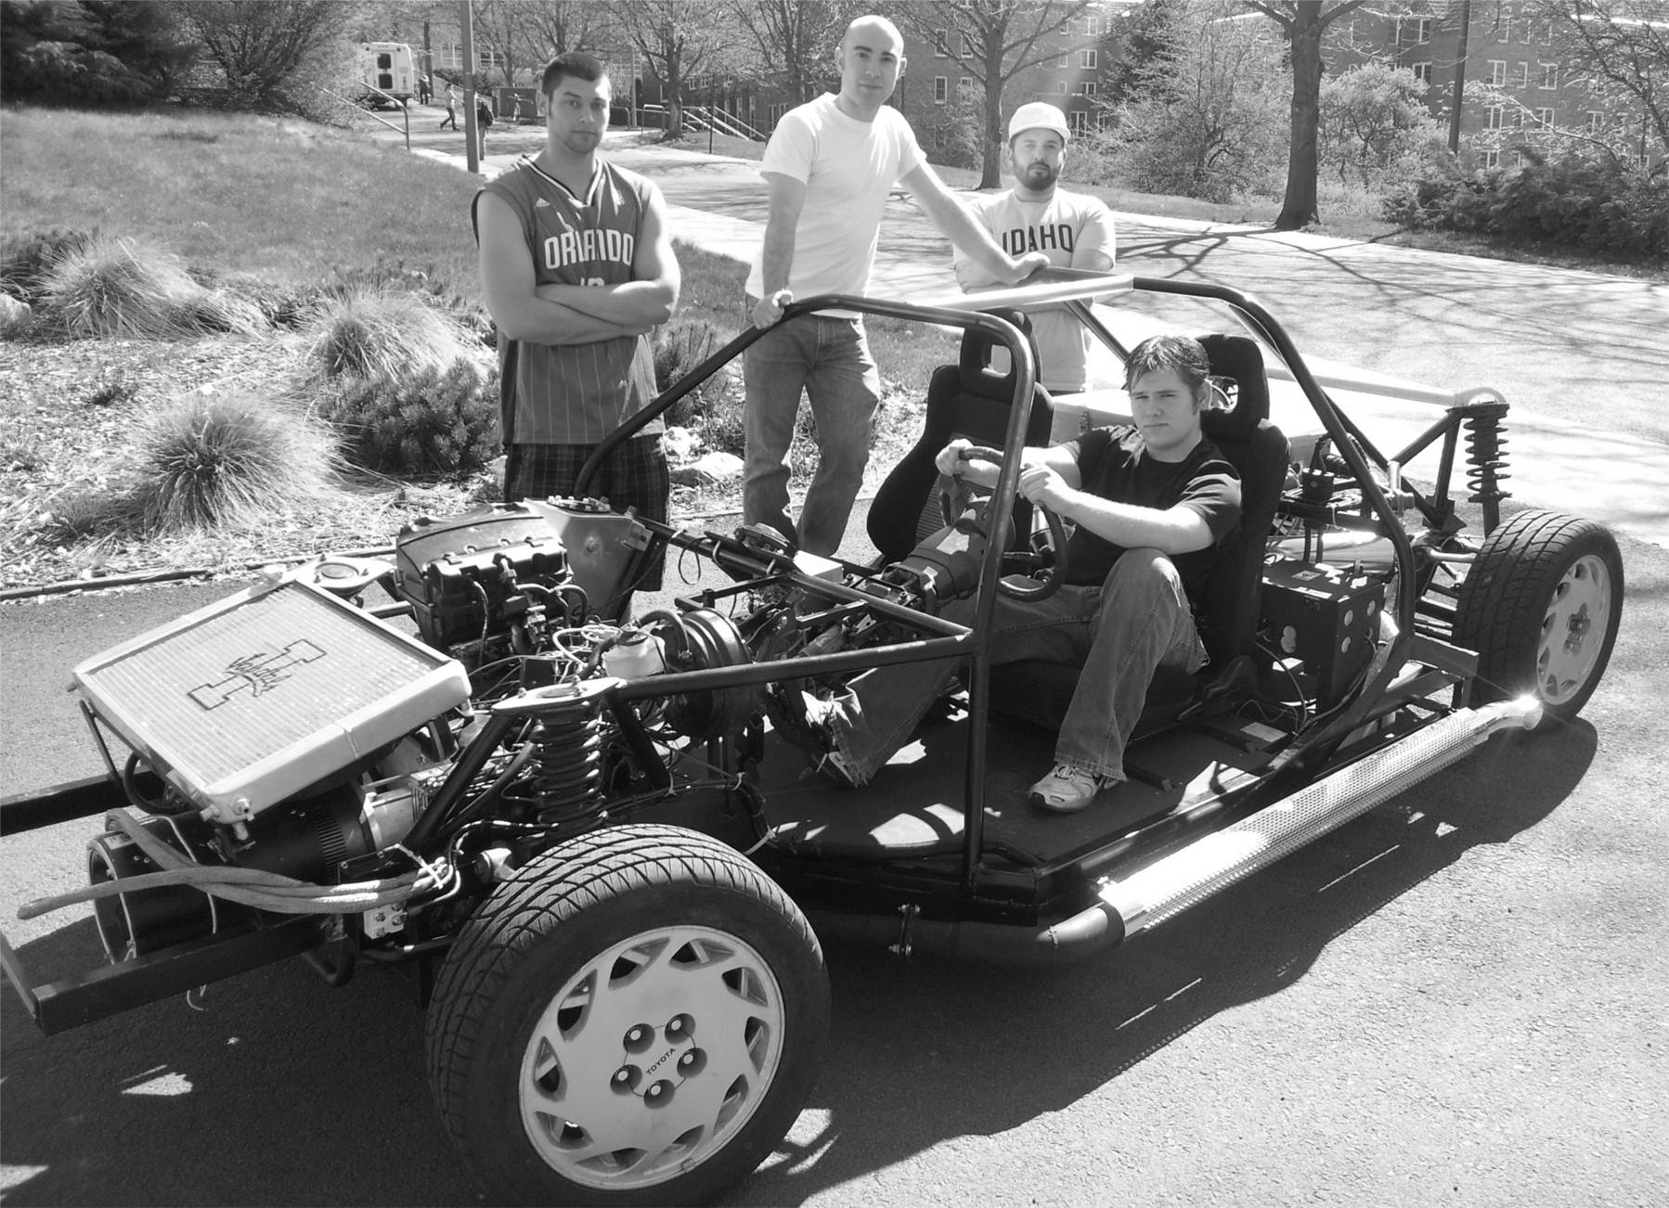
Objective
Use the generative shape design and freestyle workbench to design a concept body for the plug-in hybrid
Explore new tools in these workbenches and create a tutorial for future CATIA courses

Slide 3
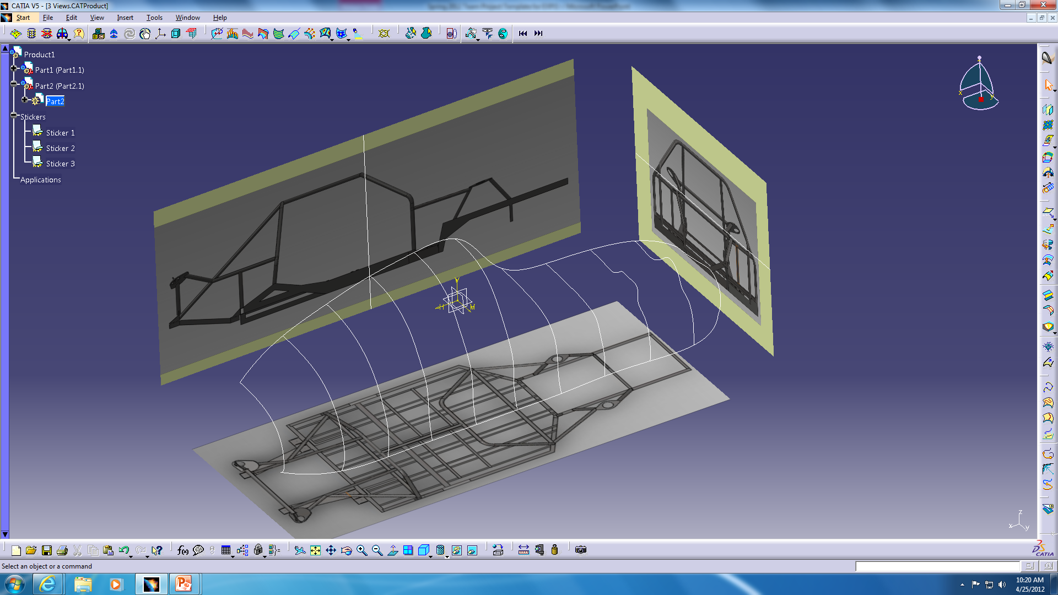
Step 1: 3D Sketches
Isometric views from the car frame were used to construct the outline
3D sketches were used to create the profile for the initial body shape

Slide 4
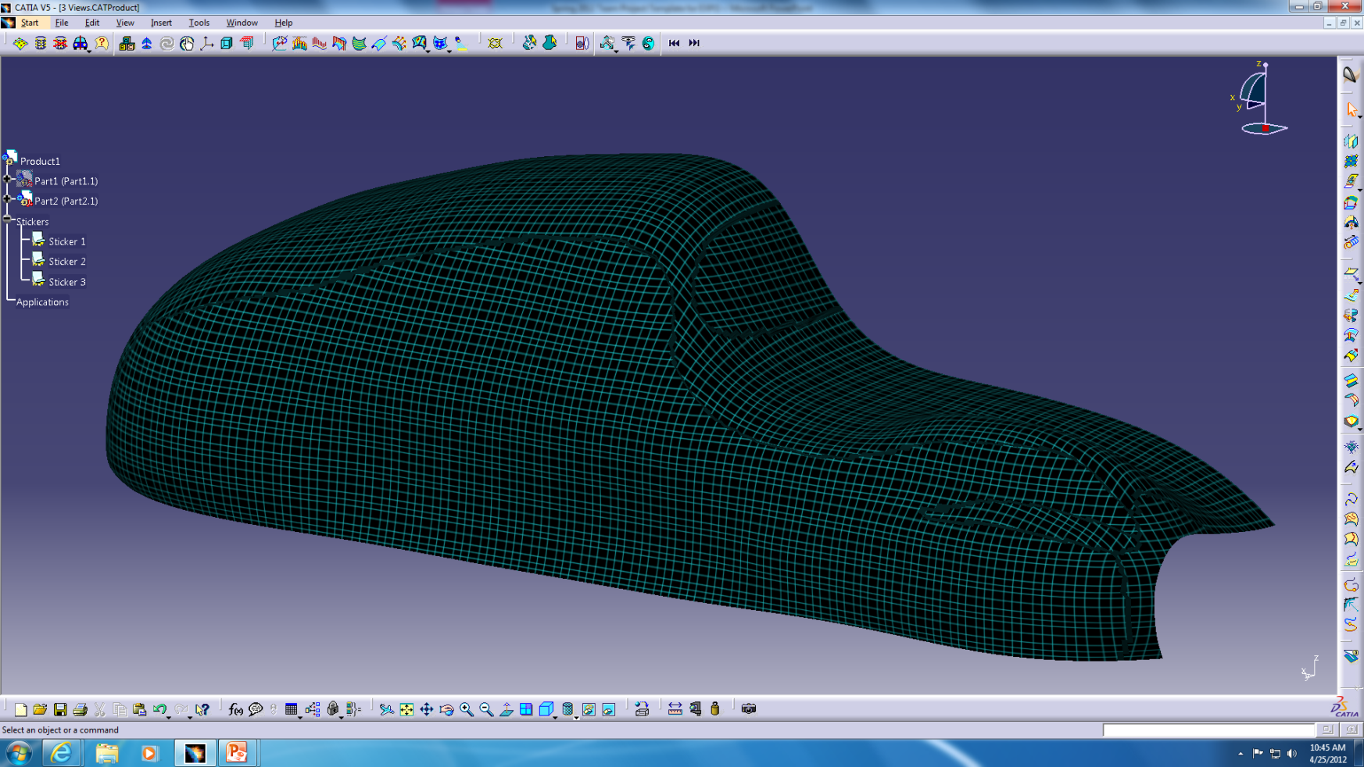
Step 2: Generate Surface
Use the multi selection solid tool to create a surface along the sketched guidelines

Slide 5
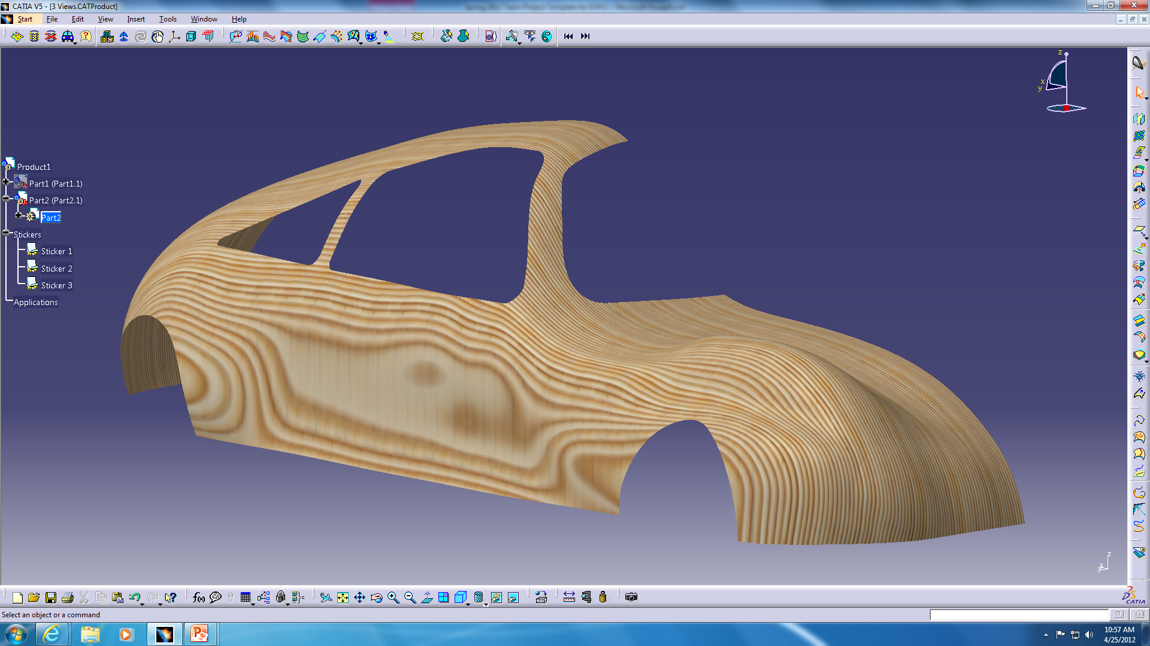
Step 3: Enhance Visual Features
Smooth contour by modifying sketches
Create windows and wheel wells by using trim and break surface commands

Slide 6
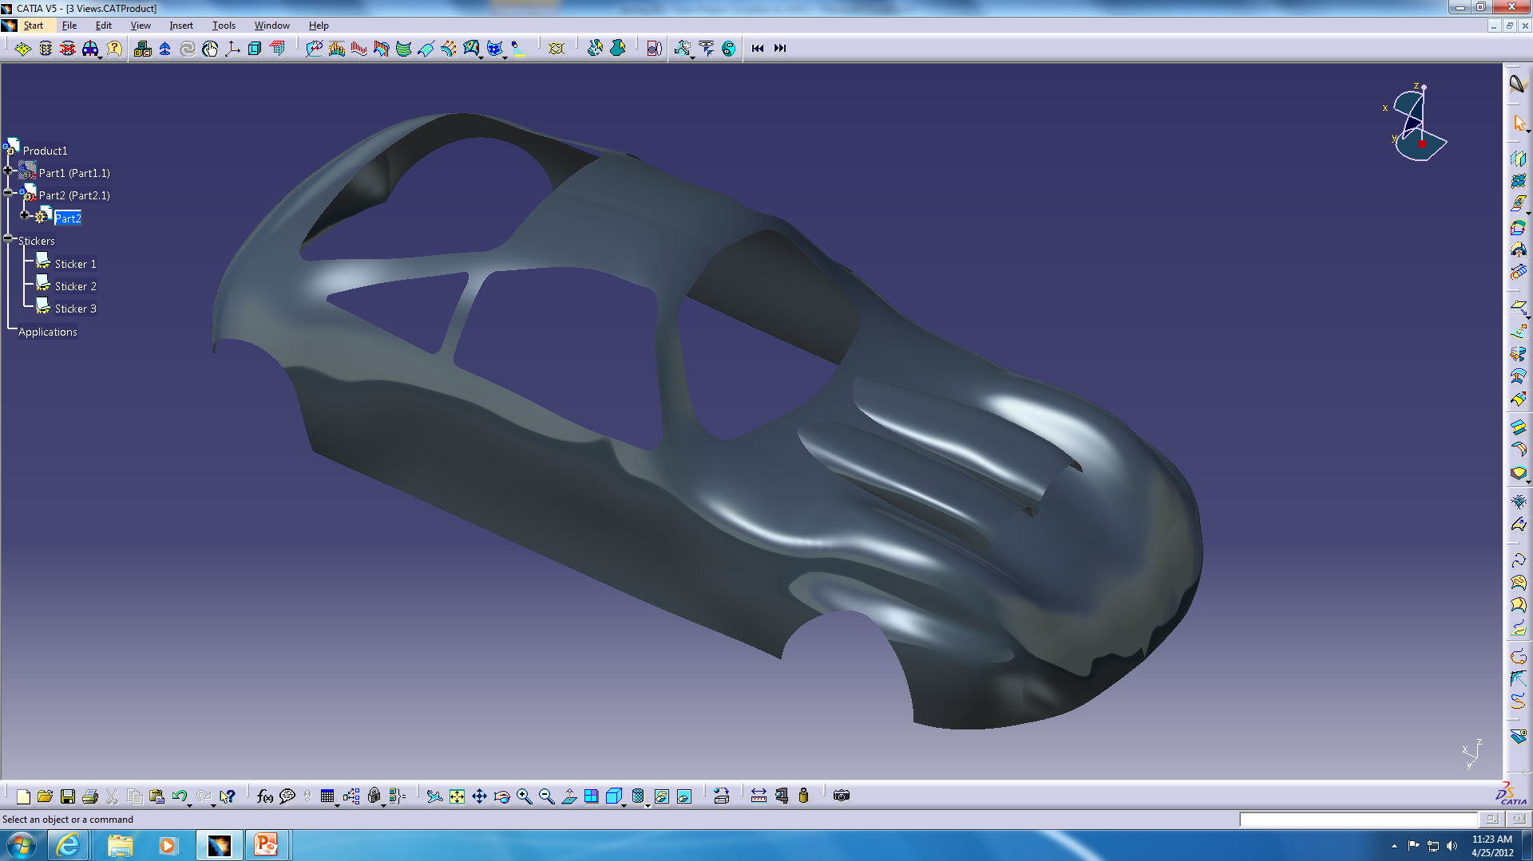
Final Product
Create the hood scoops and mirror the car body

