Slide 1
Built Pedagogy: Redesign for Large, Interactive Classes
Jeff Reznicek Scott Blee

Slide 2
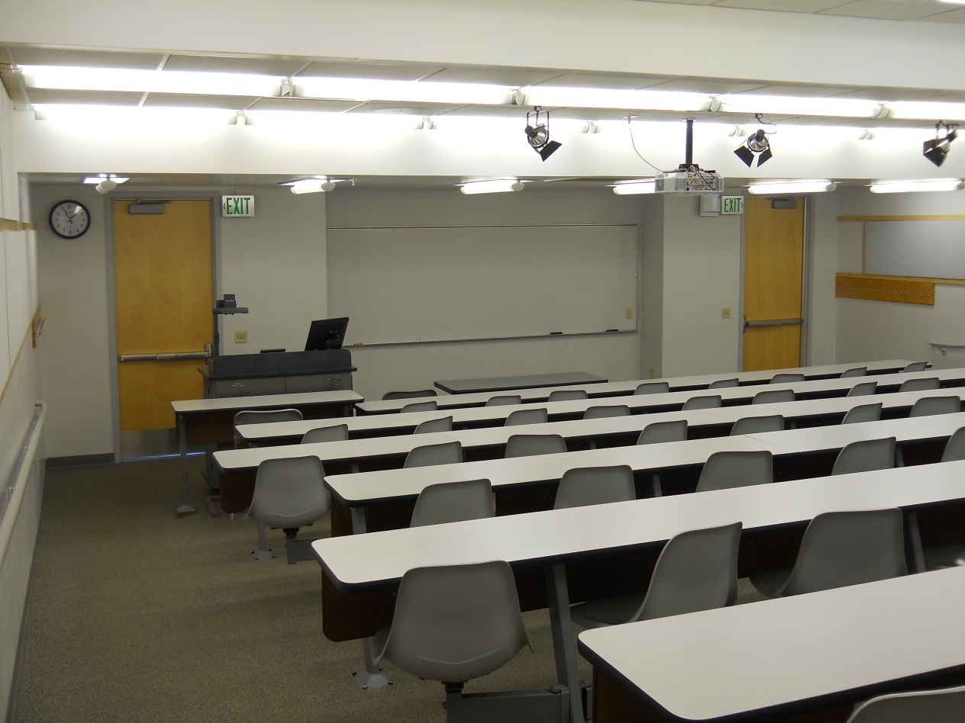
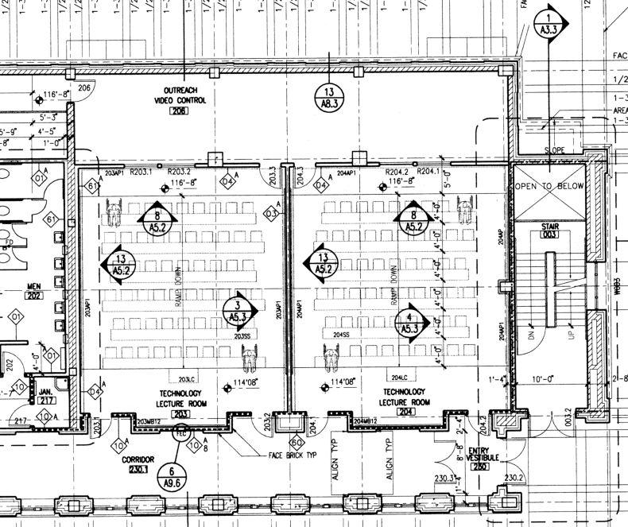
Present configuration
EP 214 and EP 216 (55 seats each)

Slide 3
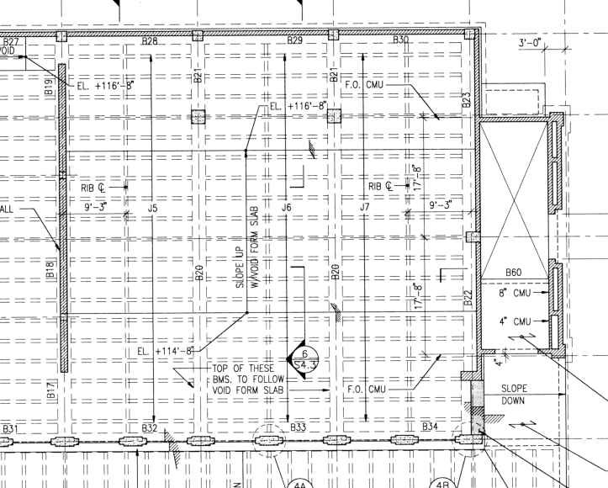
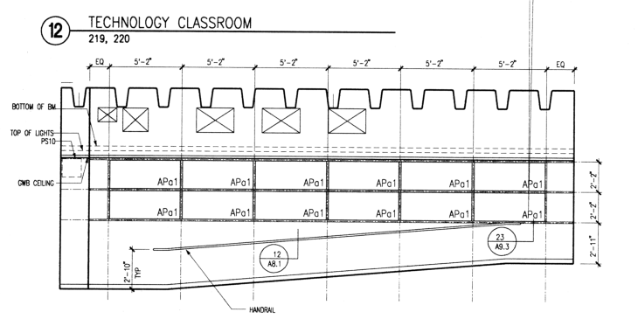
Structural constraints
Available space is about 60 feet square with two pillars near the back
The ceiling can be raised to allow for more head room

Slide 4
Traditional Aisles – 80 seats

Slide 5
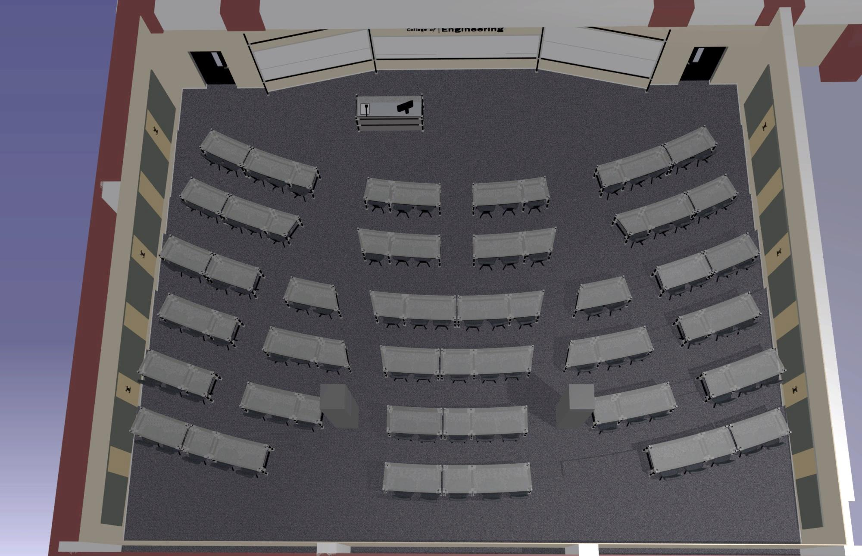
Interactive Groups – 99 seats

Slide 6
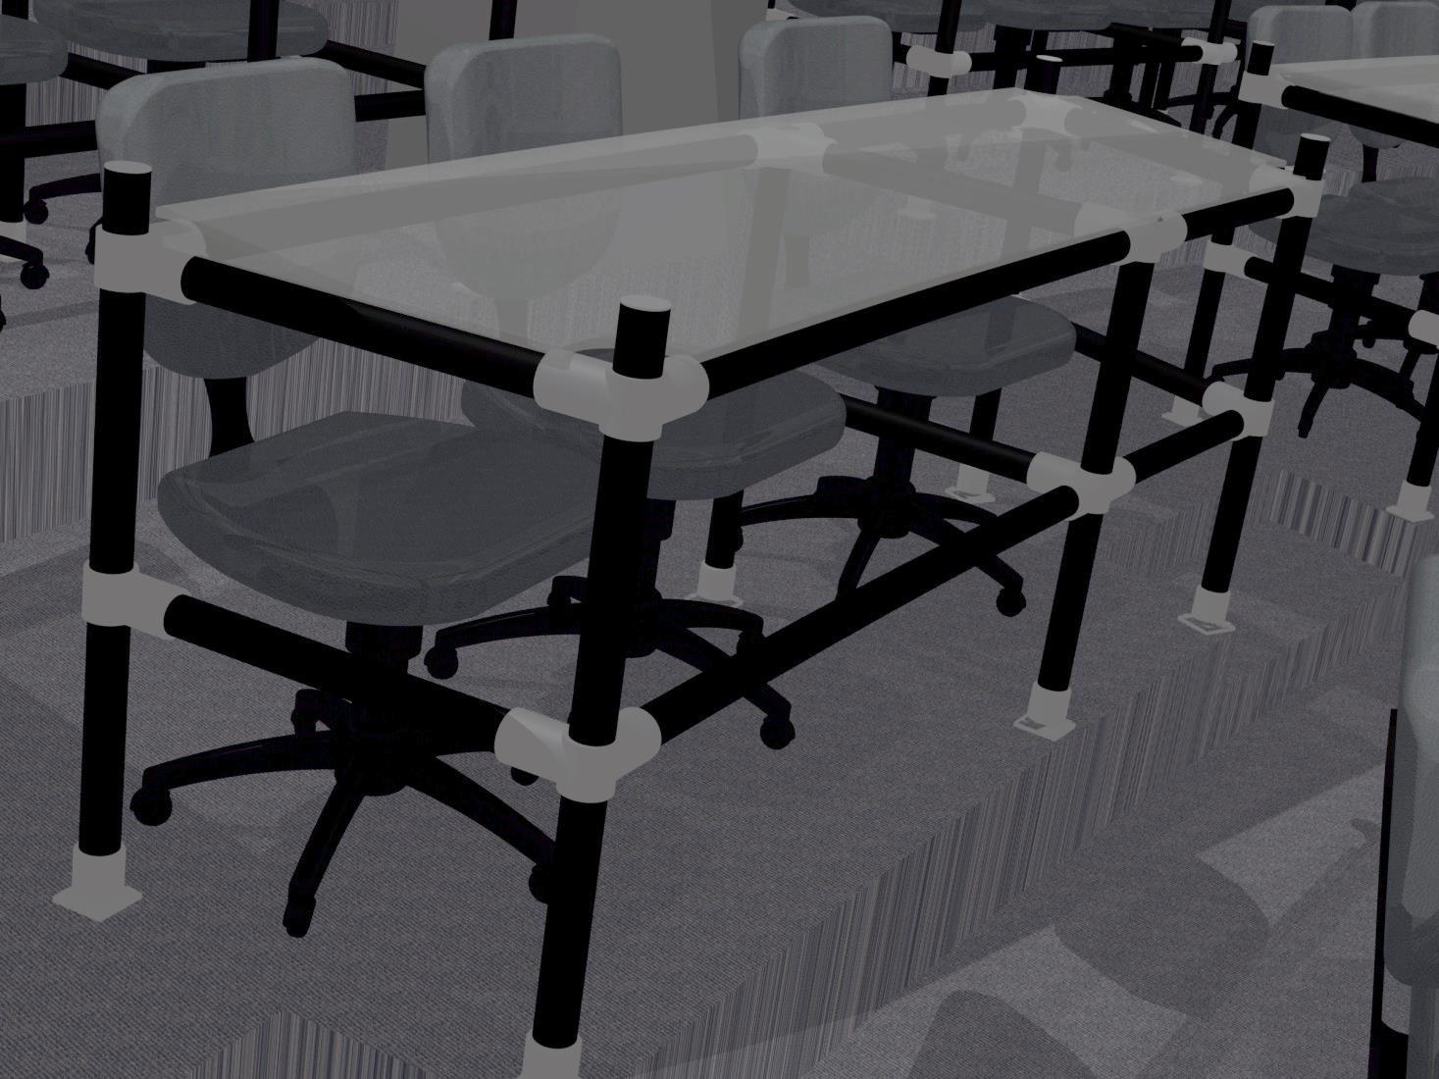
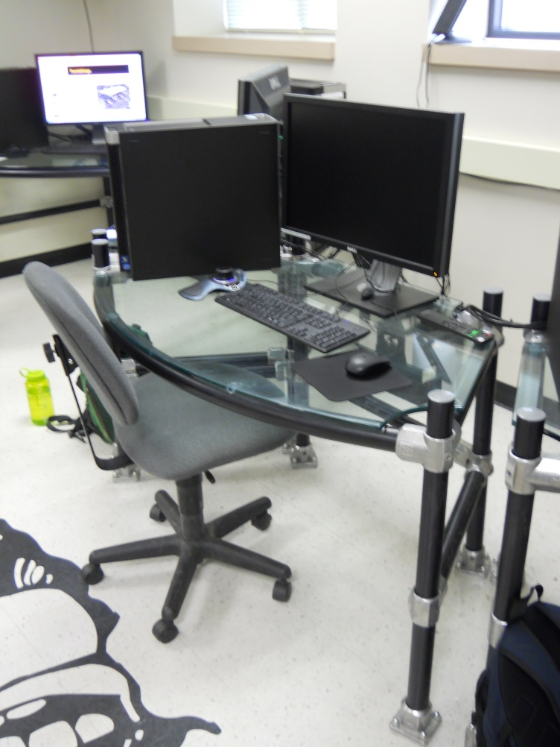
Custom Furnishings

Slide 7
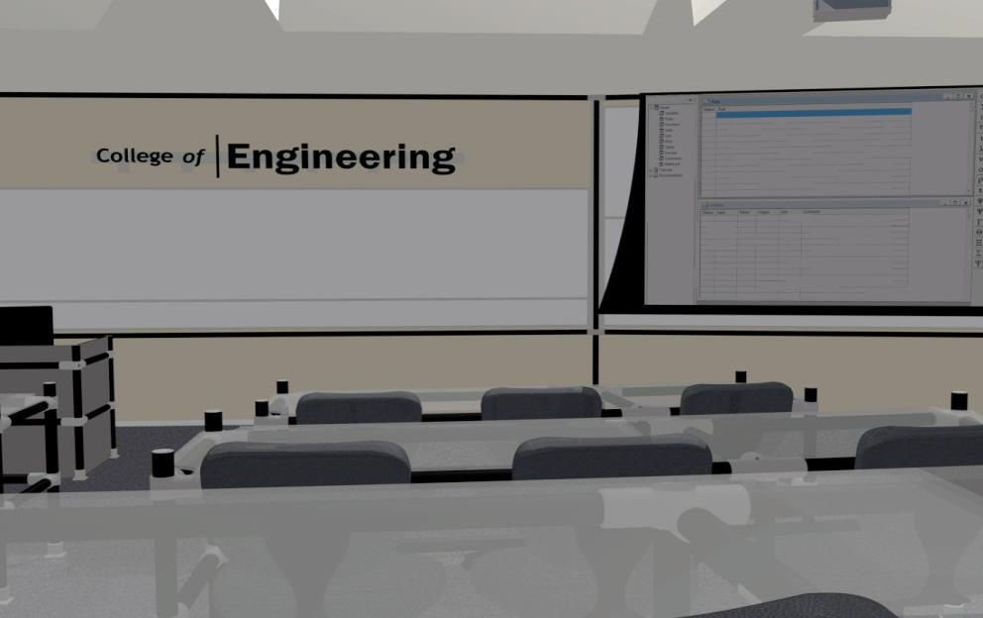
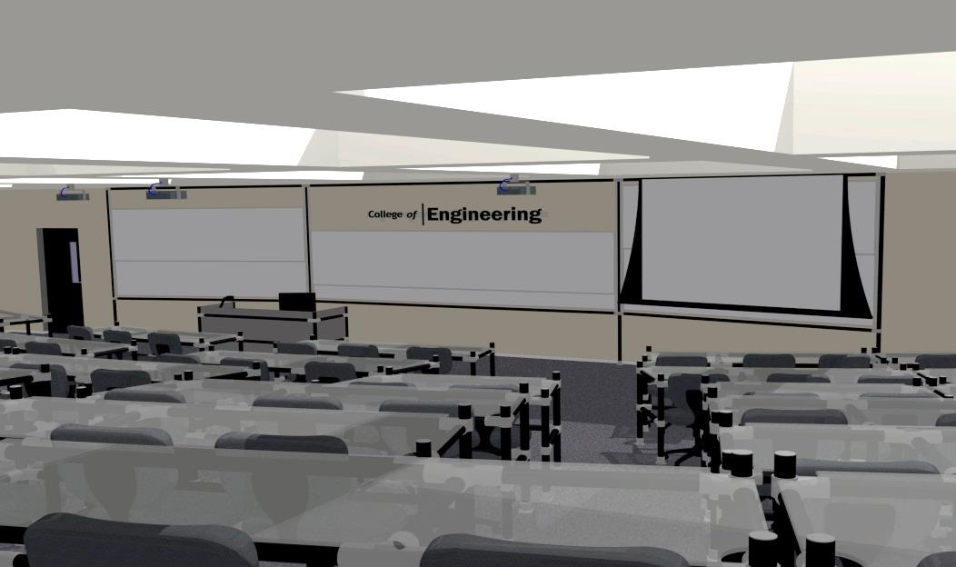
Student Views

Slide 8
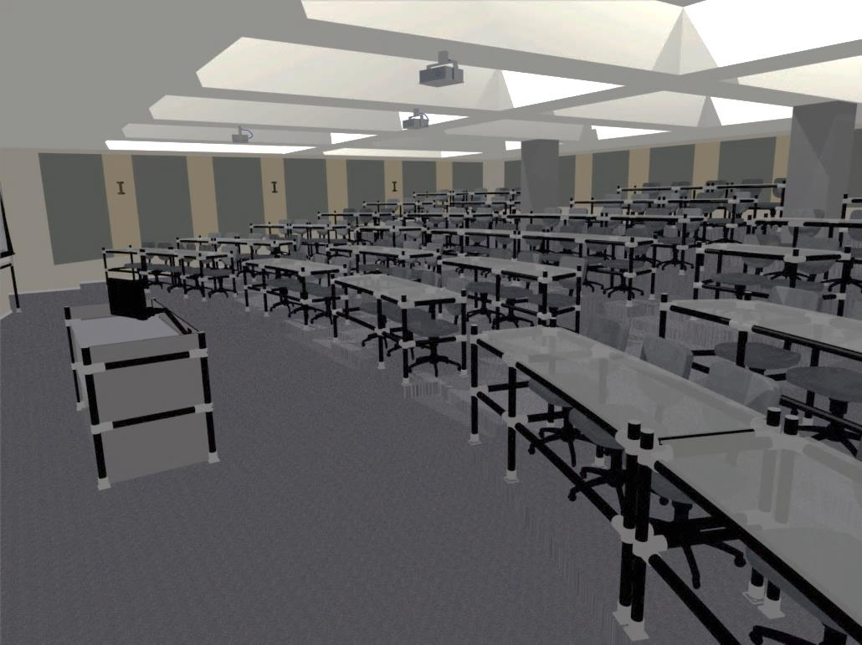
Insructor Views

Slide 9
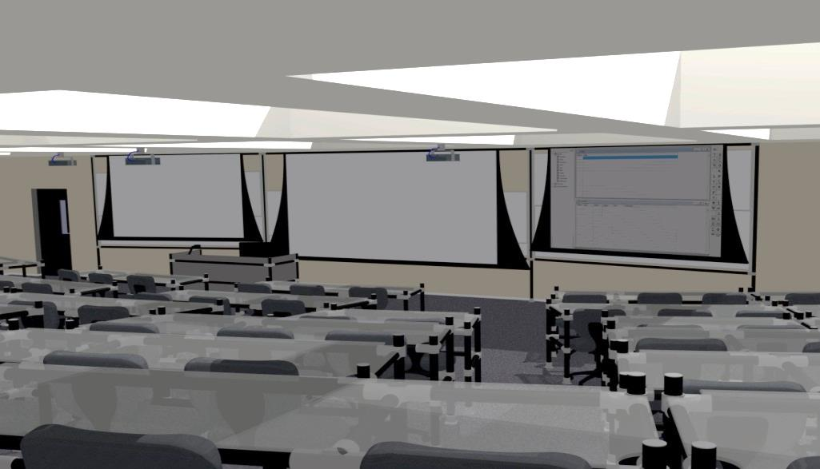
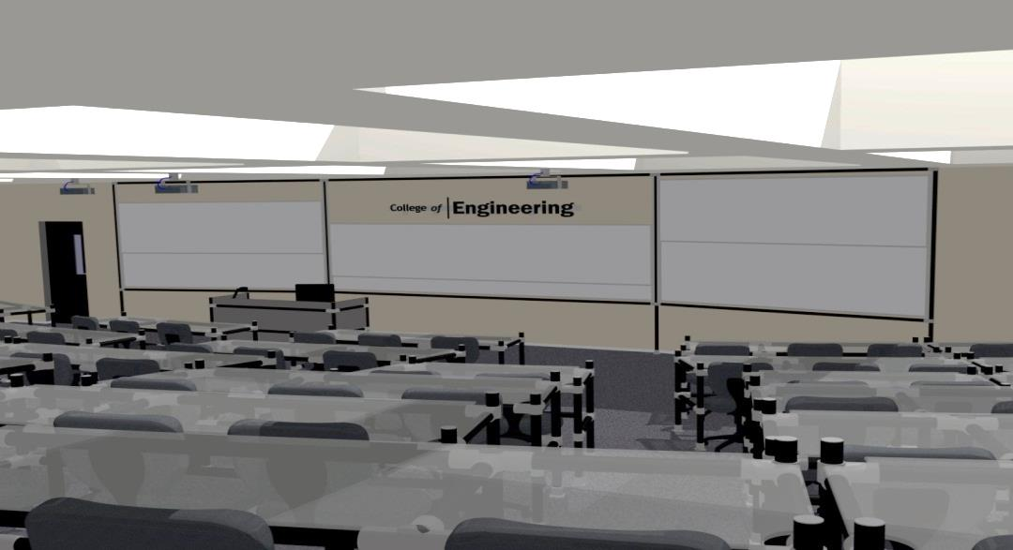
Instructional Technology

