Slide 1
Landscape Architecture with CATIA
Ali Dashti
Austin Chmelik
Derek Eaton

Slide 2
Objective
The objective of this project was to determine the feasibility of using CATIA for Landscape Architecture and Architectural Design. The application of this was the visualization of a repurposed space on campus. Ultimately, our goal was to redesign the space shown to be aesthetic and useable for the student body to enjoy.

Slide 3
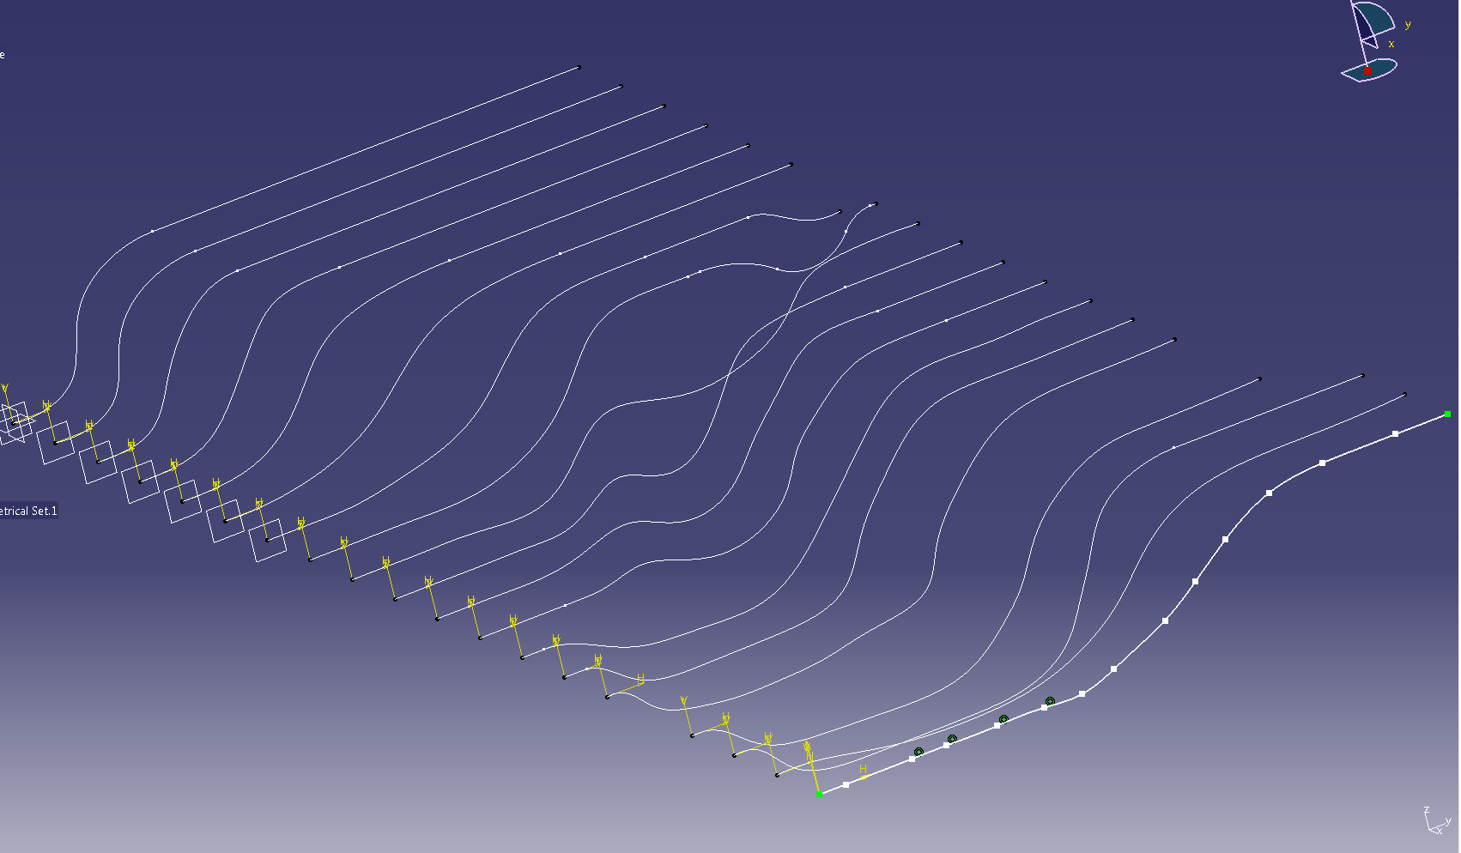
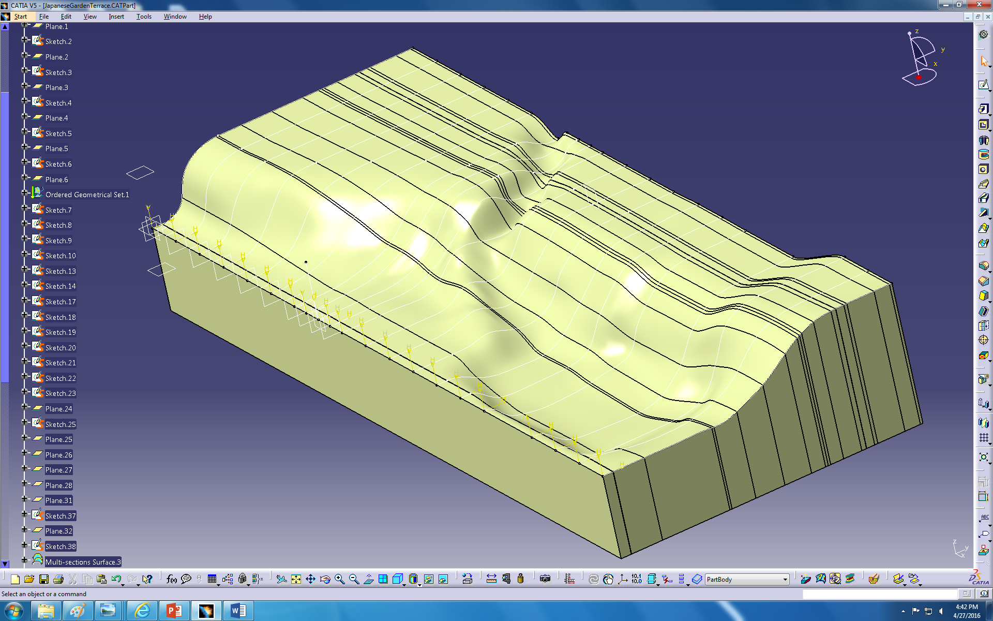
Is CATIA Suited for Landscape Design?
We quickly learned that CATIA can be rather difficult to use with respect to creating contoured landscapes. Much of our time was spent in the Generative Surface workbench splining together various surfaces and adjusting until they fit the desired shape.

Slide 4
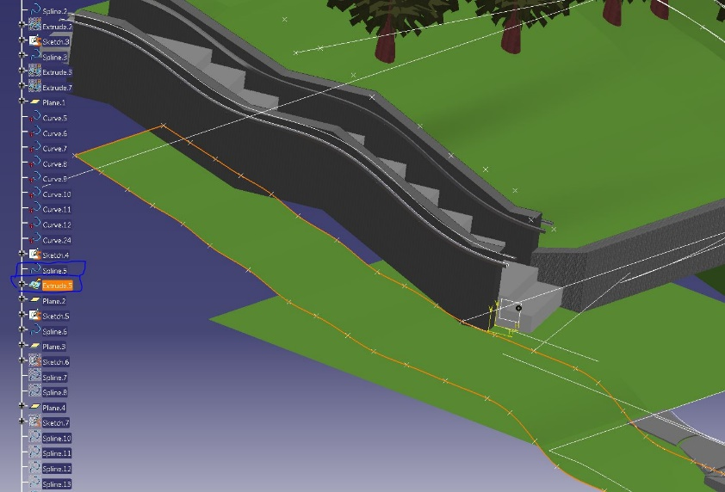
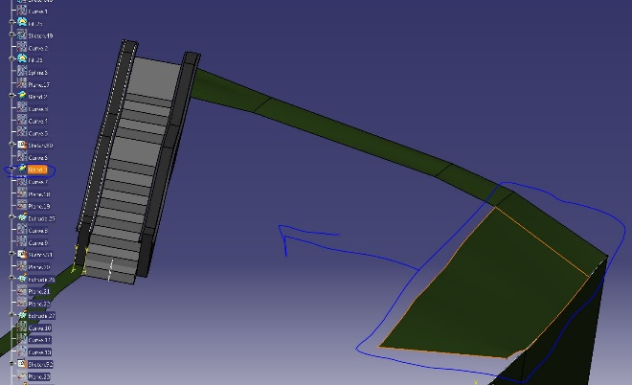
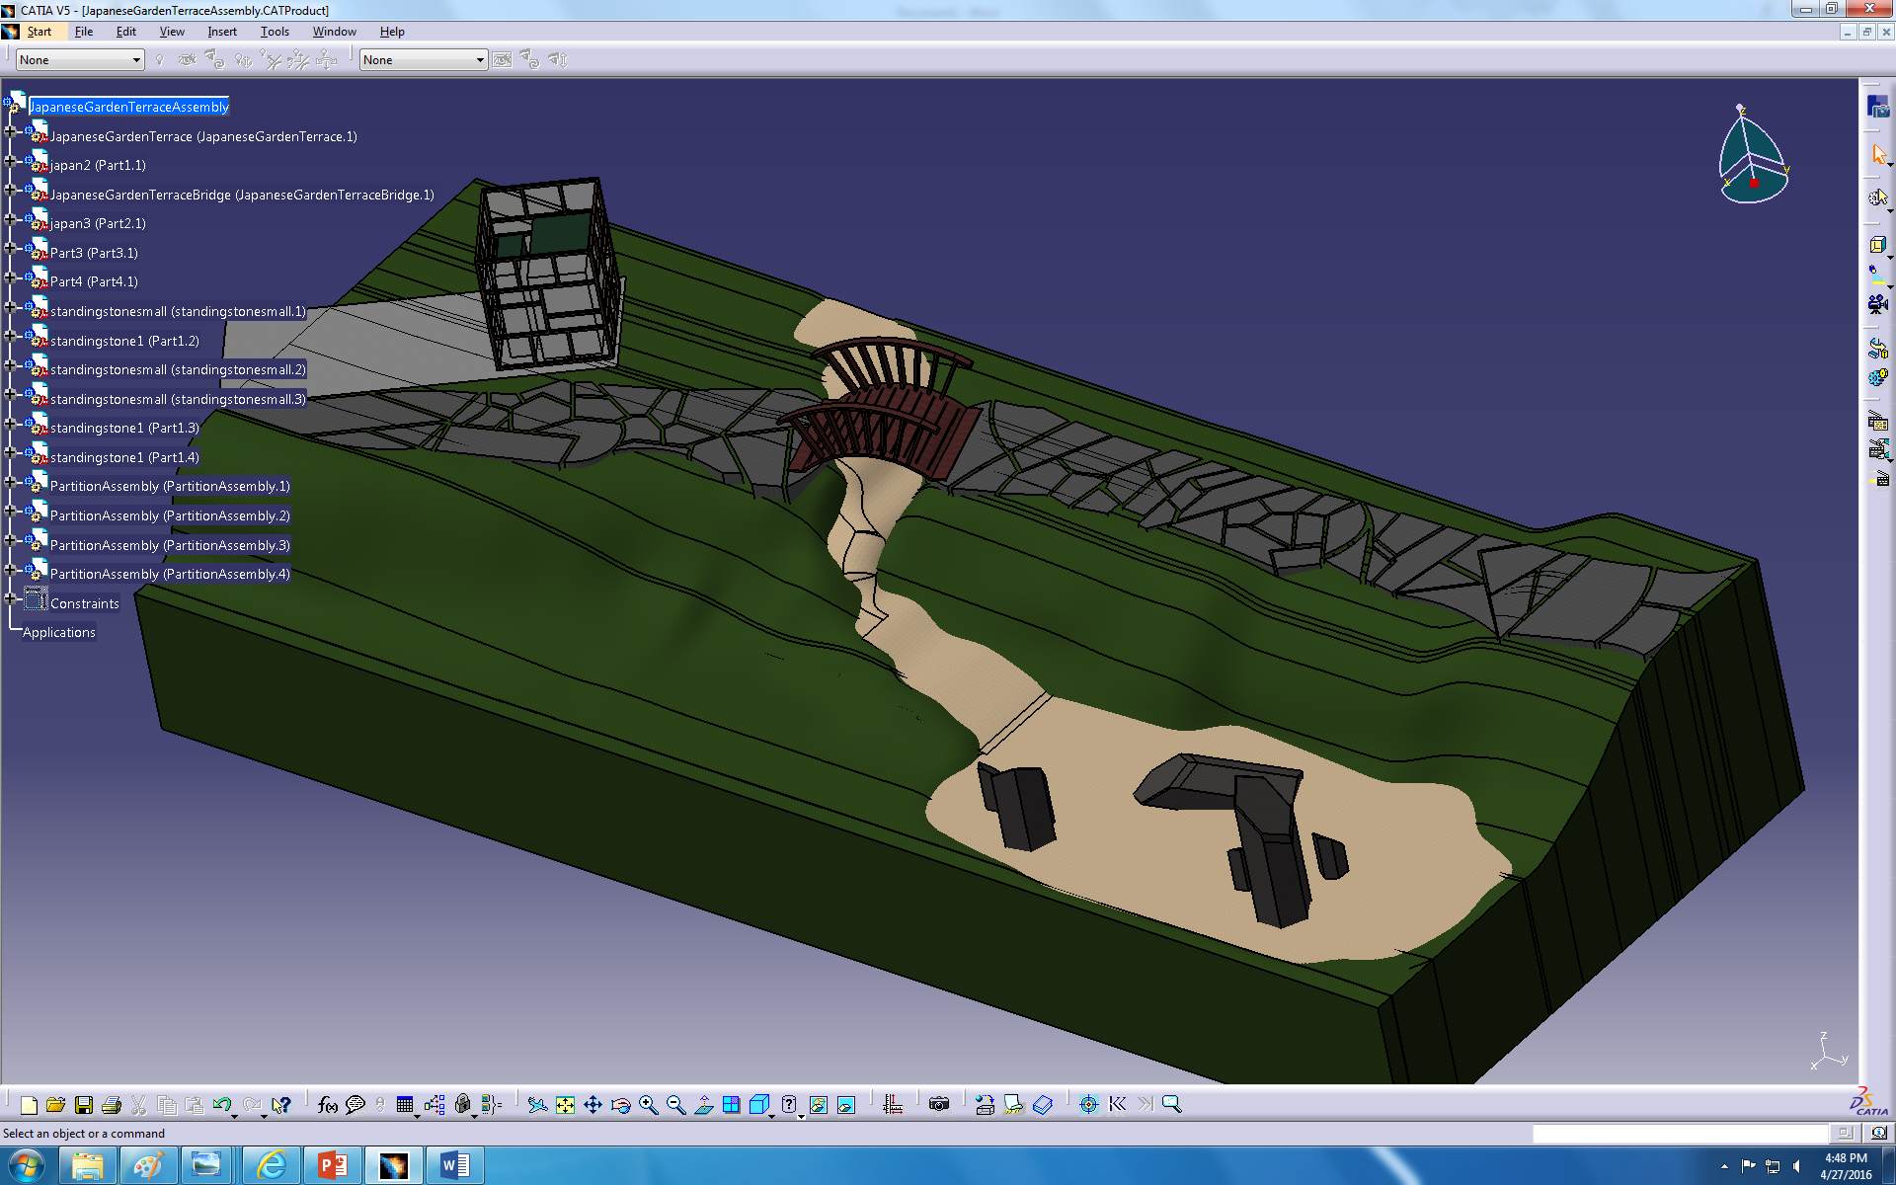
Difficulties with Surfaces
Another difficulty we ran into was with the created surfaces themselves. Blending surfaces together and connecting inserted parts and other surfaces took a lot of time to make look smooth and seamless.
Once the surfaces were figured out, bridges and retaining walls were made as well as creeks and stones. Many of the parts created had to be based on reference planes and eyeballing as it is impossible in CATIA to sketch on complex surfaces.

Slide 5
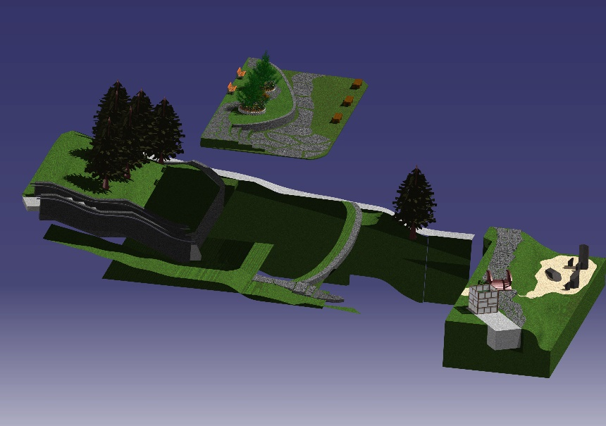
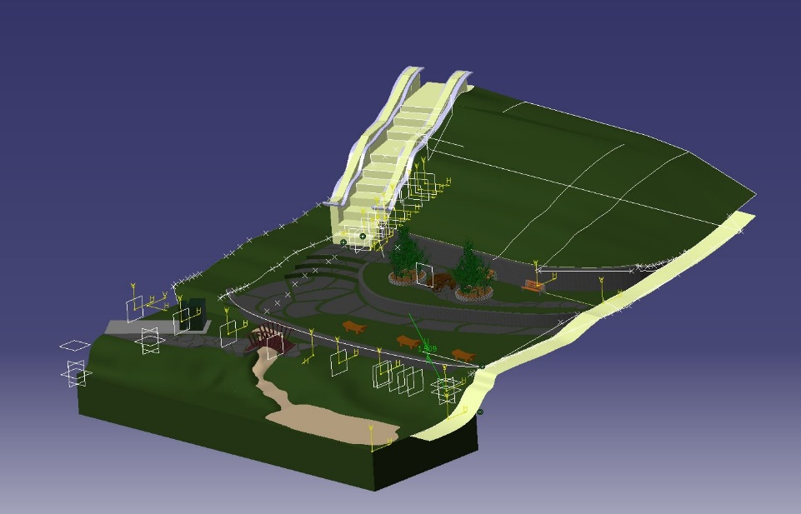
Collaboration
Each teammate took charge of a specific aspect of the design. Between designing one’s respective terrace or getting and altering a rough contour of the existing landscape, each person had a task to accomplish. When each individual task was complete, each terrace was added to an assembly with the altered landscape and oriented (and altered) in order to achieve the desired appearance.

Slide 6
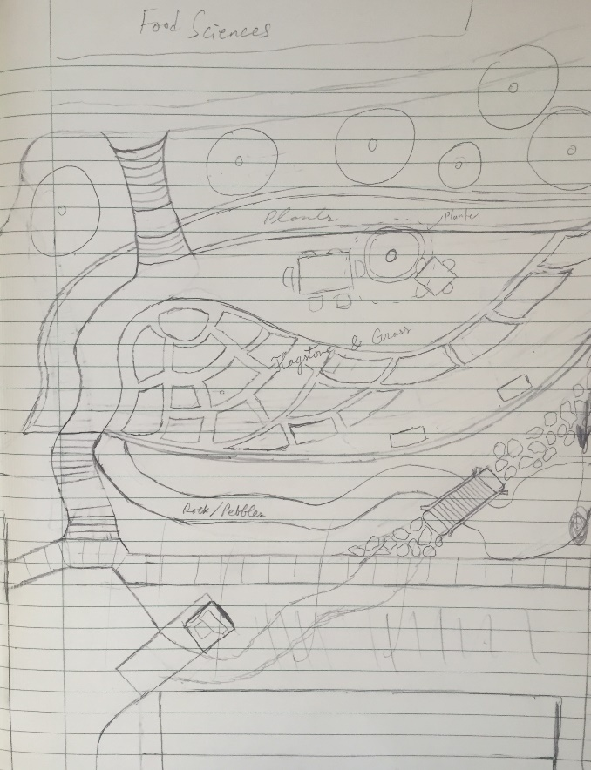
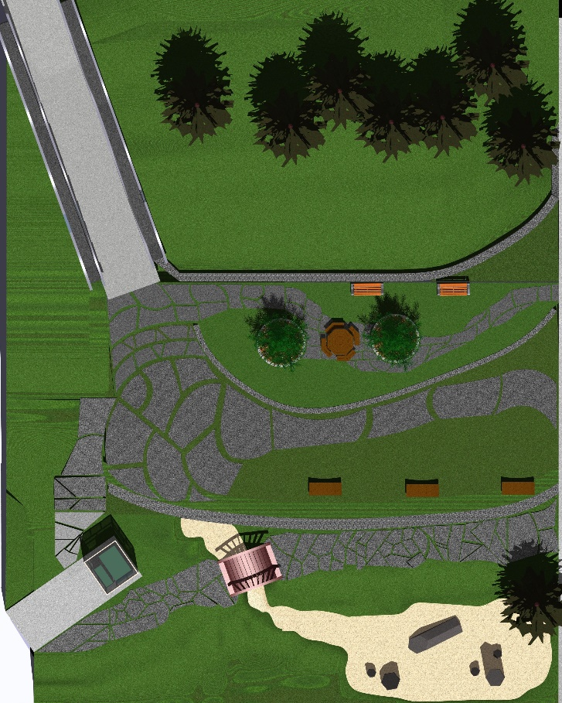
Sketch to Final Design
Our first step was to take a look at the space we were planning to redesign and decide on something that would fit well within the confines of the area as well as blend well with the architectural style of the university.
Although the spacing and overall look of the space did change slightly, the team was quite happy with the way the concepts held through and the look of the final product.

Slide 7
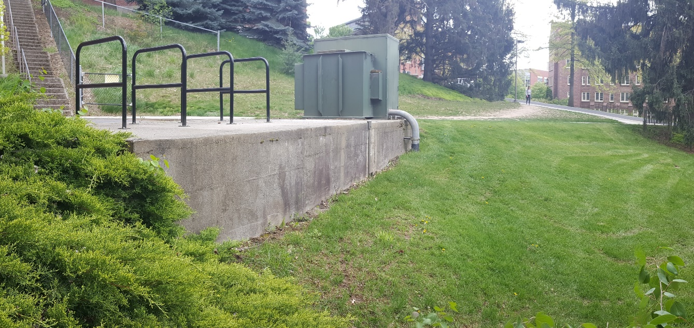
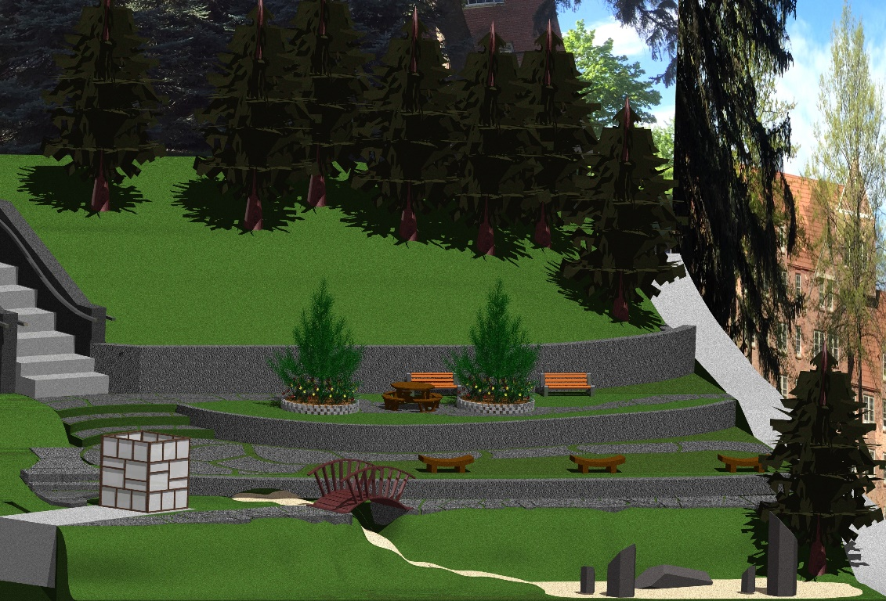
Existing vs Design
Our design combines the architectural style of Idaho with a little touch of Japan. The “creek” and “pond” flowing under the bridge is designed to be made up of fine stones with good drainage so that the university would not need to deal with pumps and water costs. It would also provide a natural channel for runoff to travel for appropriate water management in the space.

Slide 8
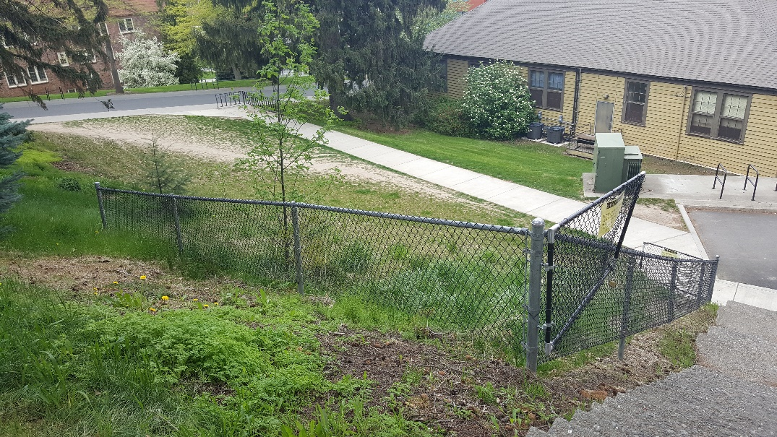
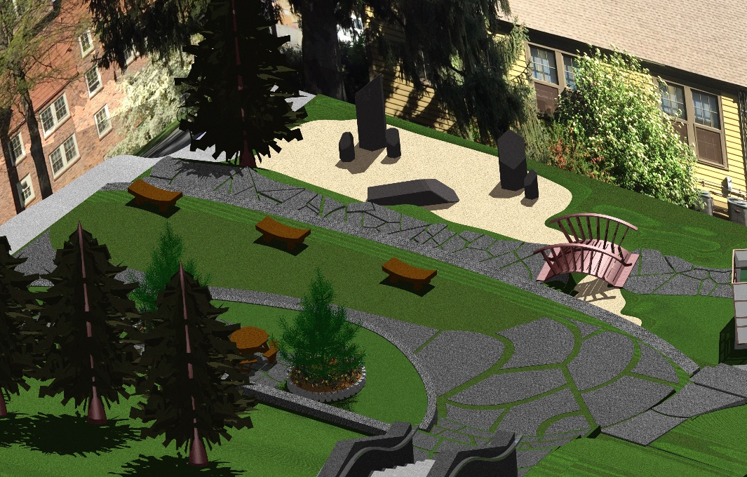
Existing vs Design
Our design alters the landscape a bit into terraces for a few different reasons. First, terraces allow for flat parcels of useable space. The lower terrace contains a path and Japanese garden style bridge over a rock garden and stream. The upper terraces offer tables, patio areas, and places to sit and take a load off from the stress of classes and Engineering projects. This side of campus is woefully lacking in spots to just get away from things, and our goal was to provide for that peaceful setting.

Slide 9
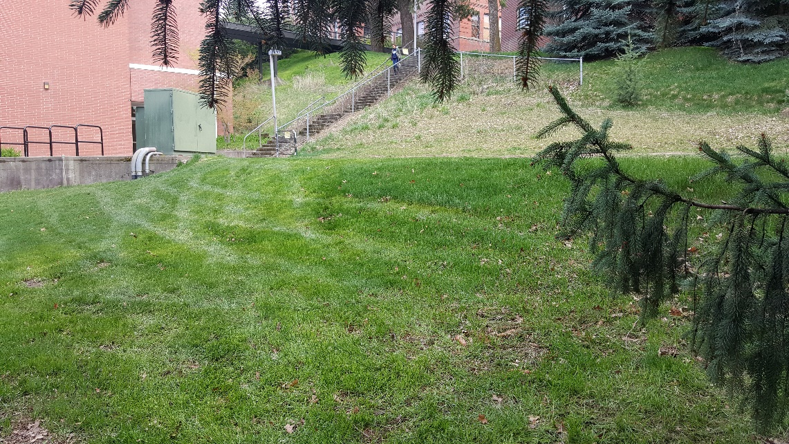
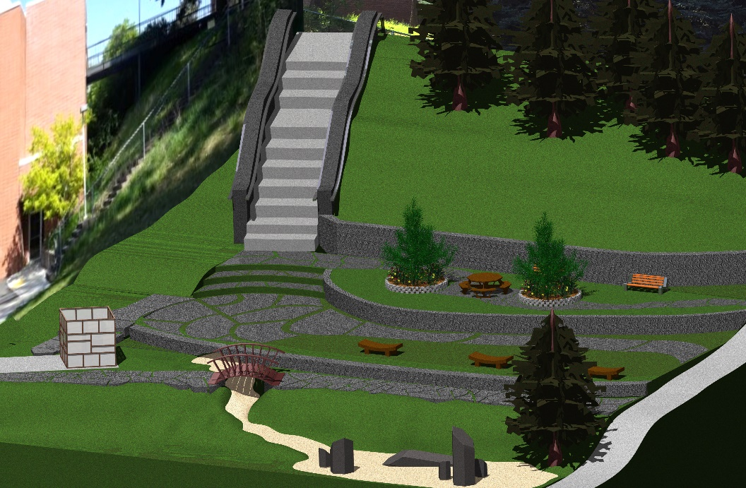
Existing vs Design
It was decided that, save a few of the smaller trees, most of the existing trees would remain in their current position and the pine trees included within the design were meant to show this.

