Slide 1
Lego Mindstorm EV3
Nathan Wagner
Kyle Peterson
Parker Hill

Slide 2
Objective:
Goals:
  Develop a 3-D Model to replicate the Track3r configuration of the Lego Mindstorm robot.
  Create an animation to replicate the actions of the actual Mindstorm robot.
  Establish a dimensioning scheme that can be followed for future Lego modeling projects.
We were provided with a Lego Mindstorm EV3 robot set with building instructions and tasked with re-creating the model in Catia V5. We were helped some by past project groups who had modeled some of the parts in previous projects.

Slide 3
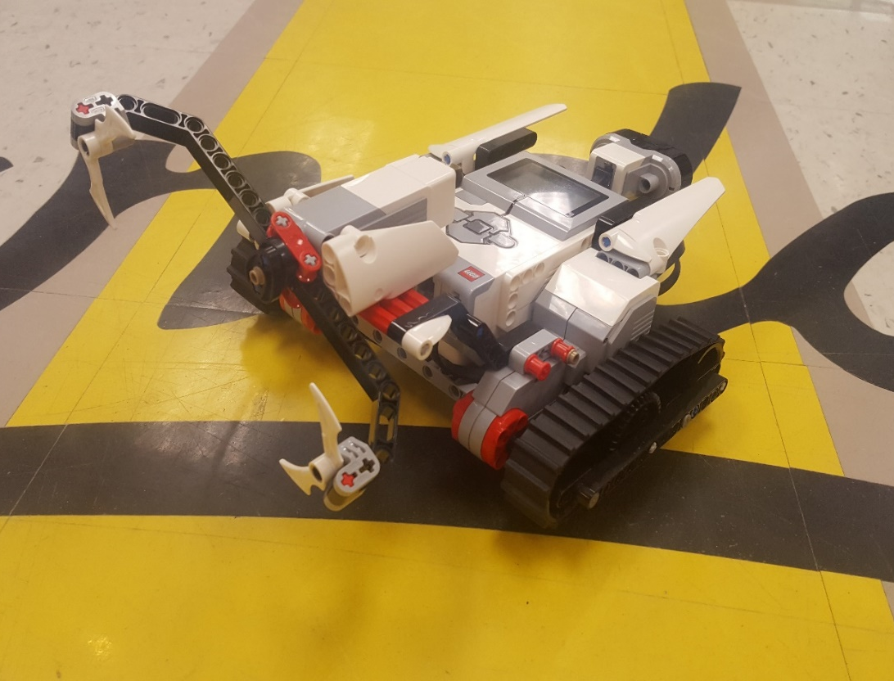
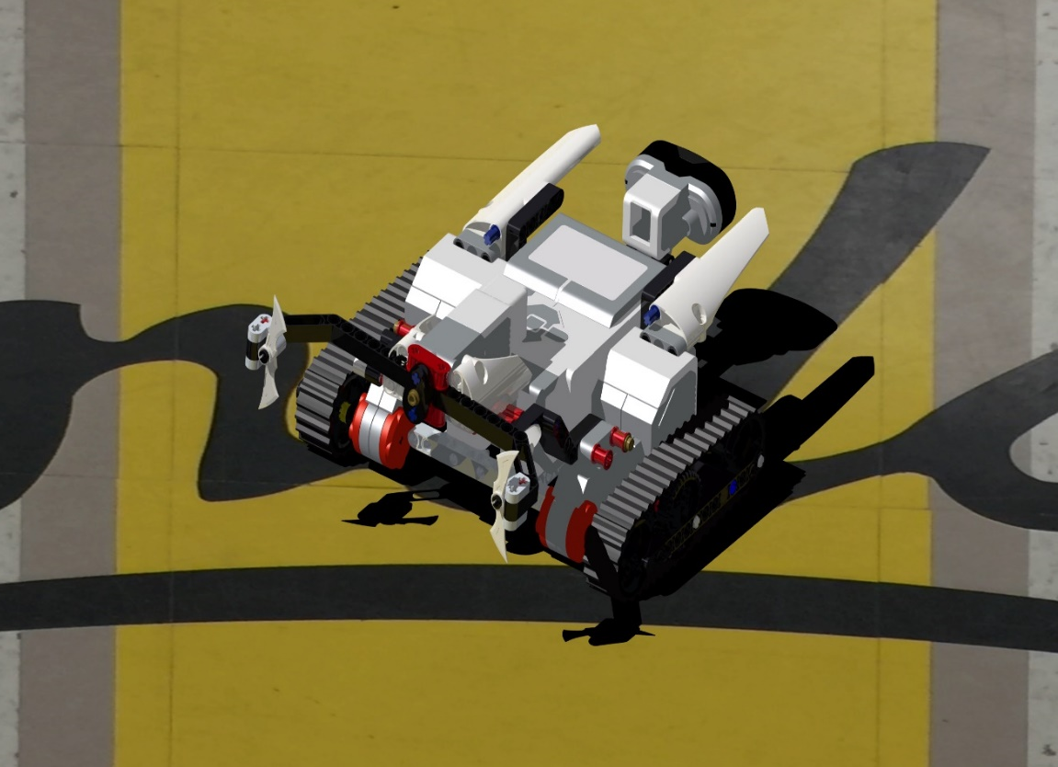
Side-By-Side Images
Constructed Mindstorm Robot
Catia Assembly Render

Slide 4
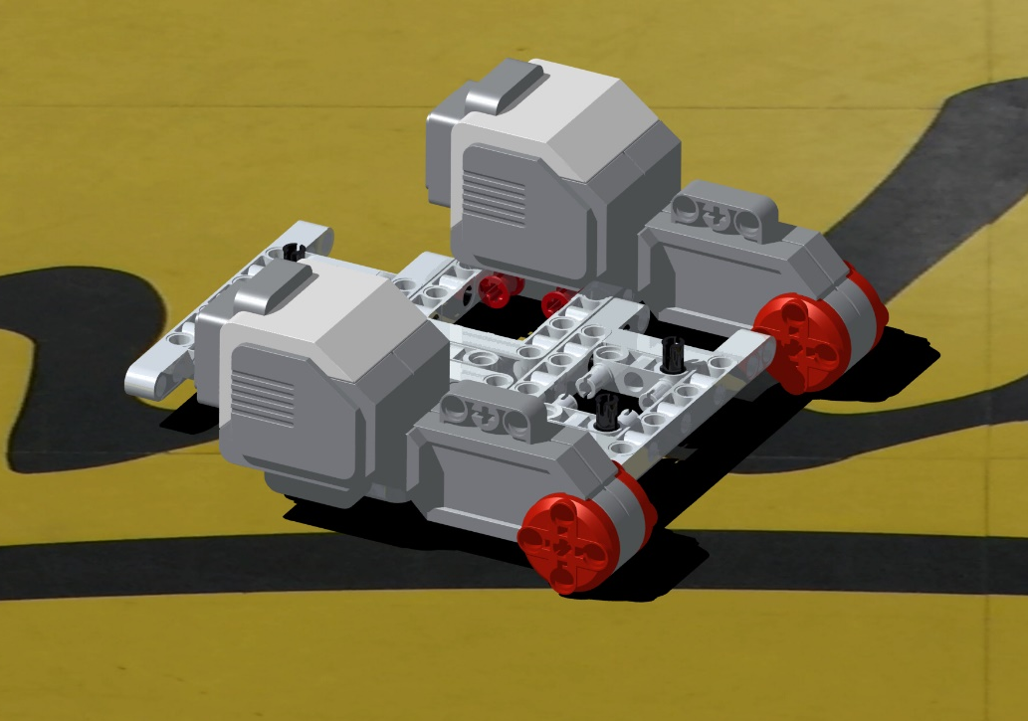
Frame Assembly Render

Slide 5
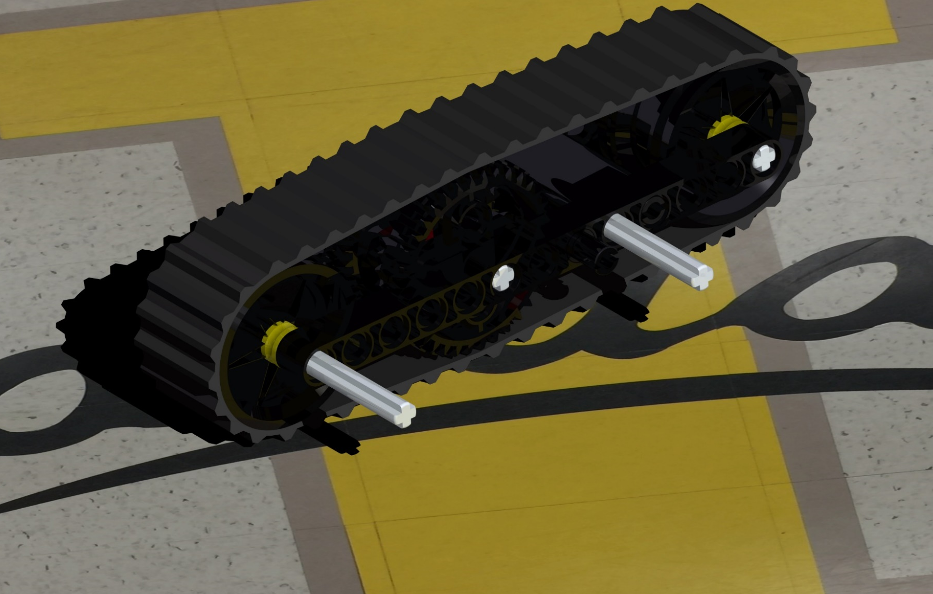
Track Assembly Render

Slide 6
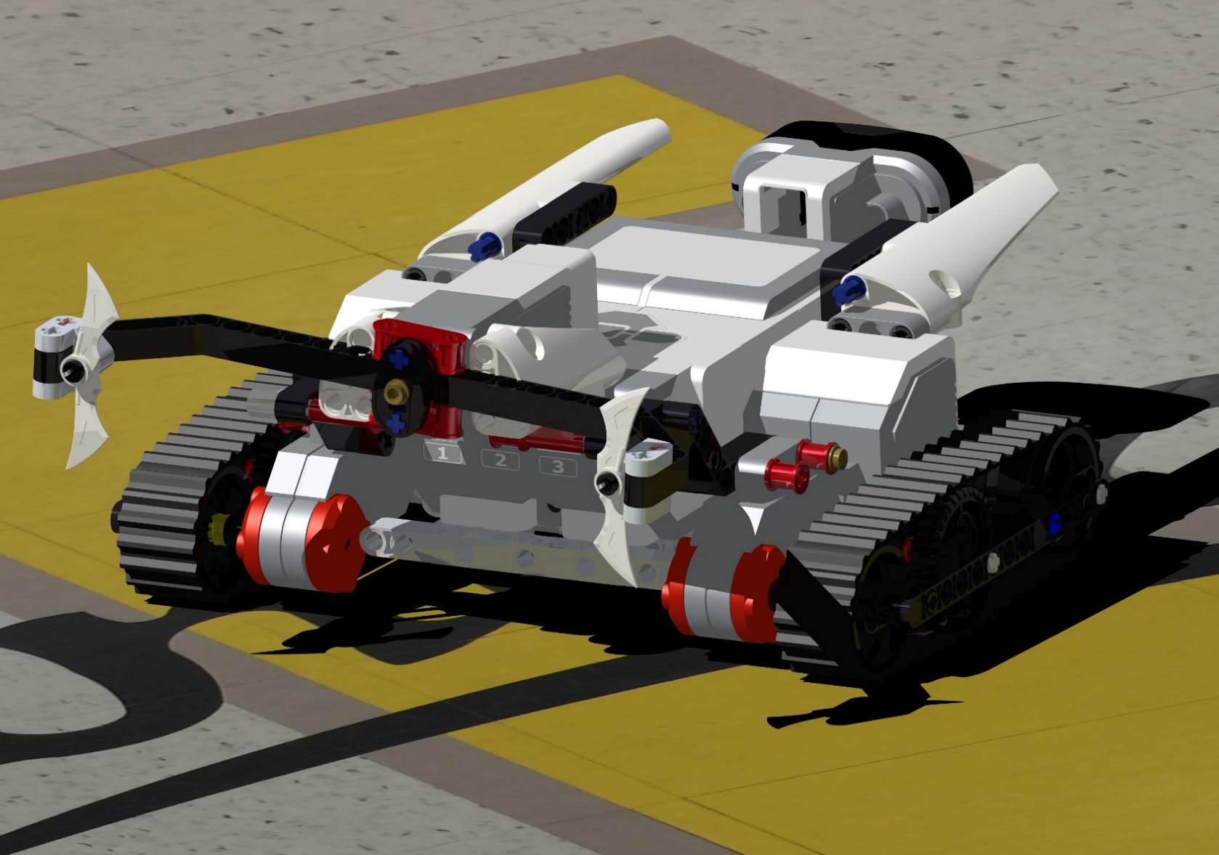
Full Assembly Render

Slide 7
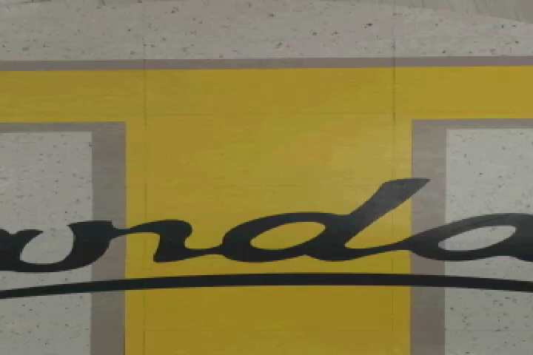
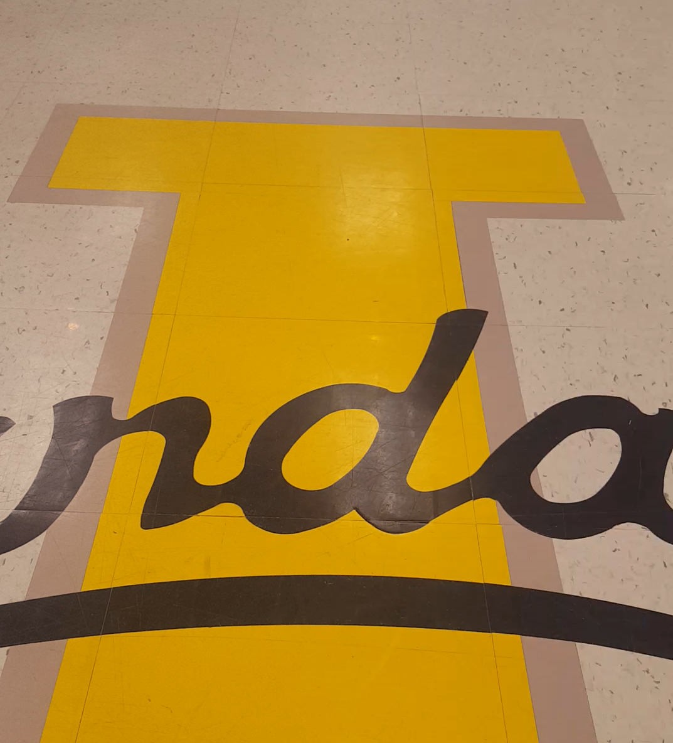
Side-By-Side Animations
Video of Programmed robot Animation created in Catia

