Slide 1
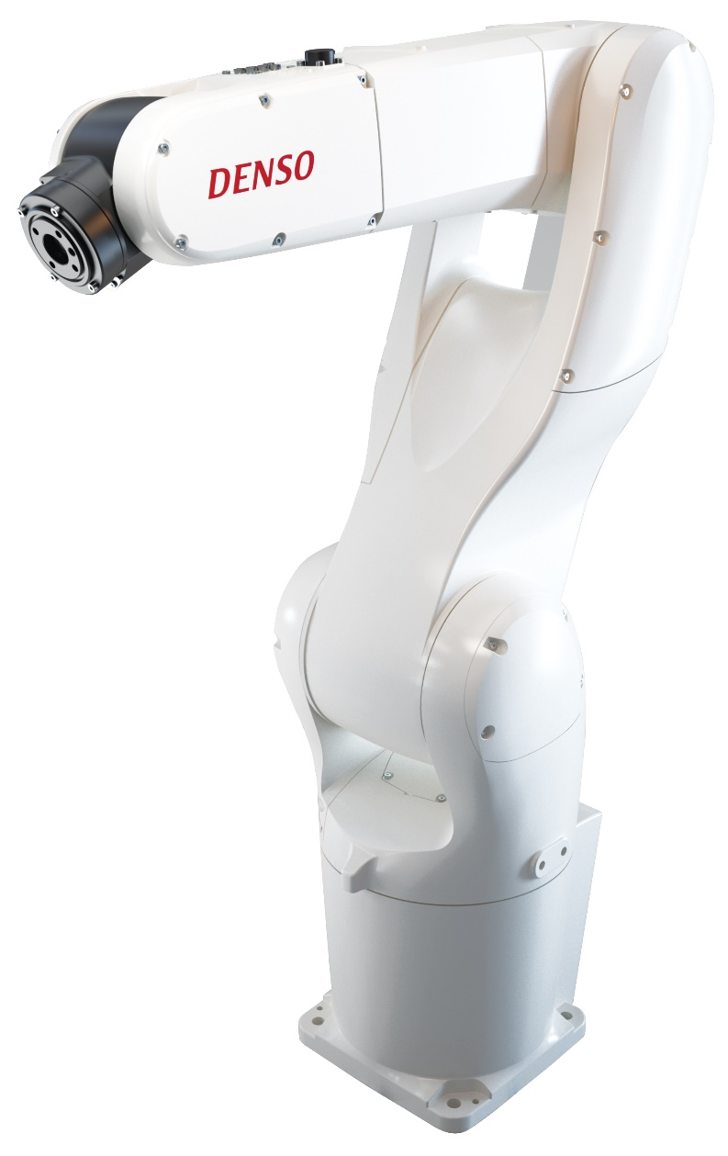
DENSO Robot Simulation with WinCAP lll Software
CATIA Final Project
Reb Revels & Smirthya Somaskantha Iyer

Slide 2
What is WinCap lll Software?
DENSO has its own software, WinCap lll, which will allow the user to simulate or program the action of the robot.
DENSO's WINCAPS III offline programming software enables users to conveniently program a robot from a remote PC without operating the robot

Slide 3
Project Description
Creating a simulation with the WinCap lll software.
The DENSO robot will perform a cup stacking process.
Import external CAD models to the simulation.

Slide 4
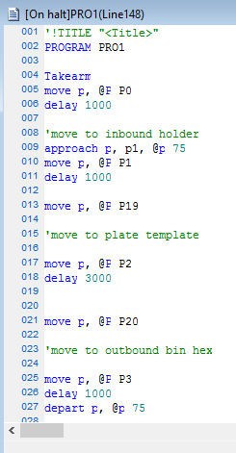
Programming
The code is pretty simple
All commands have to relate to a move of the machine.
the approach and depart command give the arm a specific way to move.
You can define speed and delay time for certain actions

Slide 5
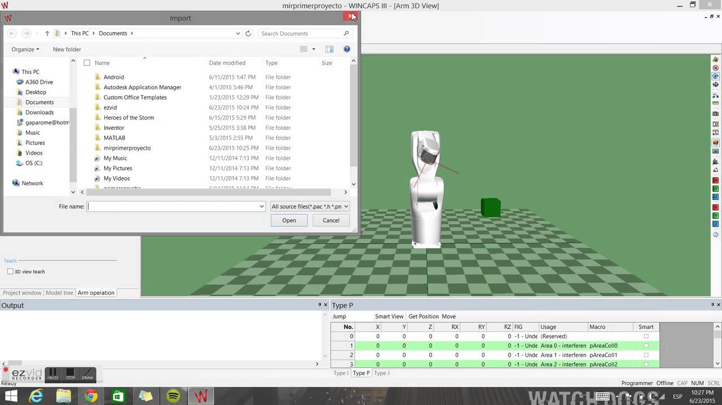
User interface

Slide 6
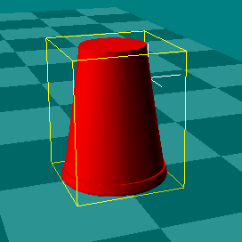
CAD Designed Cup
We learned to import 3D cad designs using solidworks.
This not only gave us the ability to be more accurate with our simulation but also saved time from constructing fixtures in the program with built in shapes.

Slide 7
Lesson Learned
CAD drawings can be imported in standard VRML and DirectX formats, and variables can be easily entered or changed. A 3-D simulation feature allows layout of automation workcells in a virtual environment. Users can verify reach, determine obstacle clearances, detect collisions, troubleshoot and debug programs, and determine cycle time.
We leant how to program the robot to do what we want it to do. The programming language is unique but it is very basic and direct.

