Slide 1
Capstone Documentation
Logbooks and Portfolios

Slide 2
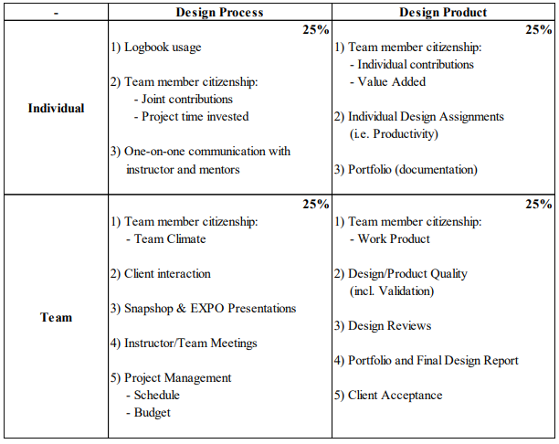
Grading Matrix
ONE DRIVE e-portfolio

Slide 3
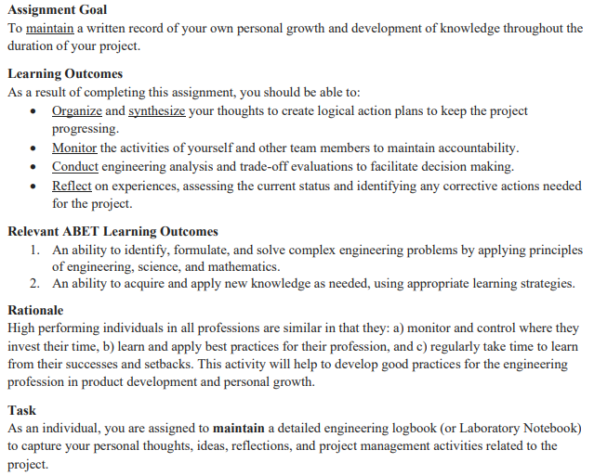
Logbooks (see Mindworks write-up)

Slide 4
LOGBOOK Self-Assessment Form
Identify your top five entries (since last collection)
Rate your performance in four areas using a 1-5 scale: - Project Management - Design Development - Assessment/Reflection - Organization
Make an entry on logbook strengths & areas for improvement

Slide 5
LOGBOOK rating scale
1 – Missing
2 – Incomplete, minimal long-term value to author
3 – moderate, some long-term value to author
4 – Complete, clear long-term value to author
5 – Exemplary, considerable long-term value to others
An average rating of 4.25 is the threshold for an A logbook
An average rating of 3.50 is the threshold for a B logbook
An average rating of 2.75 is the threshold for a C logbook
Your Logbook Grade will be based on your final submission => Use initial instructor review to calibrate

Slide 6
IDEAS FOR initial logbook Entries
What was the greatest value added by the projects fair beyond the online descriptions?
Did you experience anything unexpected?
Was there a benefit to listening to the questions/answers of others?
What did you learn about yourself from this process?
How did the experience prepare you for capstone design?

Slide 7
E-Portfolios
A team portfolio is a living record of the team's progress.
A well-built portfolio will save time in creating reports and presentations
A high-quality portfolio is useful for the client and future design teams in addition to the current design team. It contains essential design documents necessary to replicate your work

Slide 8
E-portfolio Contents
1 – Problem Definition
2 – Project Learning
3- Project Management * Meeting Minutes * Budgeting (including purchasing paperwork) 4 – Design Solution 5 – Implementation/Manufacturing
6 – Design Validation
7 – Final Project Documentation

Slide 9
Meeting Minutes
Weekly action items
Summary of progress
Meeting review: Helpful/Not
Attendance and participation
Team member contributions
Meeting Minutes

Slide 10
Balance Sheet/Budget
Initial Budget
Estimated cost for Materials/components/labor
Spending plan
Budget

Slide 11
Design Goals
Client need and project goal (with timeline).
Revision of goal. Why the revision was necessary?
New goal
Design Goals

Slide 12
Specifications and constraints
Documentation of client interview – notes, pictures, measurements, etc.
Design specifications and constraints.
Make notes on the reason(s) behind any constraints given by client.
Design Specs.

Slide 13
Project Learning
What off-the-shelf technologies you can use to solve the problem?
Why did you think the design would work?
Why the design did not work.
What needed to be changed?
Project Learning

Slide 14
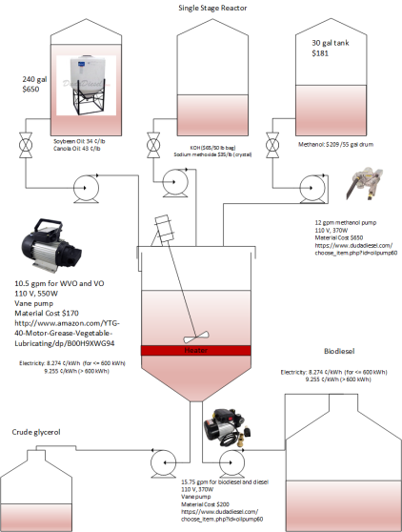
System Diagrams
Use standard symbols.
Properly label and reference.
May use software (such as Visio, lucid chart, AutoCAD™, SolidWorks™) or freehand.
Document who drew and what software was used.
System Diagrams

Slide 15
Analysis of Alternatives
Discussion on possible alternatives and why some alternatives are better than other.
Safety
Less moving parts
Lower cost
Durability
Compatibility
Foolproof
AlternativeAnalysis

Slide 16
Engineering Modeling
Physical/Chemical/Biological/Computer system modeling.
Modeling criteria, expected accuracy, pitfalls.
Which modeling software was used?
What data was needed, how the data was obtained.
Validation scheme for the model.
Modeling

Slide 17
Manufacturing/
Implementation Plan
Fabrication need.
Flowchart for process oriented projects.
Bill of materials, drawings.
Manufacturer/supplier and delivery time.
Mfg. Plan

Slide 18
Experimental Design
Characterize the purpose of the experiment.
Model validation?
Data gap?
Performance measurement?
Detailed documentation on instrumentation and measurements.
Exp. Design

Slide 19
Data Analysis
Document statistical tools used.
Document accuracy of data, and experiment.
Write about the confidence in your results.
What conclusions can be made?
Data Analysis

