Slide 1
Ethanol Compensation
Presented by:
Davis hill

Slide 2
Outline
What is it?
Why do we Care?
Measuring Ethanol Content
Flex Fuel Circuit
Wiring
Homework
Questions

Slide 3
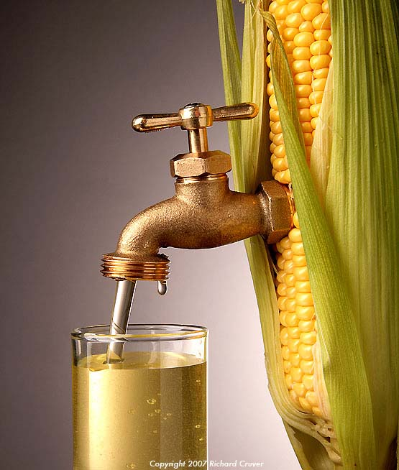
What is it?
What does the US Produce?
Freedom
Corn
Corn Facts:
The US is the leading grower of corn in the world (obviously)
Corn was first found in Mexico
In 2013 the US produced 13 BILLION bushels of corn
8% is consumed by the world population
40% goes into Biofuels (ETHANOL!!)

Slide 4
Why do we care?
Ethanol Pros
Burns Cleaner (fewer aldehydes, CO, and ${NO}_{x}$)
Higher Energy Content (~105 Octane)
CSC Rules
Requires all sleds to be “Flex Fuel Capable”
0-85% ethanol content
Exact amount unknown

Slide 5
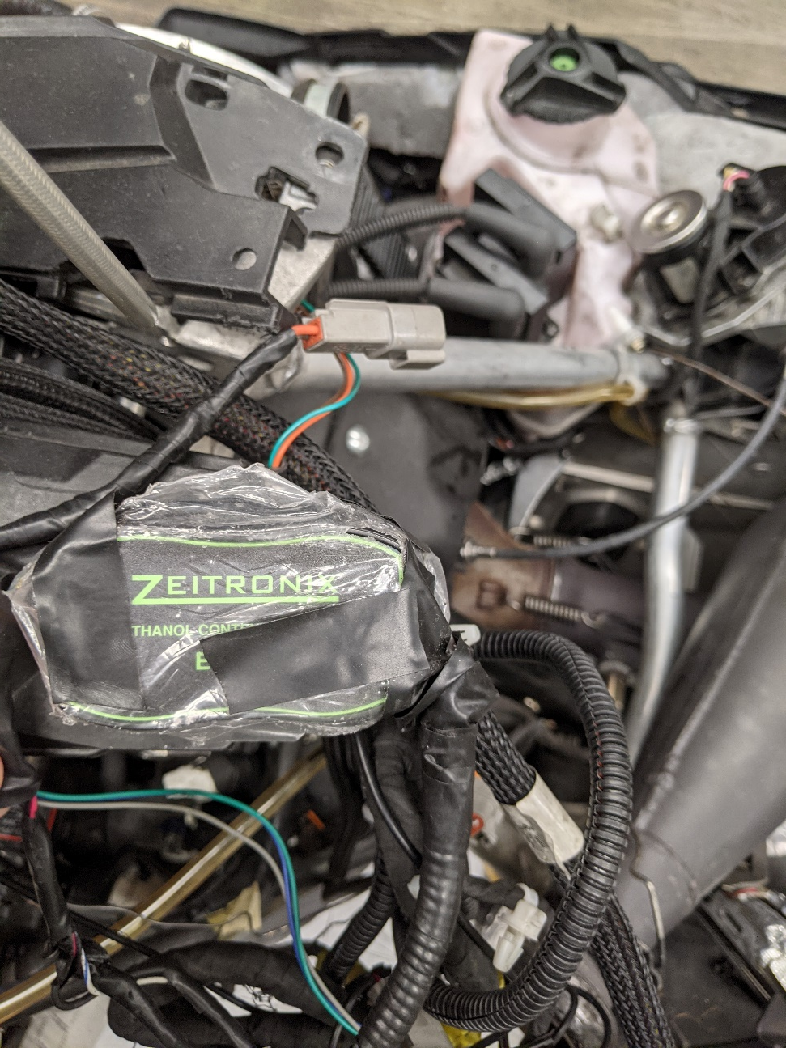
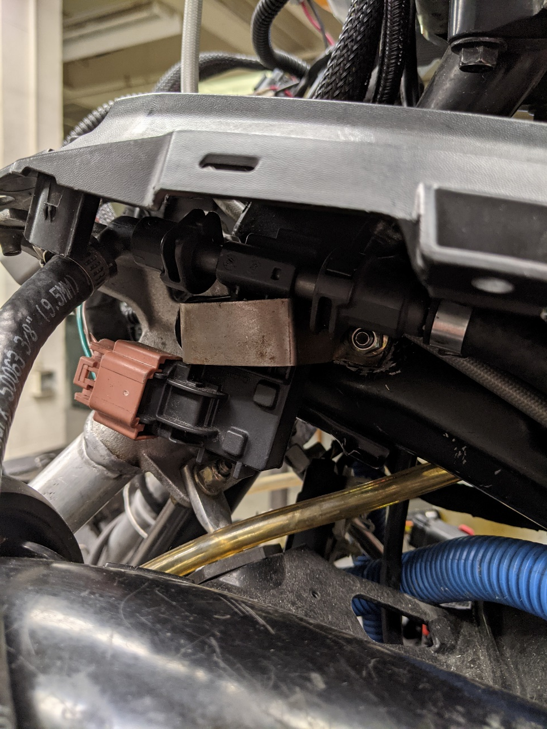
Our unit
Zietronix Flex Fuel
Replaces Intake Air Temp input to ECU
Recalibrated the ECU for ethanol compensation
Actual sensor
Module on Spectre

Slide 6
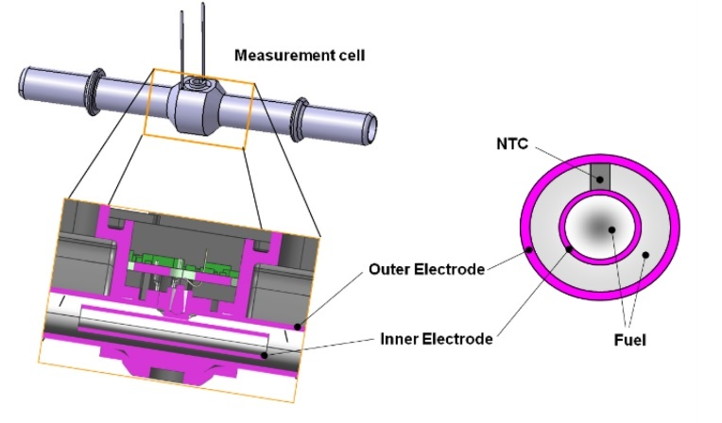
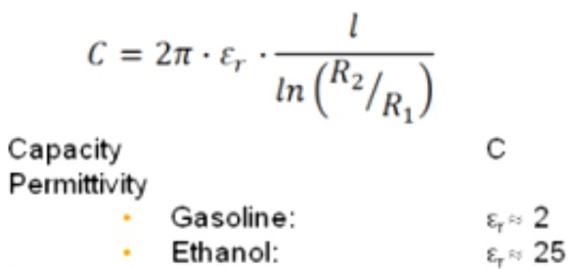
Measuring Ethanol Content
How the sensor works
Sends an AC Voltage
Measures Capacitance of Fuel (related to change in voltage)
Outputs a oscillatory voltage response (sine wave) at signal wire
Frequency of output is proportional to ethanol %
Sine wave converted to steady voltage via the Flex Fuel Circuit

Slide 7
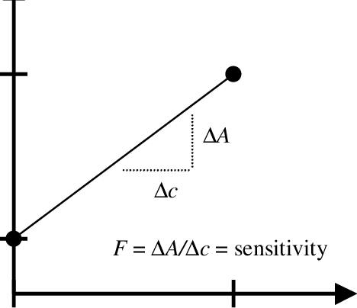
Flex Fuel circuit
Circuit calibration
Step 1:
Know the voltage range for ethanol
Step 2:
Calibrate Extremes (E00 & E85)
Step 3:
Linearly Interpolate injection quantity
in calibration of EMM
Z
Zietronix Box
Injection quantity
E85
E0
Ethanol content %

Slide 8
Wiring
Block diagram
Stock
Air Temp Sensor
ECU
CSC modified
Flex Fuel Sensor
Module
ECU

Slide 9
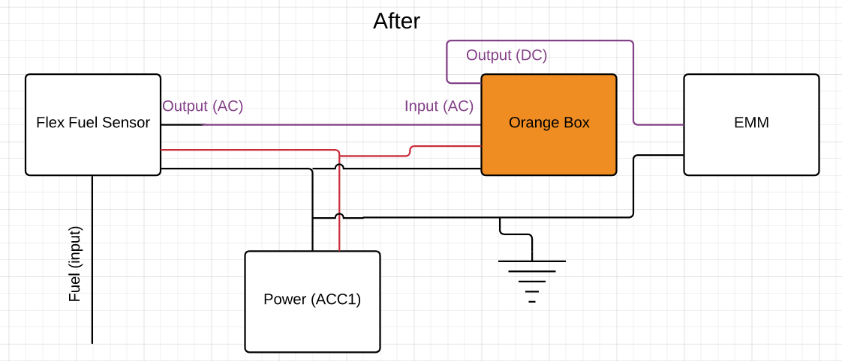
Wiring
General Wiring diagram
Z

Slide 10
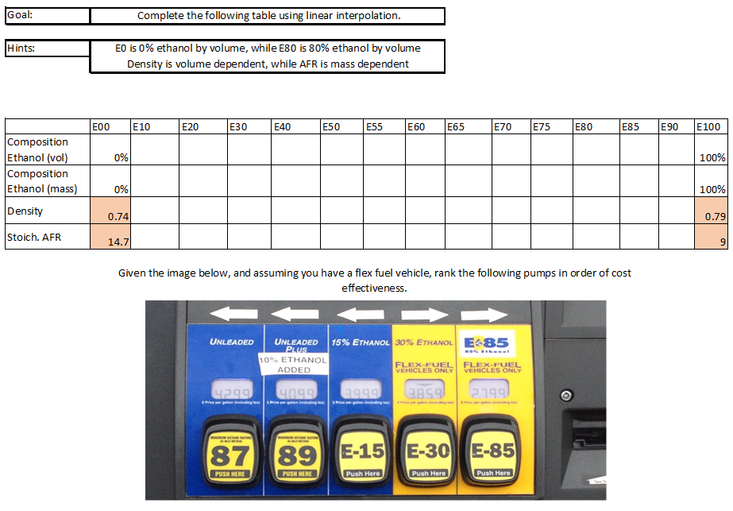
Homework

Slide 11
Questions?

Slide 12
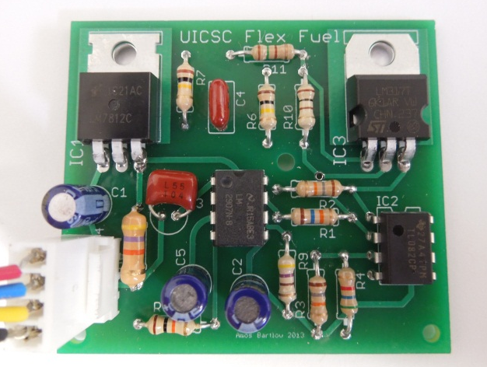
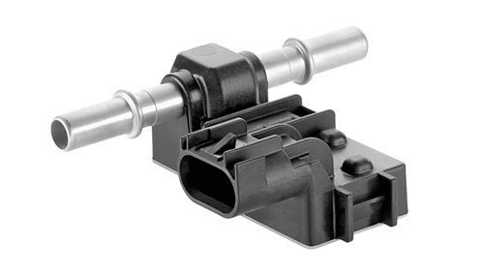
Old circuit
Circuit inputs
Continental sensor used to measure volume fractions of ethanol
In-house designed circuit (2012 Senior Design)
Lovingly referred to as the orange box
Unchanged since Senior Design Project

