Slide 1
ENGR 220: Dynamics
Chapter 12 Kinematics of a Particle
Chapter 13 Kinetics of a Particle: Force and Acceleration
Chapter 14 Kinetics of a Particle: Work and Energy
Chapter 15 Kinetics of a Particle: Impulse and Momentum
Chapter 16 Planar Kinematics of a Rigid Body
Chapter 17 Planar Kinetics of a Rigid Body: Force and Acceleration

Slide 2
Introduction
12.1
MECHANICS
STATICS
DYNAMICS
(objects in equilibrium)
(objects in motion)
KINEMATICS
KINETICS
(geometric aspects of motion)
(analysis of forces causing motion)
Chapter 12 Kinematics of a Particle

Slide 3
Rectilinear Kinematics: Continuous Motion
12.2
Velocity:
Change in position.
$$\boxed{v=\frac{ds}{dt}} \left(\text{EQ}\text{ 12−1}\right)$$
instantaneous velocity is the time derivative of position
Acceleration:
Change in velocity.
$$\boxed{a=\frac{dv}{dt}} \left(\text{EQ}\text{ 12−2}\right)$$
instantaneous acceleration is the time derivative of velocity
Relationship between position, velocity, and acceleration:
With no time dependance

Slide 4
Rectilinear Kinematics: Continuous Motion
12.2
Special Case: Constant Acceleration
Velocity as a Function of Time:
Position as a Function of Time:
Velocity as a Function of Position:

Slide 5
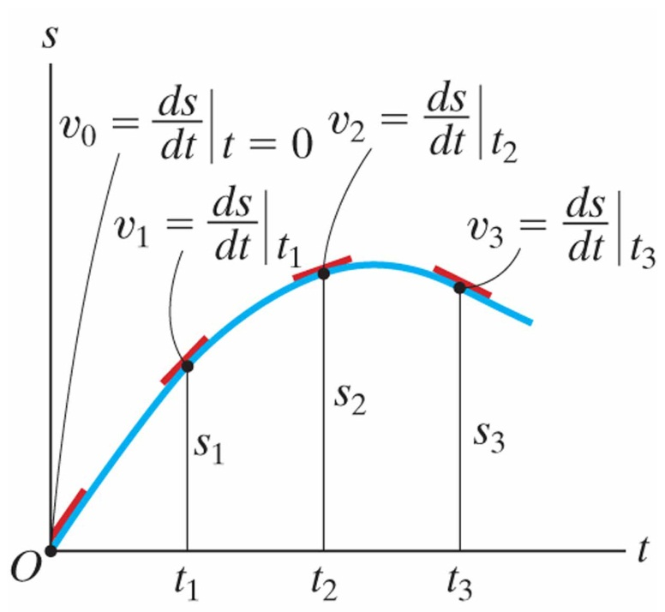
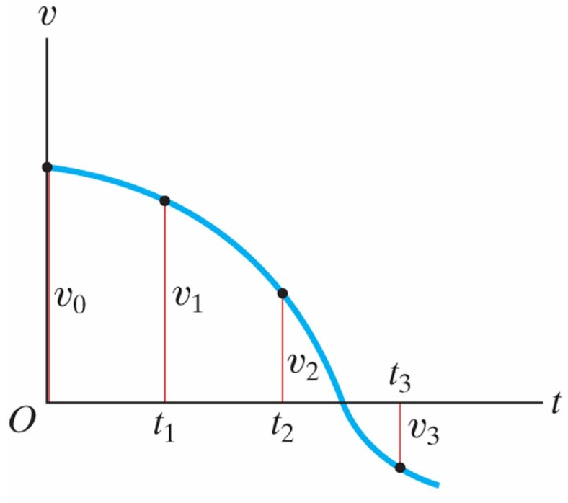
Rectilinear Kinematics: Erratic Motion
12.3
In many cases the position, velocity, and acceleration of a particle cannot be described by a continuous mathematical function along its entire path.
The s-t and v-t graphs:

Slide 6
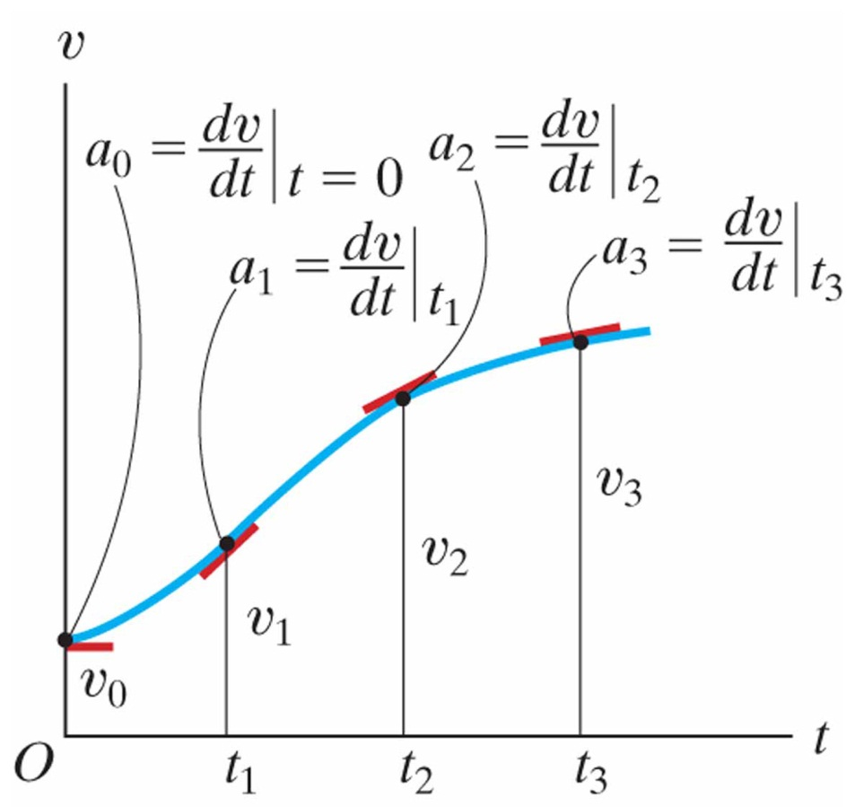
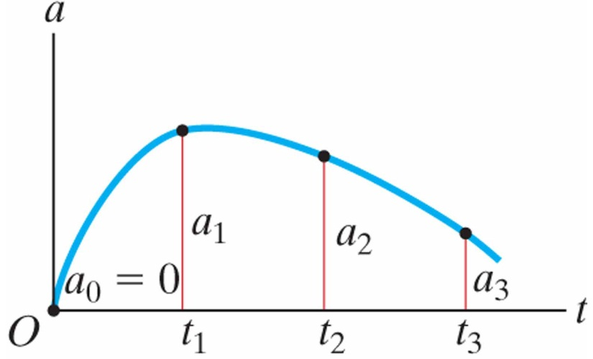
Rectilinear Kinematics: Erratic Motion
12.3
In many cases the position, velocity, and acceleration of a particle cannot be described by a continuous mathematical function along its entire path.
The v-t and a-t graphs:

Slide 7
Relationship Between s-t, v-t, and a-t Graphs
How about the other way? What if you have a plot of acceleration as a function of time? How to you get to velocity? Or position?
You know that:
In theory, if I gave you a plot of acceleration vs. time, and some grid paper, you could probably draw me a pretty accurate velocity vs. time plot.

Slide 8
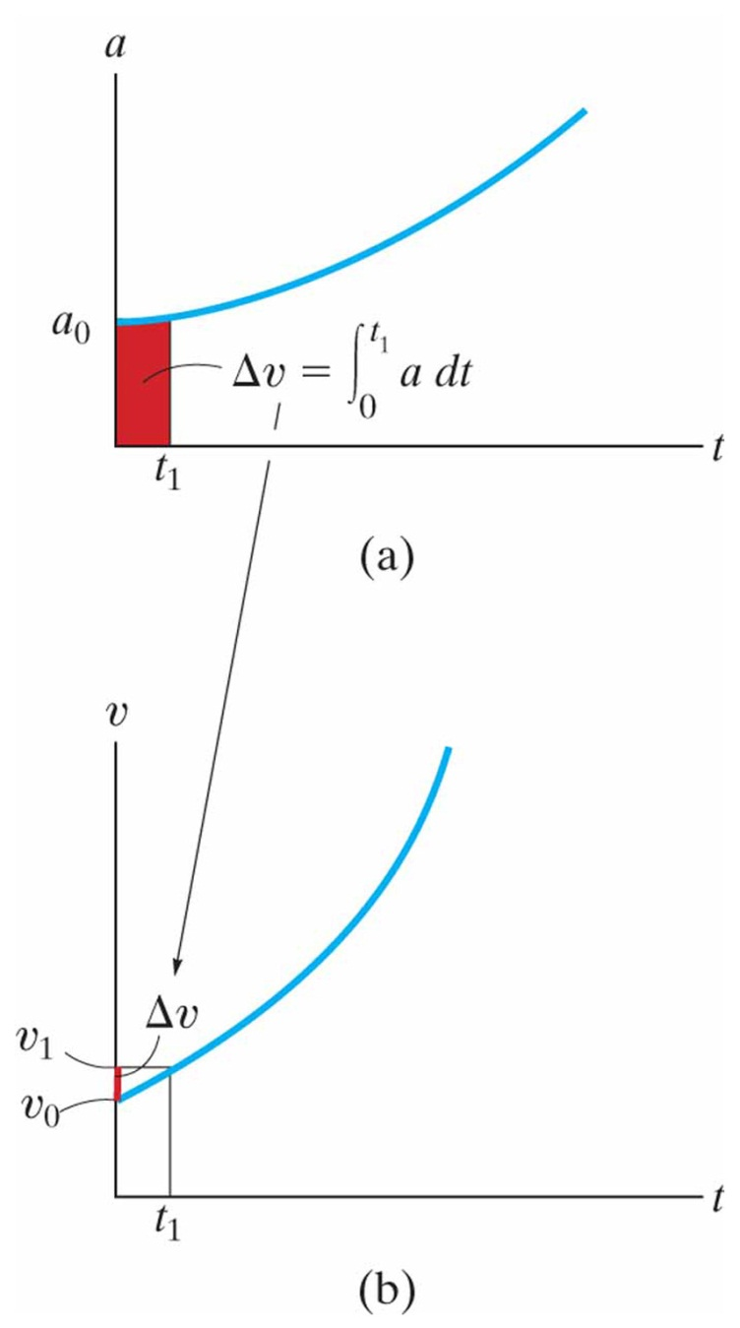
Rectilinear Kinematics: Erratic Motion
12.3
In many cases the position, velocity, and acceleration of a particle cannot be described by a continuous mathematical function along its entire path.
The a-t and v-t graphs:

Slide 9
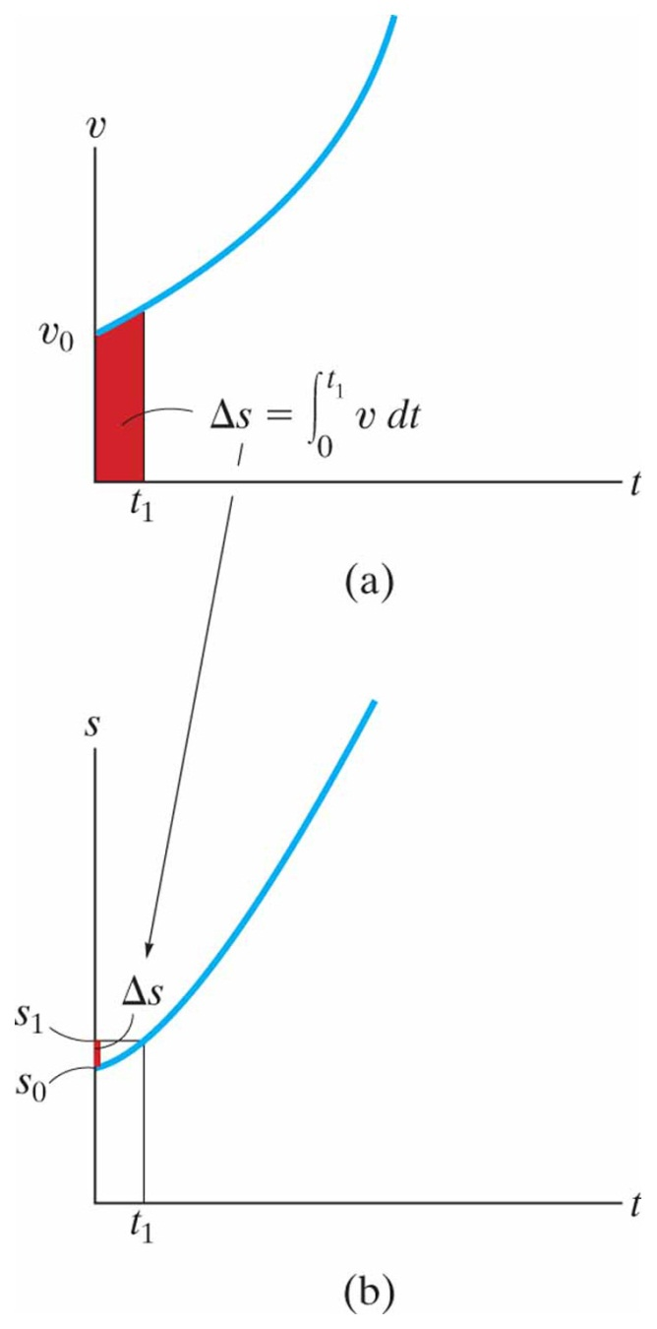
Rectilinear Kinematics: Erratic Motion
12.3
In many cases the position, velocity, and acceleration of a particle cannot be described by a continuous mathematical function along its entire path.
The v-t and s-t graphs:

Slide 10
Curvilinear Motion: Rectangular Components
12.5
Position:
A particle located at (x,y,z) from origin 0.
position:
magnitude:
Velocity:
Velocity has direction and magnitude. Velocity is always tangent to the path. Tail emanates from the particle.
vector velocity:
magnitude:

Slide 11
Curvilinear Motion: Rectangular Components
12.5
Acceleration:
Acceleration has direction and magnitude. Acceleration points towards the inside of the path curve.
vector acceleration:
magnitude:

Slide 12
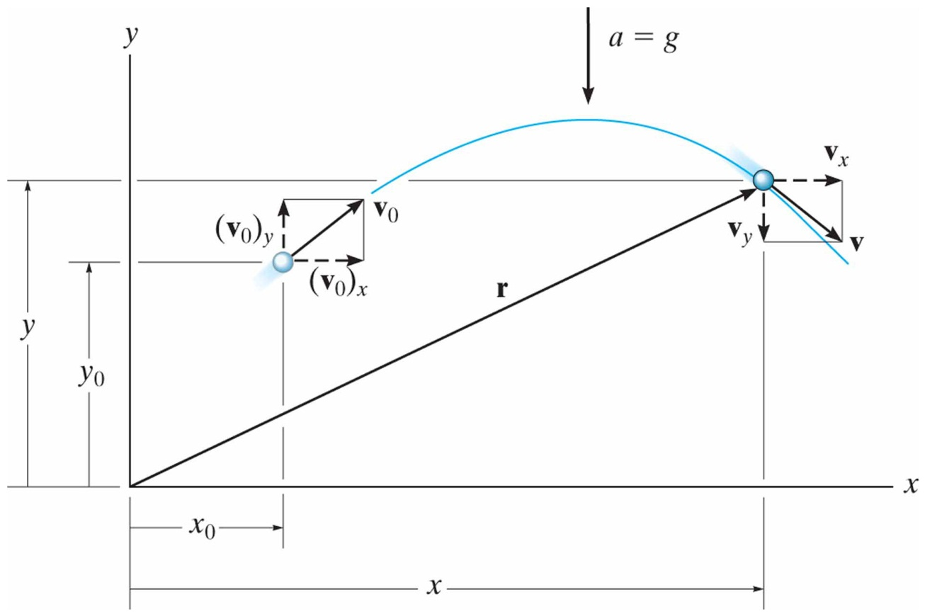
Motion of a Projectile
12.6
Free-flight motion of a projectile using rectangular components.
Assumptions for Analysis:
constant acceleration (no variation with altitude or elevation)
no friction/damping from air (no forces act on particle during flight)
Constant Acceleration
Equations:
$$a_{c}=g=9.81\frac{ \text{m}}{s^{2}}=32.2\frac{ \text{ft}}{s^{2}}$$
For projectile flight, use:
Horizontal Motion:
Vertical Motion:

Slide 13
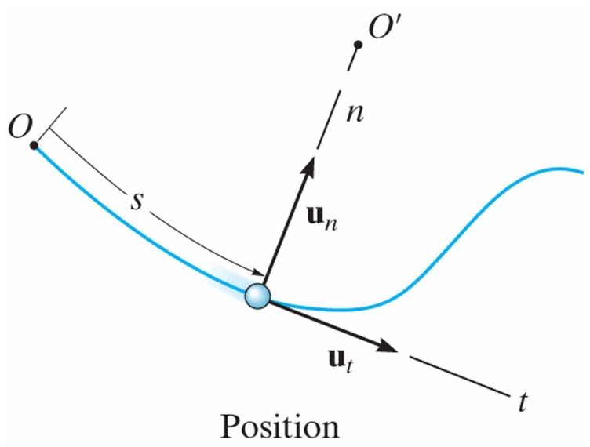
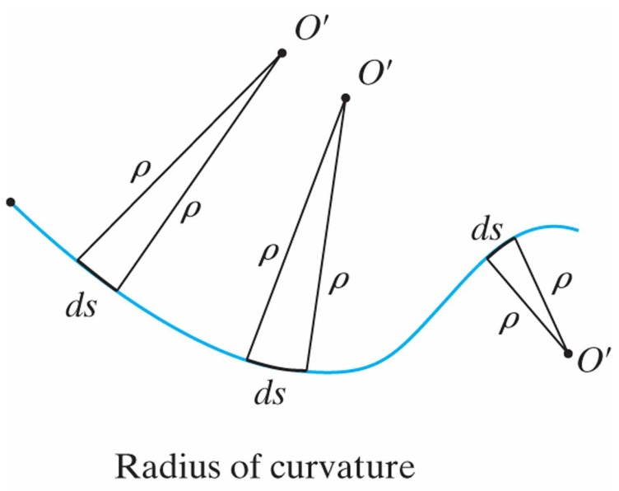
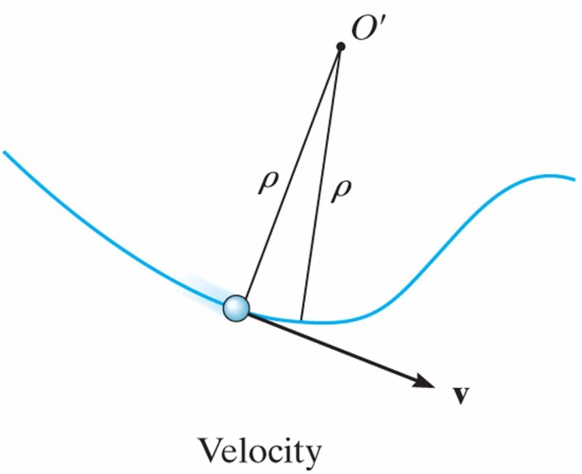
Curvilinear Motion: Normal and Tangential Components
12.7
Planar Motion:
Coordinate system has origin at a fixed point on the curve, and at the instant considered this origin happens to coincide with the location of the particle.
Position:
The tangential direction, t is tangent to the path and points in the direction of motion.
Velocity:
The normal direction, n is perpendicular to the tangential direction and points to the instantaneous center of curvature 0’.

Slide 14
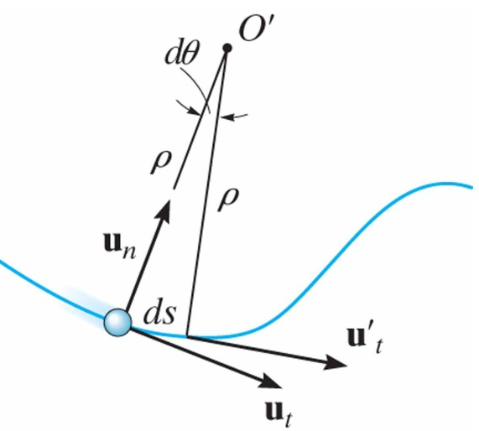
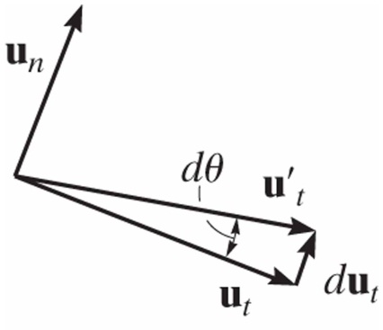
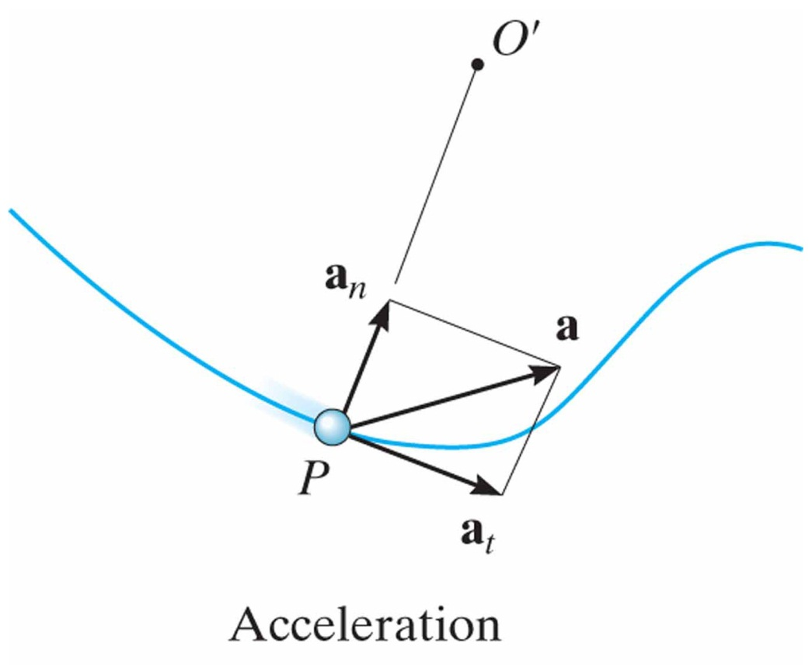
Curvilinear Motion: Normal and Tangential Components
12.7
Acceleration
Analysis:
Acceleration is time rate of change of velocity:
Acceleration:
magnitude:

Slide 15
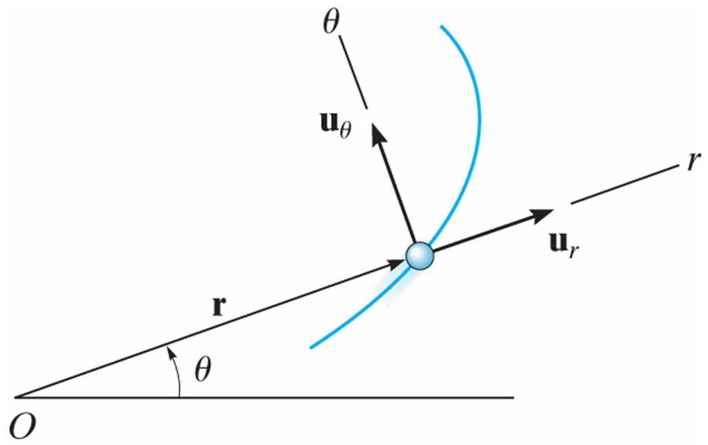
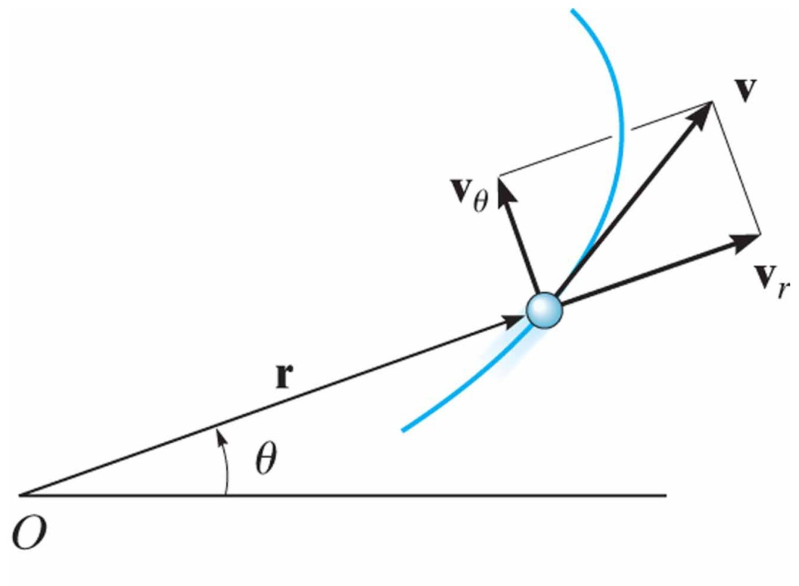
Curvilinear Motion: Cylindrical Components
12.8
Polar Coordinates:
Position:
Velocity:
velocity magnitude:

Slide 16
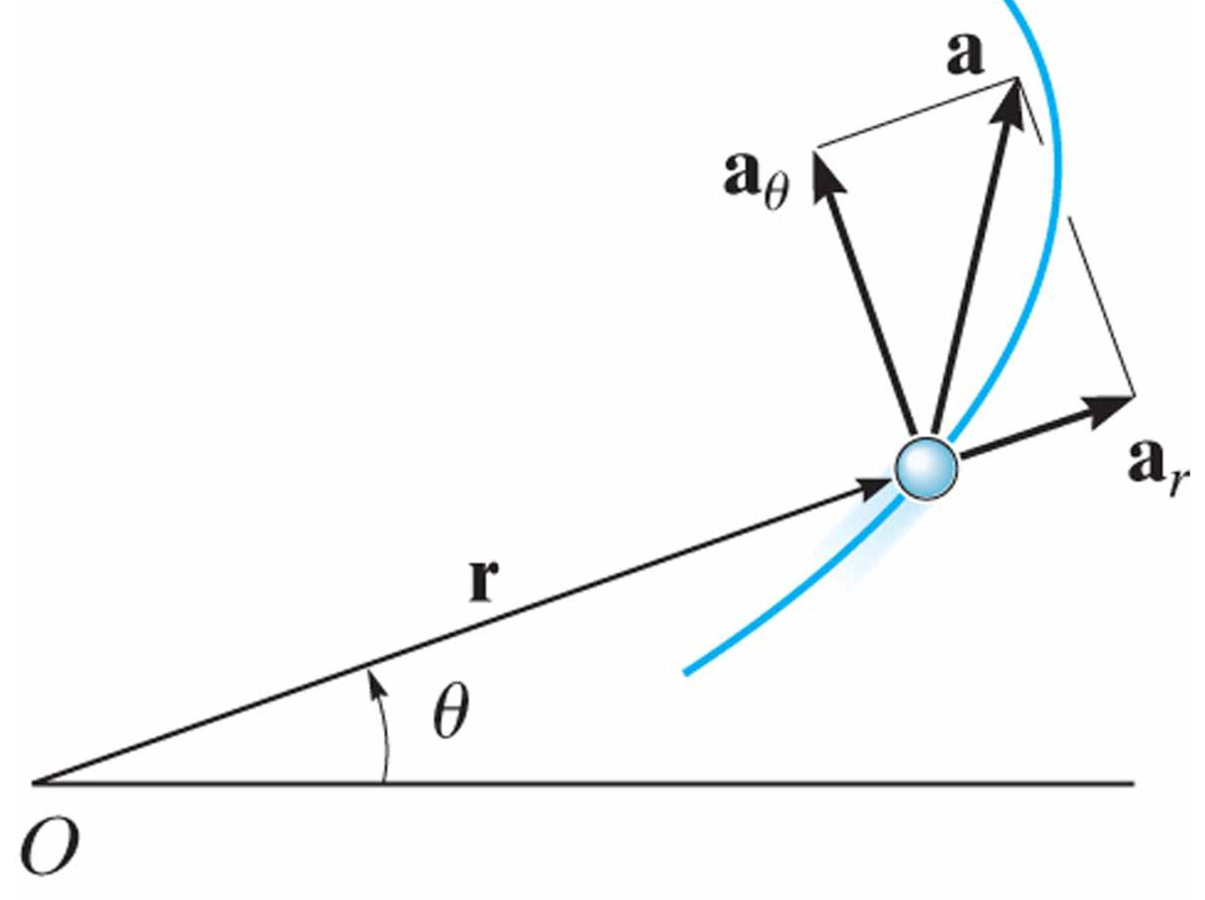
Curvilinear Motion: Cylindrical Components
12.8
Polar Coordinates:
Acceleration:
Acceleration magnitude:

Slide 17
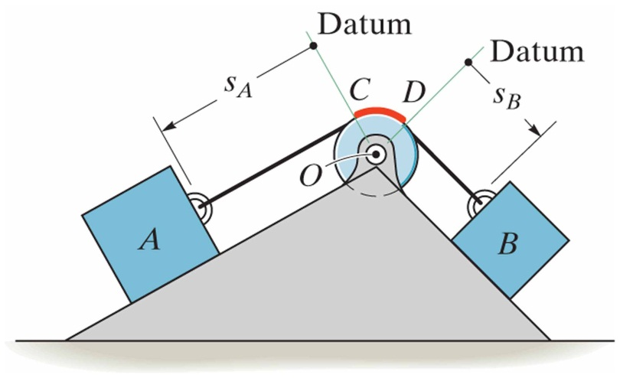
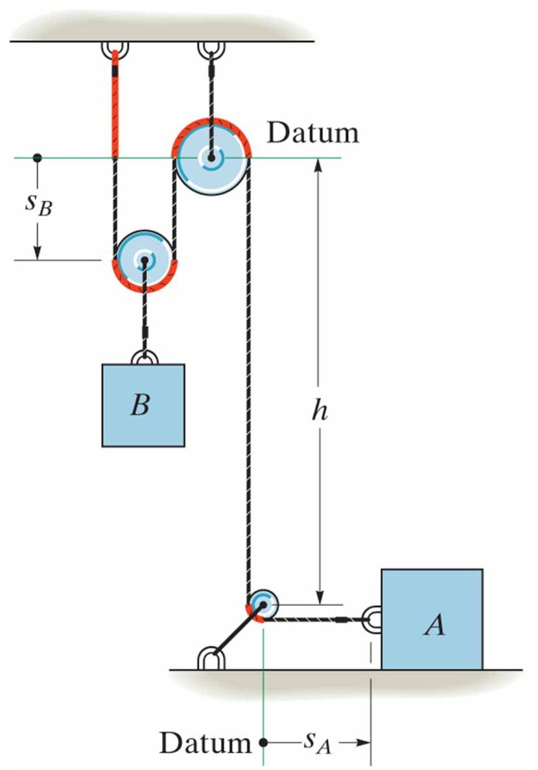
Absolute Dependent Motion Analysis of Two Particles
12.9
The motion of one particle depends directly on the motion of another particle.
Example 1:
Example 2:

Slide 18
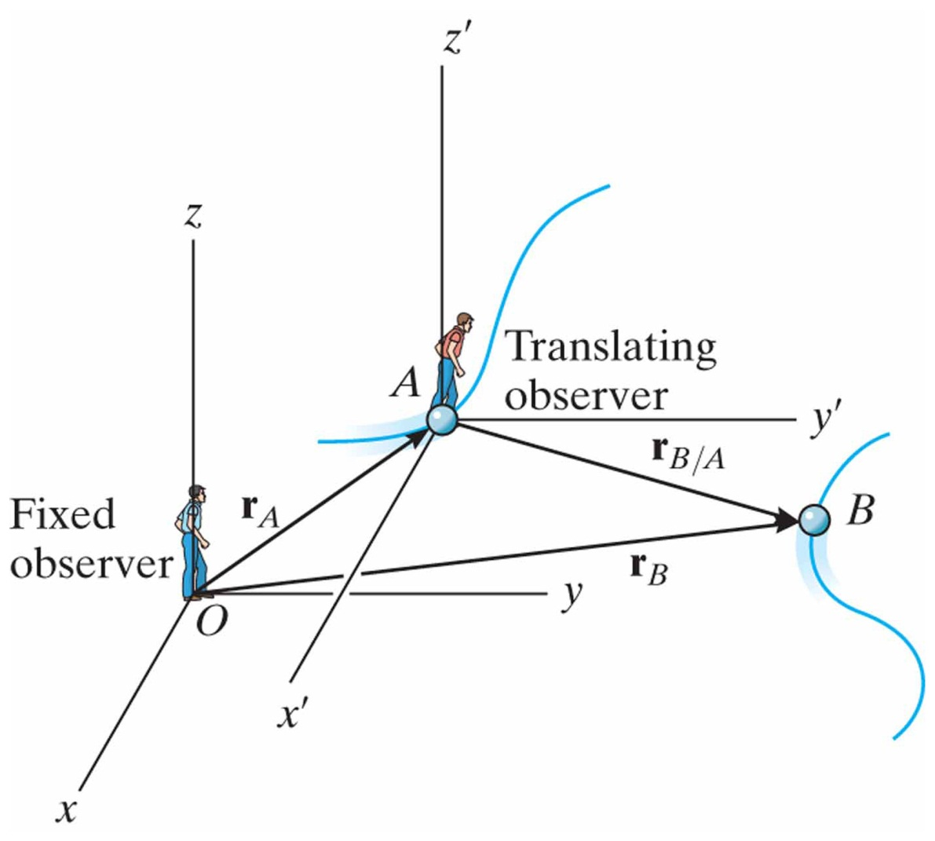
Relative-Motion of Two particles Using Translating Axes
12.10
Translating frame of reference is attached to and moves with particle A.
Position:
Velocity:
Acceleration:

