Slide 1
ME 345 Heat Transfer (HTx)
Professor:
Dr. Dan Cordon (AKA Dr. Dan)

Slide 2
Week 1 HW Questions
Conduction Problem
Convection Problem
Radiation Problem

Slide 3
Draw Heat Flow Diagrams
The Spoon in a cup of freshly-poured coffee
The Mug of freshly-poured coffee sitting on a table, still with spoon in it
The Transient Version
The Quasi-Steady-State Version
The Long-Term Steady-State Version

Slide 4
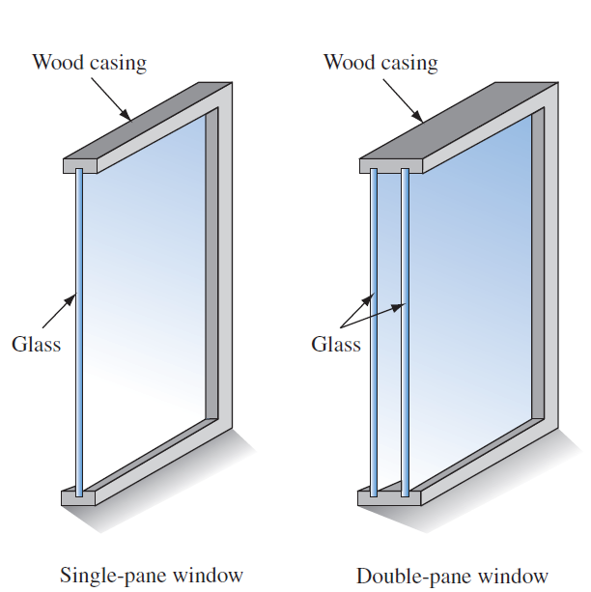
In-Class Activity
Draw a heat flow diagram showing the path/forms of heat transfer for both a single pane window and and double pane window. Assume room air temp is 75 °F, and the outside air temp is 50 °F.

Slide 5
Example Problem 1.24
Spherical interplanetary probe has a rate of heat generation of 150 [W]. Calculate the steady-state surface temperature of the probe if radiation to space is the only means of rejecting heat (assume T_{sur} is at absolute zero). Diameter and emissivity are as shown in the schematic.
$$q_{rad}^{′′}=εE_{b}−αG=εσ(T_{s}^{4}−T_{sur}^{4})$$
σ = (5.67 x 10⁻⁸ [W/m²K⁴])

Slide 6
Solution to Problem 1.24

Slide 7
Solution to Problem 1.24

Slide 8
Draw Your Heat Flow Diagrams
Welding (with a torch)
Welding (MIG)
Welding (TIG)
Phone Touchscreen
Change in heat
Change in resistance
Change in impedance
Cooking on a stovetop
Electric range with metal pot
Gas range with metal pot
Inductive range with metal pot

Slide 9
Draw Your Heat Flow Diagrams
Cooking on a stovetop
Aluminum pan vs cast iron pan
Rain falling on a hot light bulb
Hot-Side of Turbocharger
Marshmallow and a fire
Microwaving something (non-metallic)
Nuclear fuel rod
Melting ice cream cone at the beach
CPU/GPU cooler
Tire/Brake assembly under deceleration

Slide 10
Methods of Cooking
Moist Heat Methods
Sous Vide
Poaching
Simmering
Steaming
Boiling
French: ‘sue veeD’
Vacuum-sealed food, low temp for long time
Food submerged in 140-180 °F liquid
Food submerged in 180-205 °F liquid
Food surrounded in steam
Food submerged in 212 °F turbulent liquid

Slide 11
Methods of Cooking
Dry Heat Methods
Baking
Grilling
Roasting
Sauteing
Frying
Broiling
Surrounded by hot air, cook from all sides
Radiant heat from below (through grates)
Like baking, but often at higher temps
In a hot, shallow pan, usually with a fat/oil
Immersion in a hot oil/fat
High heat from above

Slide 12
Methods of Cooking
Combined Methods
Braising
Stewing
Seared in hot pan, then cooked in hot liquid, partially submerged
Cooked in hot liquid, completely submerged – liquid becomes integral part of the food after it gains elements lost from meat/vegetables

