Slide 1
ME 345 Heat Transfer (HTx)
Professor:
Dr. Dan Cordon (AKA Dr. Dan)

Slide 2
1D SS HEAT EQUATION
The Heat Equation for a Plane Wall (1D, SS, no generation, and constant thermal conductivity)
looks like:
$\frac{d^{2}T}{dx^{2}}=0$ or $\frac{d}{dx}\left(\frac{dT}{dx}\right)=0$

Slide 3
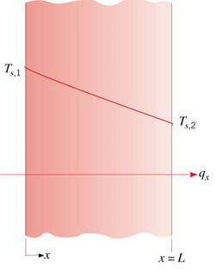
THE PLANE WALL
1D SS heat transfer in cartesian coordinates. No internal heat generation. Looking only at temperature distribution in the wall.
BCs:
@ x=0, T(0) = T_{s,1}
@ x=L, T(L) = T_{s,2}

Slide 4
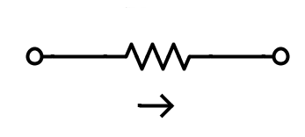
THERMAL RESISTANCE MODEL
$$R_{t,cond}=\frac{T_{s,1}−T_{s,2}}{q_{x}}=\frac{∆T}{q_{x}} =\frac{L}{kA}$$
Treat temperature like voltage (potential)
Treat heat flow like current flow
$$T_{s,1}$$
$$R_{L,cond}$$
$$T_{s,2}$$
$$q_{x}$$

Slide 5
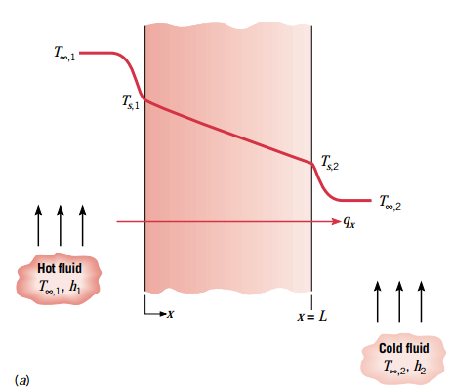
THERMAL RESISTANCE MODEL
Can solve for heat rate knowing any two temperatures
Using the total resistance

Slide 6
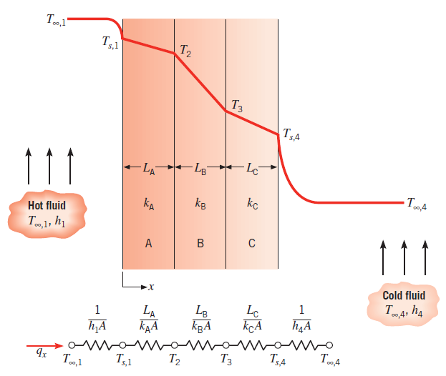
3-LAYER THERMAL RESISTANCE MODEL

Slide 7
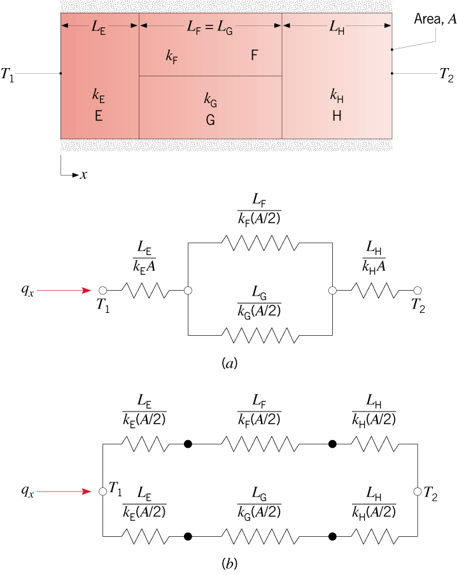
SERIES-PARALLEL PLANE WALL
Assuming isothermal surfaces perpendicular to heat flux
Assuming adiabatic surfaces between F and G

Slide 8
THERMAL RESISTANCE MODEL
Cool Things to Check
Relative size of each thermal resistor?
Which leg of parallel resistors has most flow?
What changes can you make to either increase or decrease heat flow?
Draw Circuit Diagrams
Single and double pane windows
Insulated bottle

Slide 9
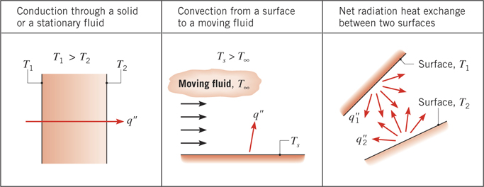
SUMMARY: PLANE WALL THERMAL RESISTANCE
HTx Mode | Heat Rate (q) | Thermal Resistance (R_{t})
Conduction | $$q=kA\frac{T_{h}−T_{c}}{L}$$ | $$R_{t,cond}=\frac{∆T}{q}=\frac{L}{kA}$$
Convection | $$q=hA\left(T_{s}−T_{∞}\right)$$ | $$R_{t,conv}=\frac{∆T}{q}=\frac{1}{hA}$$
Radiation | $$q=εσA\left(T_{s}^{4}−T_{∞}^{4}\right)$$ $$q=εσA\left(T_{s}−T_{∞}\right)\left(T_{s}+T_{∞}\right)\left(T_{s}^{2}+T_{∞}^{2}\right)$$ | $$R_{t,rad}=\frac{∆T}{q}=\frac{1}{h_{r}A}$$ $$h_{r}=εσ\left(T_{s}+T_{∞}\right)\left(T_{s}^{2}+T_{∞}^{2}\right)$$

Slide 10
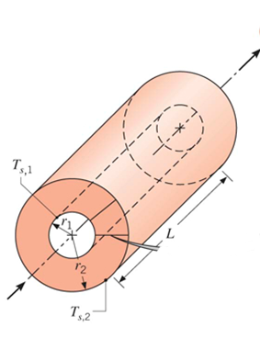
THE CYLINDRICAL WALL
When 1D, SS, no heat generation, and constant thermal conductivity
$$\frac{1}{r}\frac{∂}{∂r}\left(kr\frac{∂T}{∂r}\right)=0$$

Slide 11
1D SS CYLINDRICAL WALL
1D SS heat transfer in cylindrical coordinates. No internal heat generation.
Heat rate at any point in the r-direction is:
Heat rate (not heat flux) is constant in radial direction
Integrate heat equation twice ($\frac{1}{r}\frac{∂}{∂r}\left(kr\frac{∂T}{∂r}\right)=0$)
$$T\left(r\right)=C_{1}\ln\left(r\right)+C_{2}$$
BC’s: $T\left(r_{1}\right)=T_{s,1} and T\left(r_{2}\right)=T_{s,2}$
This gives us two equations with C1 and C2

Slide 12
1D SS CYLINDRICAL WALL
Solve for C1 and C2 and substitute into T(r) equation
Using Fourier’s Law we can also find the heat rate as
Remembering that thermal resistance can be defined as:
$$R_{t,cond}=\frac{∆T}{q}$$
For conduction through a cylindrical wall this becomes
$$R_{t,cond}=\frac{ln⁡\left({r_{2}}/{r_{1}}\right)}{2πLk}$$

Slide 13
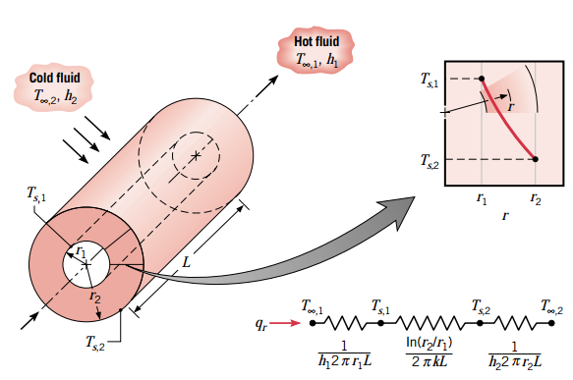
1D SS CYLINDRICAL WALL
Implications:
Temperature profile in radial direction is not linear
See a logarithmic decay

Slide 14
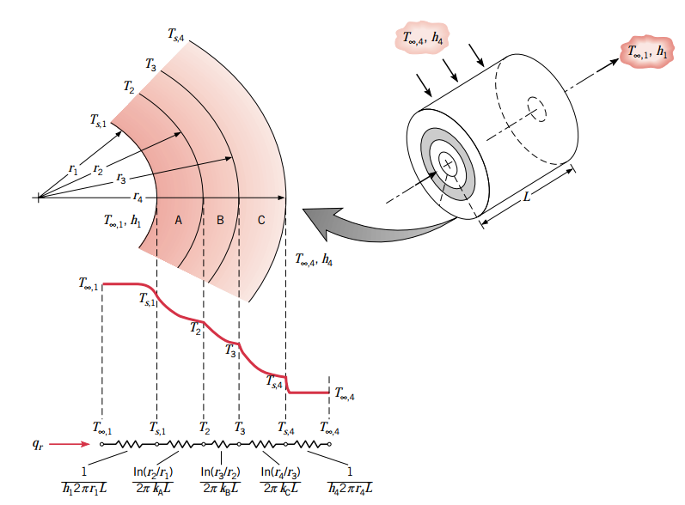
3-LAYER THERMAL RESISTANCE MODEL

Slide 15
3-LAYER THERMAL RESISTANCE MODEL
Neglecting contact resistance between layers we can get the heat rate as
We can express this in terms of the total resistance
And we can define an overall heat transfer coefficient U such that

Slide 16
OVERALL HEAT TRANSFER COEFFICIENT
U needs to be matched with an area
If we choose the inside area (At T_{s,1})
To get: $q_{r}=U_{1}A_{1}\left(T_{∞,1}−T_{∞,4}\right)$
But could use any area so long as

Slide 17
THE SHPERICAL WALL (SHELL)
When 1D, SS, no heat generation, and constant thermal conductivity
$$\frac{1}{r^{2}}\frac{∂}{∂r}\left(kr^{2}\frac{∂T}{∂r}\right)=0$$

Slide 18
1D SS SPHERICAL WALL
Using Fourier’s Law we can also find the heat rate as
Remembering that thermal resistance can be defined as:
$$R_{t,cond}=\frac{∆T}{q}$$
For conduction through a spherical wall this becomes
$$R_{t,cond}=\frac{1}{4πk}\left(\frac{1}{r_{1}}−\frac{1}{r_{2}}\right)$$
Spherical layers can be done just like cylindrical with appropriate equation for R_{total} and an overall heat transfer coefficient to get $q_{r}=UA\left(T_{∞,int}−T_{∞,ext}\right)$

Slide 19
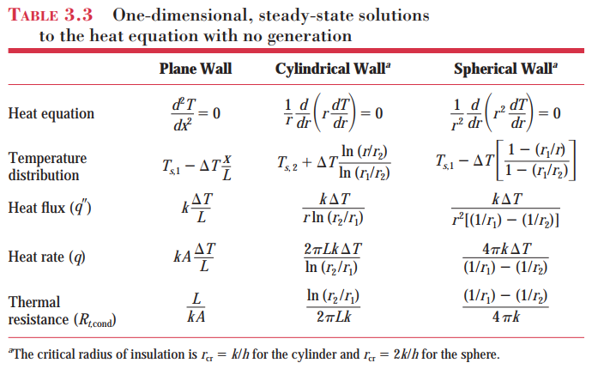
Summary: 1D SS THERMAL RESISTANCE

