Slide 1
ME 345 Heat Transfer (HTx)
Professor:
Dr. Dan Cordon (AKA Dr. Dan)

Slide 2
2D SS HEAT EQUATION
Consider the steady-state 2D Heat Equation with constant thermal conductivity and no volumetric heat generation.
Once the SS solution of T(x, y) was found you could still use Fourier’s Law to determine q_{x}’’ and q_{y}’’

Slide 3
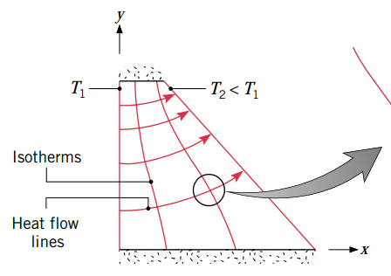
2D SS HEAT EQUATION
There are multiple ways to approach solving this equation.
Analytical solutions
Graphical solutions
Numerical solutions
Finite difference
Finite element
Boundary element

Slide 4
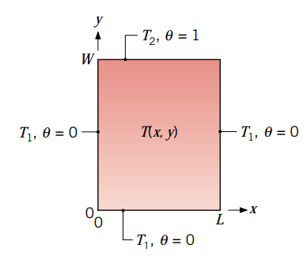
ANALYTICAL SOLUTIONS
Can do this with Separation of Variables
Consider this 2D square plate with T1 on three surfaces
@y = 0
@x = 0
@x = L
T2 on top surface2
@y = W
To simplify the solution we can define a new variable such that:

Slide 5
ANALYTICAL SOLUTIONS
Like dimensionless temperature
This means that on surfaces x = 0, x = L, and y = 0 that θ = 0
At surface y = L we have θ = 1
Everywhere in between we will have values of θ that are between 0-1
So the Heat Equation turns into:
Boundary Conditions

Slide 6
ANALYTICAL SOLUTIONS
We then assume the form of the solution could be expressed as the product of two functions (superposition)
One function depends only on x
One function depends only on y
So our assumed solution should look like:
Substituting that into our Heat Equation we get:

Slide 7
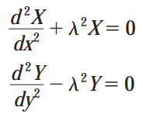
ANALYTICAL SOLUTIONS
This is already separated, and since one side is equal to the other side we can define a separation constant, λ².
What was formerly one partial differential equation is now two ordinary differential equations:

Slide 8
ANALYTICAL SOLUTIONS
It turns out that the general form of solutions to X and Y look like:
And when you substitute that back into the Heat Equation you get:
(This is true for cartesian geometries of any boundary condition)

Slide 9
ANALYTICAL SOLUTIONS
Applying boundary conditions for *this* problem When θ (0,y) = 0 we find that
When θ (x,0) = 0 we get: which is only satisfied when
When θ (L,y) = 0 we get:
And here is where things get interesting. The last equation requires that λ must be discrete values for which

Slide 10
ANALYTICAL SOLUTIONS
This means the solution to the Heat Equation is:
Combine the constants (which are going to be a function of n), and use a really tricky trig substitution (thank you mathematicians!) We get the solution to the Heat Equation for *this* problem is:

Slide 11
ANALYTICAL SOLUTIONS
But now we have a new problem. There is literally an infinite number of solutions to this form of the solution.
But, we can use superposition to get:
We are *almost* done, except we still need to come up with C_{n}. We get this from applying the last boundary condition.

Slide 12
ANALYTICAL SOLUTIONS
Okay, I totally lied. We are *not* almost done. Because finding C_{n} is a difficult problem all its own.
The textbook has a great step-by-step derivation which uses orthogonality and creating an infinite Fourier series (yes, the same person that gets credit for Fourier’s Law) that would solve for C_{n}.
……. B.O.C ……

Slide 13
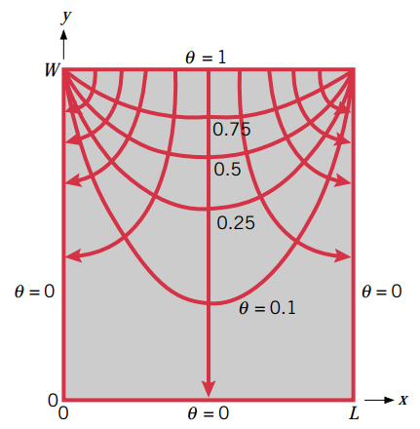
ANALYTICAL SOLUTIONS
Put it all together and we finally have:
Isotherms are shown as the parabolic lines
Heat flow lines are the ones with arrows on the end

Slide 14
GRAPHICAL SOLUTIONS
You already know several things about the solution to this problem without doing any math.
You know the temperature on each surface
You know the slope of the heat flux at each surface
You know that heat flux is always perpendicular to the isotherms
You could nearly sketch the temperature profile of this solution without doing any calculus.
Once you had the temperature profile you could easily sketch the heat flow lines.
This is the root of graphical solutions

Slide 15
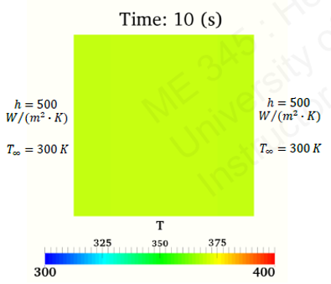
NUMERICAL SOLUTIONS
As computing power continues to improve it’s more and more common to do numeric simulations for any HTx problems 2D or more (especially when transient).
Numeric solutions (when they do solve) make really pretty pictures.
The trouble is knowing when these pictures are correct and when they are not.
Need to fall back on a graphical solution to check if numeric solution is reasonable.

