Slide 1
ME 345 Heat Transfer (HTx)
Professor:
Dr. Dan Cordon (AKA Dr. Dan)

Slide 2
CLASSIFYING CONVECTION
Type of Flow
External
Internal
Impinging
Laminar
Developing
Turbulent
Fully Developed
Mix of Both
Be Purposeful About:
$h_{x}$ – local coefficient
$\overline{h}$ – average coefficient

Slide 3
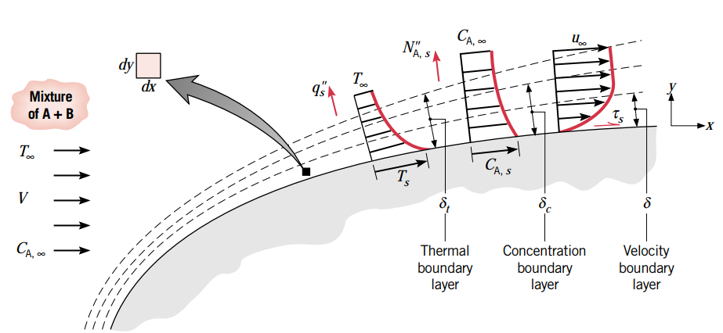
BOUNDARY LAYER FORMATION
This shows velocity, thermal, and concentration boundary layer formation.
Thickness of each boundary layer is arbitrary (not always in this order or magnitude)

Slide 4
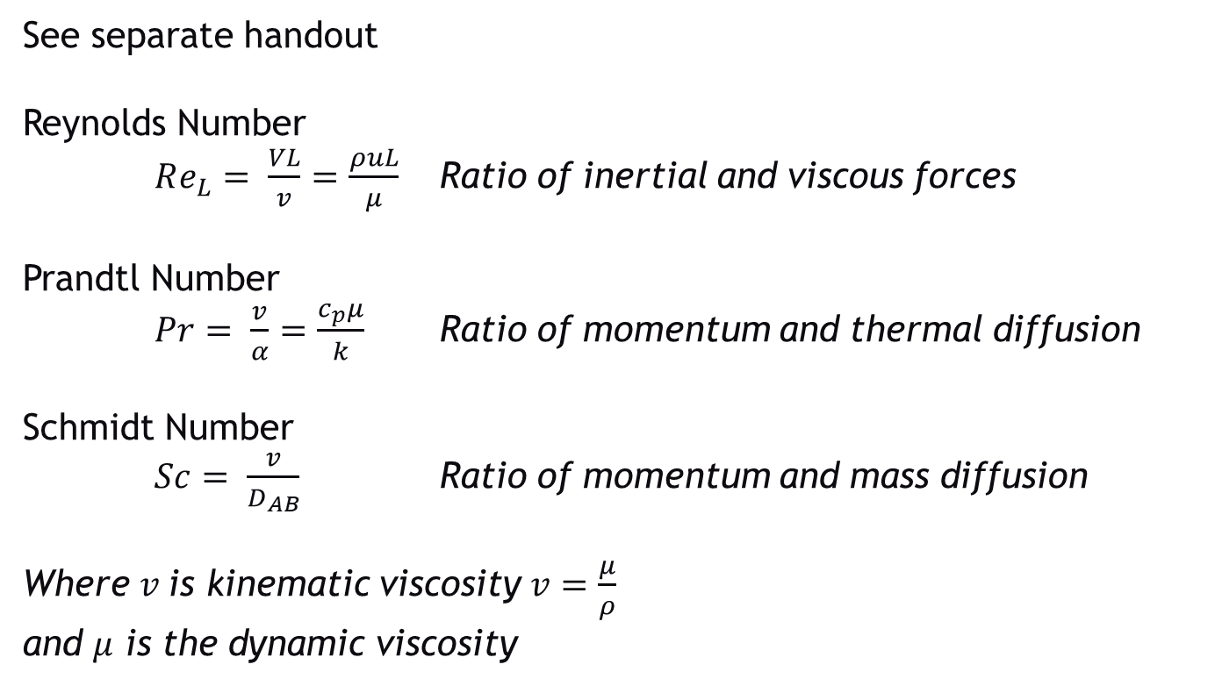
DIMENSIONLESS PARAMETERS
See separate handout
Reynolds Number
$Re_{L}= \frac{VL}{v}=\frac{ρuL}{μ}$ Ratio of inertial and viscous forces
Prandtl Number
$Pr= \frac{v}{α}=\frac{c_{p}μ}{k}$ Ratio of momentum and thermal diffusion
Schmidt Number
$Sc= \frac{v}{D_{AB}}$ Ratio of momentum and mass diffusion
Where $v$is kinematic viscosity $v=\frac{μ}{ρ}$ and $μ$ is the dynamic viscosity

Slide 5
DIMENSIONLESS PARAMETERS
See separate handout
Nusselt Number
$Nu= \frac{h∗L}{k_{f}}=+{\left.\frac{∂T^{∗}}{∂y^{∗}}\right|}_{y^{∗}=0}$
Dimensionless temperature gradient at the surface
Average Nusselt Number
$\overline{Nu}= \frac{\overline{h}∗L}{k_{f}}$
We will use correlations for $\overline{Nu}$ to find the average convection coefficient over a surface

Slide 6
SIMILITUDE
The solution to the differential equations will be the same *IF* two cases have similitude *and* the same boundary conditions
(Appendix D and E have solutions to common conditions)
For velocity boundary layer calculations:
Reynolds number must be same
For thermal boundary layer calculations:
Reynolds number must be same
Prandtl number must be same
For concentration boundary layer calculations:
Reynolds number must be same
Schmidt number must be same

Slide 7
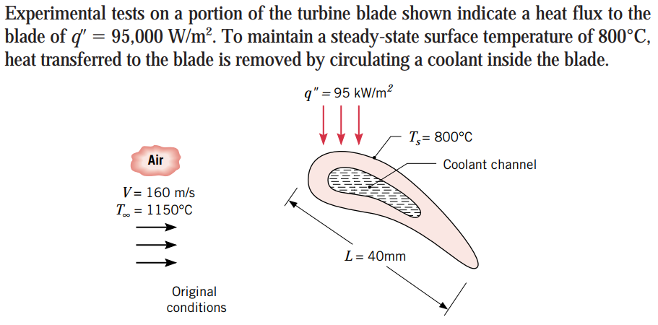
EXAMPLE 6.5
Part 1: Determine the heat flux to the blade if T_{s, 1} = 700 °C by increasing coolant flow

Slide 8
EXAMPLE 6.5
Assumptions
Solution Path
Find h for original conditions using known surface flux
Same conditions apply for Part 1, but with a different surface temp
Solution – Part 1
So h = 271.43 [W/m²K]
Since Re_{L}, Pr, x* and Nu are unchanged we can use this same convection coefficient for the Part 1 conditions

Slide 9
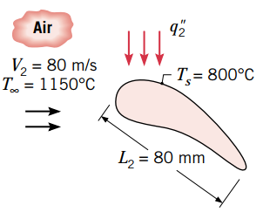
EXAMPLE 6.5
This makes sense that the heat flux at the surface would need to increase since the Delta_T has increased.
Part 2:
Now you are going to increase the size of the blade and lower the velocity.

Slide 10
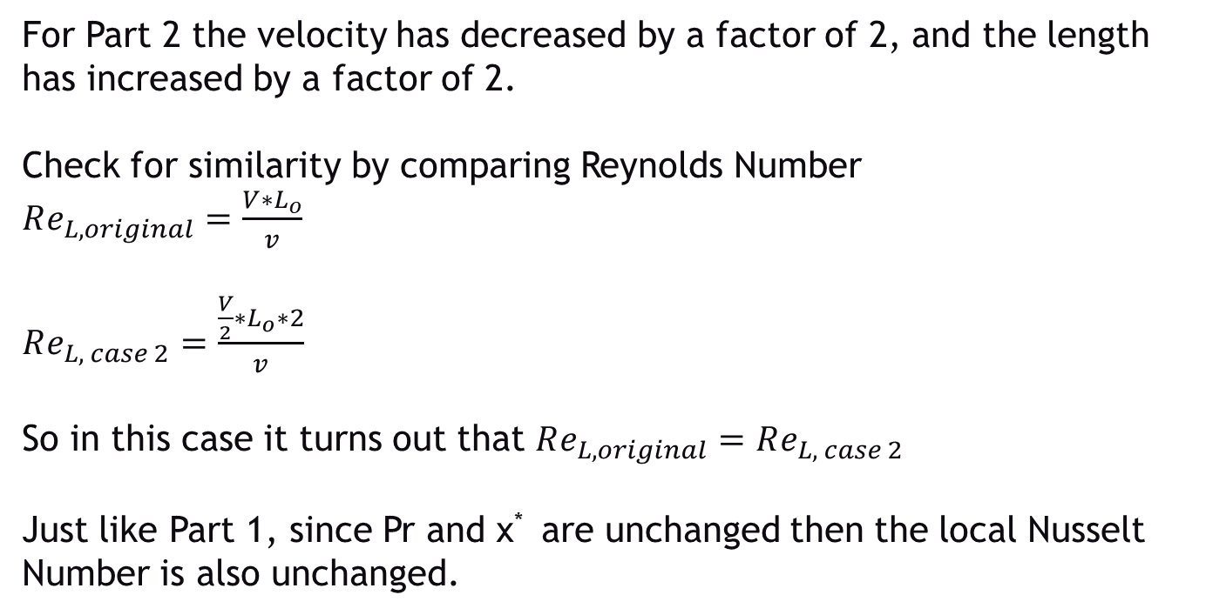
EXAMPLE 6.5
For Part 2 the velocity has decreased by a factor of 2, and the length has increased by a factor of 2.
Check for similarity by comparing Reynolds Number
$Re_{L, original}=\frac{V∗L_{o}}{v}$
$Re_{L, case 2}=\frac{\frac{V}{2}∗L_{o}∗2}{v}$
So in this case it turns out that $Re_{L, original}=Re_{L, case 2}$
Just like Part 1, since Pr and x* are unchanged then the local Nusselt Number is also unchanged.

Slide 11
EXAMPLE 6.5
Calculating the heat flux then becomes:
This works only because the Reynolds Number, Prandtl Number, and x* were the same for the original and large case. If this weren’t true you would have to solve the differential equation for the new case.

Slide 12
CHAPTER 6 SUMMARY
Takeaways from Chapter 6
Difference between local and average convection coefficient
Differences between velocity, thermal, and concentration boundary layers
General trends for laminar flow
General trends for turbulent flow
Learning some new dimensionless parameters related to convection heat transfer
Nusselt Number contains information about convection heat transfer coefficient, and is a function of Re, Pr, and x*

