Slide 1
ME 345 Heat Transfer (HTx)
Professor:
Dr. Dan Cordon (AKA Dr. Dan)

Slide 2
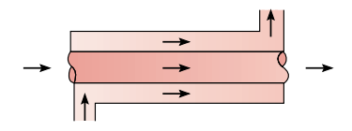
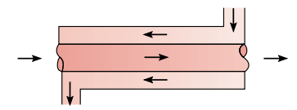
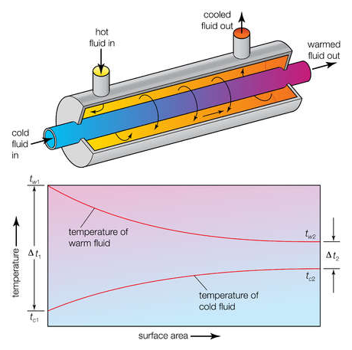
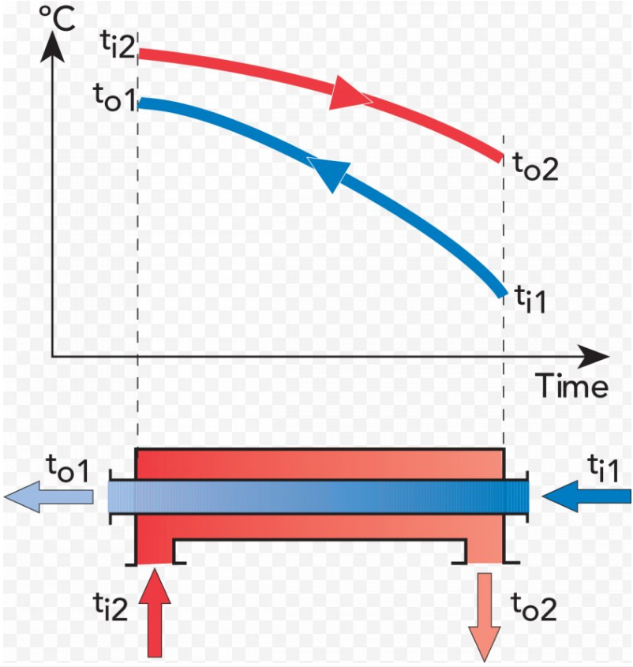
CONCENTRIC TUBE HEAT EXCHANGERS
Parallel Flow (wrong) Counterflow

Slide 3
RATE of HEAT TRANSFER
The rate of heat transfer associated with either stream in a heat exchanger in which incompressible fluid or ideal gas with constant specific heats flows is
c_{p} is the specific heat (at constant pressure)
m_dot is the mass flow rate
The rate of heat transfer in a heat exchanger is
A = any convenient reference area
F = correction factor for log mean temperature difference for more complex heat exchangers (shell and tube arrangements with several tube or shell passes or cross-flow exchangers with mixed and unmixed flow); otherwise F = 1.
U = “overall heat-transfer coefficient” (based on area A and the log mean temperature difference)
∆T_{lm} = log mean temperature difference

Slide 4
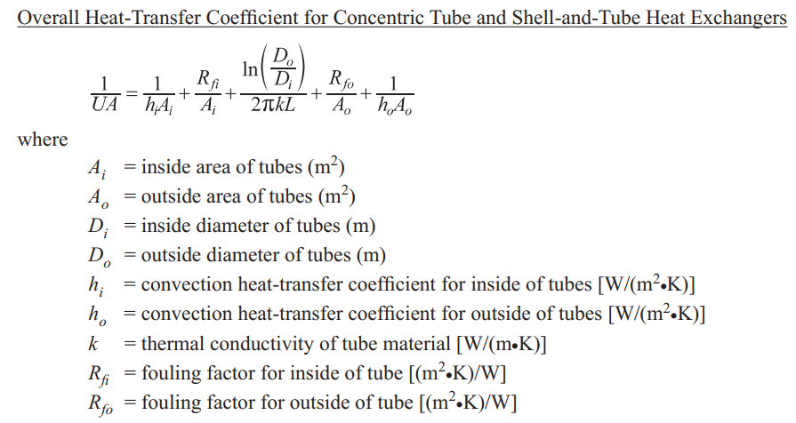
OVERALL HEAT TRANSFER COEFFICIENT

Slide 5
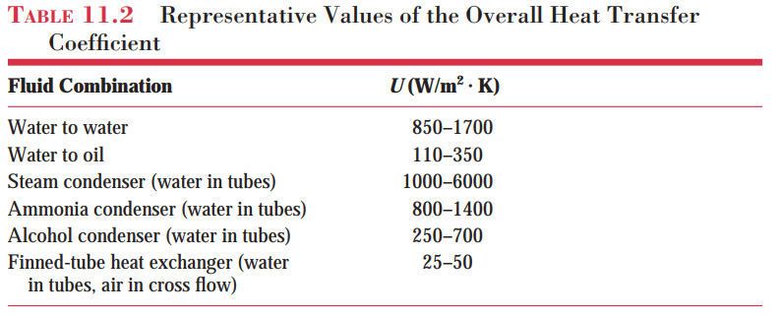
OVERALL HEAT TRANSFER COEFFICIENT

Slide 6
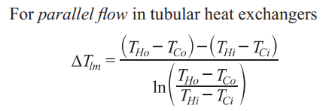
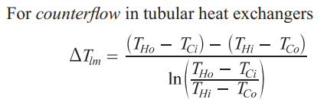
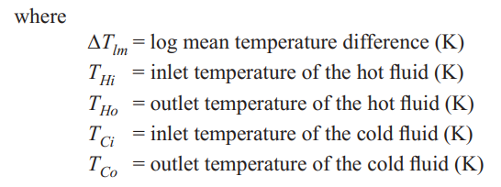
LOG MEAN TEMPERATURE DIFFERENCE

Slide 7
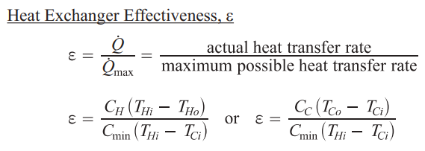
HEAT EXCHANGER EFFECTIVENESS

Slide 8
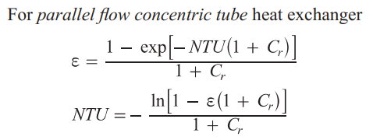
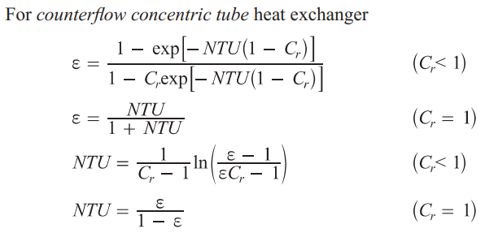
NUMBER of TRANSFER UNITS (NTU)

Slide 9
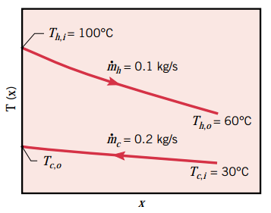
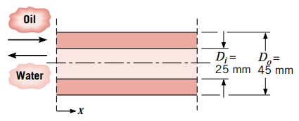
EXAMPLE 11.1
Find: Tube length necessary to achieve the desired hot fluid outlet temperature if U = 38.1 W/m²K.

Slide 10
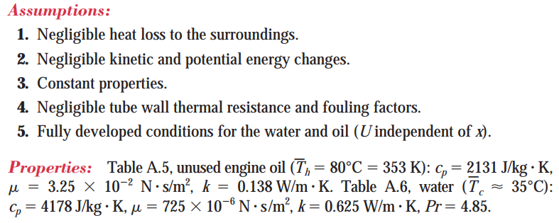
EXAMPLE 11.1

Slide 11
EXAMPLE 11.1
Choosing to look up water properties at 35 C was no coincidence. In reality, you might start this problem looking up water properties at 30 C, then solving for T_{c,o} and then looking up properties again at the average temperature.

Slide 12
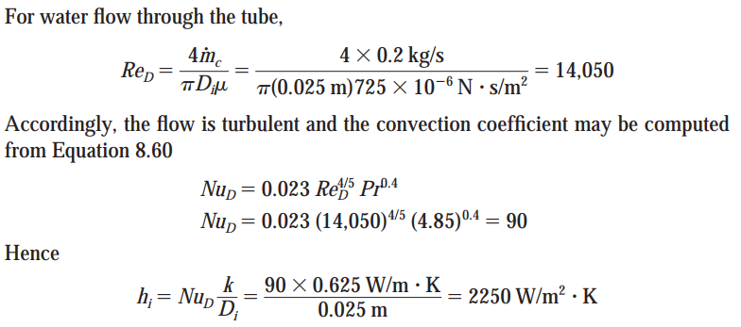
EXAMPLE 11.1
If you weren’t provided U you could calculate it. You would need to calculate the Reynolds Number for the inner and outer flows, then choose appropriate correlations for Nusselt Number (if laminar or turbulent) and the Prandtl Number.

Slide 13
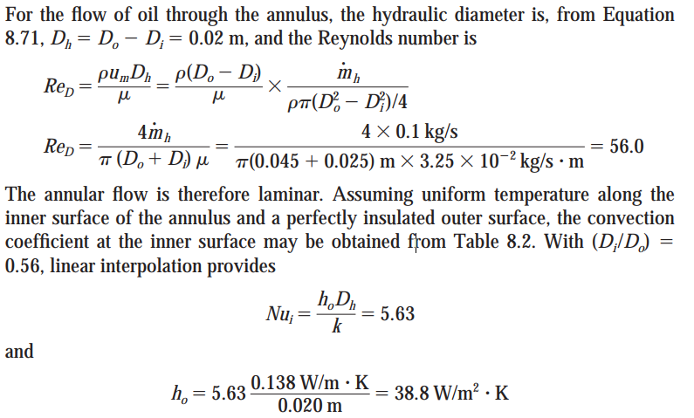
EXAMPLE 11.1

Slide 14
EXAMPLE 11.1
Our chart for U says a concentric tube heat exchanger between oil and water should be U = 110-350 W/m²K. But in this case with the oil flow being laminar (and with a very low convection coefficient) the overall heat transfer coefficient is *much* lower.

Slide 15
EXAMPLE 11.1
Let’s calculate the heat exchanger effectiveness for this problem as well.
or
But since we already know the heat transfer rate we can also use the equation:
Running some equations in EES……

Slide 16
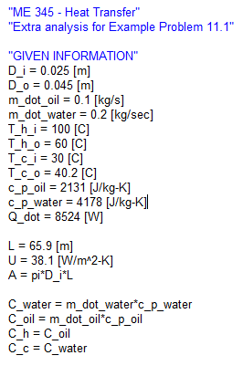
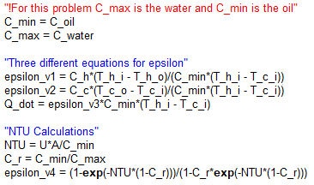
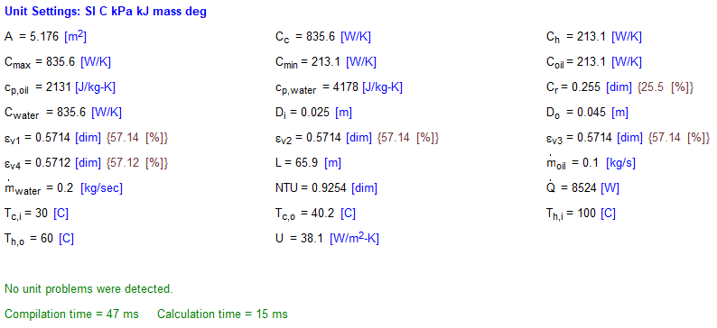
EXAMPLE 11.1

