Slide 1
ME 433 Internal Combustion Engines
Professor:
Dr. Dan Cordon (AKA Dr. Dan)

Slide 2
Road Load Modeling
We can use Equations of Motion (EOM) to model the steady-state power requirements or transient response of a vehicle.
The key forces acting on a road-going vehicle are depicted in the figure below.
Rolling Resistance (tires/bearings)
Drag Force (aerodynamics)
Weight (gravity)
θ
Propulsion Force (from engine/motor)

Slide 3
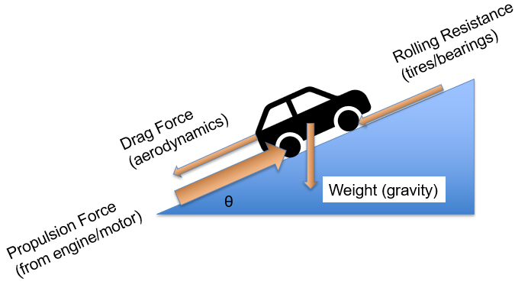
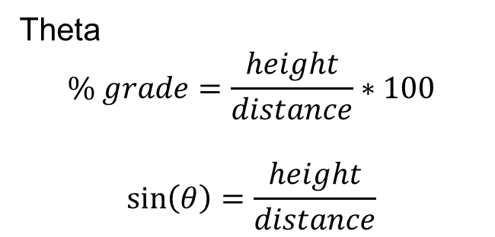
Σ Forces against Direction of Travel
Rolling Force
$${F_{R}=c}_{R}∗F_{normal}=c_{R}∗m∗g∗cos⁡(θ)$$
Gravity Force
$$F_{weight}=m∗g∗sin⁡(θ)$$
Drag Force
$$F_{D}=0.5∗c_{D}{∗ρ}_{air}∗A_{frontal}∗Vel^{2}$$
Theta
$$\% grade=\frac{height}{distance}∗100$$
$$\sin\left(θ\right)=\frac{height}{distance}$$
distance
θ
height

Slide 4
Typical Values
Rolling Force
For most rubber-tire vehicles the coefficient of rolling resistance is:
0.008 < c_{R} < 0.035
Drag Force
For most vehicle shapes the coefficient of drag is:
0.3 < c_{D} < 0.5
Frontal Area
Bicycle and Rider 0.3 – 0.5 [m²]
Motorcycle and Rider 0.5 – 0.8 [m²]
Small Car 1.6 – 2.0 [m²]
Typical Sedan 2.0 – 2.5 [m²]
Typical SUV 2.7 – 3.5 [m²]
Semi Truck ~9.5 [m²]

Slide 5
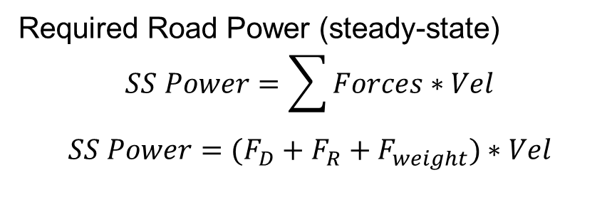
Power
Required Road Power (steady-state)
$$SS Power=\sum{Forces}∗Vel$$
$$SS Power=(F_{D}+F_{R}+F_{weight})∗Vel$$
$$SS Power=\left[0.5∗c_{D}{∗ρ}_{air}∗A_{frontal}∗Vel^{2}+c_{R}∗m∗g∗\cos\left(θ\right)+m∗g∗\sin\left(θ\right)\right]∗Vel$$
Calculate
Toyota Supra on Flat Ground
A_{F} = 2.23 [m²]
c_{D} = 0.38 and c_{R} = 0.01
Weight = 3415 lb_{f} = 15,190 [N]
Rho_{air} = 1.2 [kg/m³]
Speed = 35 [mph] = 15.7 [m/s]
Theta = 0
Calculate
Honda Accord on Lewiston Grade
A_{F} = 1.86 [m²]
c_{D} = 0.32 and c_{R} = 0.008
Weight = 3000 lb_{f} = 13,345 [N]
Rho_{air} = 1.2 [kg/m³]
Speed = 65 [mph] = 29.1 [m/s]
Theta = 3.7 [deg]

Slide 6
Σ Forces = m*a
Acceleration Model
If you have a Torque and Speed at the engine you’re just a few steps away from having a Force and Velocity at the wheels.
Remember that for geartrains the gear ratio (either the radius ratio or number of teeth ratio) will act as a torque multiplier and a speed reducer.
The velocity of the tire-road interface can be related to the tire radius and RPM of the tire.
$$Torque_{out}=Torque_{in}∗\frac{75 teeth}{25 teeth}$$
$${RPM}_{out}={RPM}_{in}∗\frac{25 teeth}{75 teeth}$$
$$Velocity=Radius∗\left(2π\right)∗RPM$$
$$SS Power=\left[0.5∗c_{D}{∗ρ}_{air}∗A_{frontal}∗Vel^{2}+c_{R}∗m∗g∗\cos\left(θ\right)+m∗g∗\sin\left(θ\right)\right]∗Vel$$

Slide 7
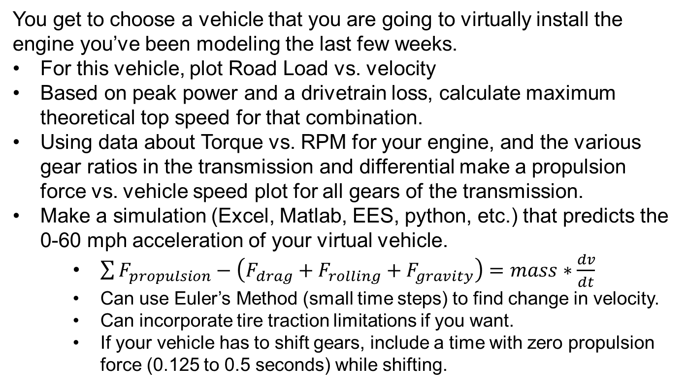
Week 8 Homework
You get to choose a vehicle that you are going to virtually install the engine you’ve been modeling the last few weeks.
For this vehicle, plot Road Load vs. velocity
Based on peak power and a drivetrain loss, calculate maximum theoretical top speed for that combination.
Using data about Torque vs. RPM for your engine, and the various gear ratios in the transmission and differential make a propulsion force vs. vehicle speed plot for all gears of the transmission.
Make a simulation (Excel, Matlab, EES, python, etc.) that predicts the 0-60 mph acceleration of your virtual vehicle.
$\sum{F_{propulsion}−\left(F_{drag}+F_{rolling}+F_{gravity}\right)=mass∗\frac{dv}{dt}}$
Can use Euler’s Method (small time steps) to find change in velocity.
Can incorporate tire traction limitations if you want.
If your vehicle has to shift gears, include a time with zero propulsion force (0.125 to 0.5 seconds) while shifting.
$$SS Power=\left[0.5∗c_{D}{∗ρ}_{air}∗A_{frontal}∗Vel^{2}+c_{R}∗m∗g∗\cos\left(θ\right)+m∗g∗\sin\left(θ\right)\right]∗Vel$$

