Slide 1
ME 433 Internal Combustion Engines
Professor:
Dr. Dan Cordon (AKA Dr. Dan)

Slide 2
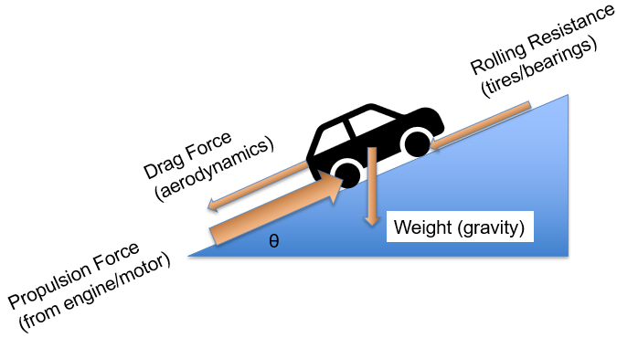
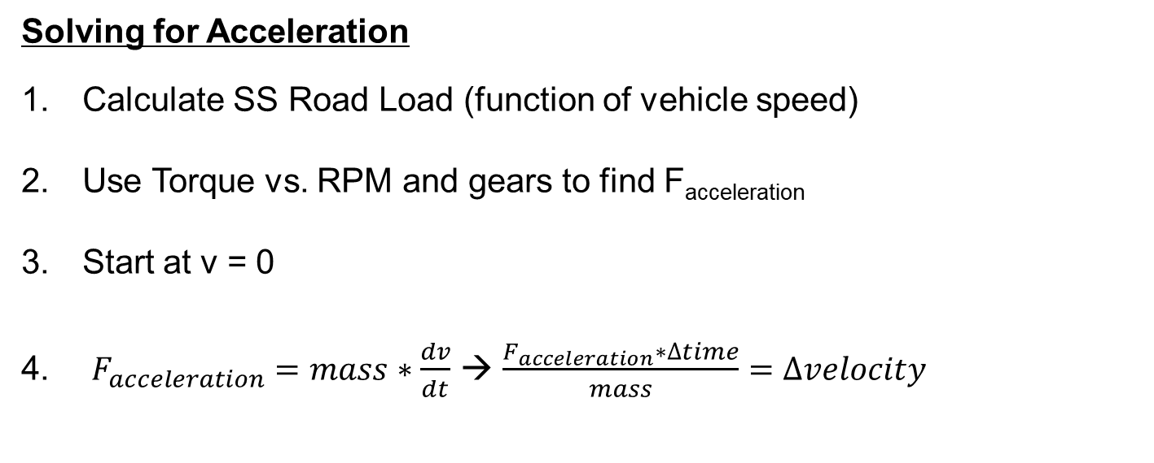
Last Lecture Ended With
$$F_{acceleration}=F_{propulsion}−\left[0.5∗c_{D}{∗ρ}_{air}∗A_{frontal}∗Vel^{2}+c_{R}∗m∗g∗\cos\left(θ\right)+m∗g∗\sin\left(θ\right)\right]$$
Solving for Acceleration
Calculate SS Road Load (function of vehicle speed)
Use Torque vs. RPM and gears to find F_{acceleration}
Start at v = 0
$F_{acceleration}=mass∗\frac{dv}{dt}$ → $\frac{F_{acceleration}∗∆time}{mass}=∆velocity$

Slide 3
Limitations of This Model
This model is going to over-predict the rate of acceleration for the following reasons:
It assumes all propulsion force will results in vehicle acceleration. There is a maximum tire propulsion force, and if the engine/drivetrain is capable of more than this, the model will be way off. The model assumes infinite traction.
We can calculate a maximum tire propulsion force using something simple like F_{tire} = mu_{k}*F_{normal}
We can go one step better and using kinetic moments from ENGR 220 to see how F_{normal} changes with acceleration (good for RWD cars, bad for FWD cars)
Our model only accounts for translational acceleration.
Angular acceleration can make up nearly 25% of the acceleration (especially at low vehicle speeds)
For every rotating part we should also include: $\sum{T}=I∗α$

Slide 4
Hybrid FSAE Acceleration Modeling
We did a ground-up vehicle design for the Hybrid FSAE competition. It took two years to create our math model and measure all the components, but once we had a full simulation, we made some great discoveries.
Our 0-60 simulation was within 0.05 seconds of the actual vehicle acceleration. There was more than a 0.05 second variation in each data collection, so we had to take dozens of runs to get our confidence interval small enough to confirm our simulation was more accurate than our vehicle.
Where to add electric motor?
Our first car put the motor on the crankshaft → Torque multiplication from transmission resulted in higher propulsion force.
Simulated motor on transmission input, transmission output, differential input, and axle shafts.
High rotating inertia, and higher alpha made it more advantageous to move motor further downstream than logic dictated.

Slide 5
Vehicle Racetrack Modeling
What about simulating a vehicle going around a race track?
Need to Know, and How to Measure:
Everything for linear acceleration model
Additional road load forces when vehicle is turning (tire scrub as a function of speed and arc radius)
With electric-only propulsion, can measure power output and speed to calculate torque at motor.
Drive in a series of circles at various constant speeds.
Alignment and suspension geometry change these values.
Track layout (straight lengths, corner radiuses, and track width).
Satellite images were a huge help.
Any banking on the track (especially corners)
YouTube videos initially, then gathered track data each visit.
Predictions about friction coefficient changes around track
Drag a piece of rubber with a weight on top – measure force.
Maximum braking tire forces, maximum acceleration tire forces, and cornering tire forces.

Slide 6
Key Steps for Vehicle Racetrack Modeling
We need to model the track backwards (from the lowest speed in the final corner).
Use data about tire cornering forces to get: $\sum{F_{normal}=mass∗a_{normal}}$ and $a_{normal}= \frac{{vel}^{2}}{ρ}$
The above equation allows us to calculate the maximum velocity at any point in a corner
Now analyze the previous corner on the track to find the magnitude and location of minimum speed. Apply the acceleration model leaving that corner to get velocity as a function of position on the track.
Your model needs to switch from acceleration to deceleration (braking) such that you can slow the vehicle down to the speed necessary for the subsequent corner.
Analyze the previous, previous corner → Repeat the process
You get theoretical maximum velocity at any location on the track.

Slide 7
Discoveries from Vehicle Racetrack Modeling
Optimal cornering path was not always what math would predict. Largest constant radius is only true for steady-state cornering speed.
Red → Braking
Orange → Constant Speed
Green → Acceleration
With lower power vehicles conserving momentum (constant radius) returned fastest lap times.
If your braking and acceleration forcers are high compared to cornering forces, sometimes a non- symmetric line was faster.
If corner preceded a straightaway, corner exit speed was more important than mid-corner speed.
If corner was at end of a straightaway, the opposite shaped path provided lower lap times.

Slide 8
Discoveries from Motorcycle Road Racing
Turns on motorcycles have added complexity because the arc of a leaning motorcycle depends on:
Location of center of mass
Velocity
Steering head angle (and wheelbase)
Under braking the steering head angle gets steeper. Under braking the same lean angle will follow a tighter arc.
Under acceleration the steering head angle gets less steep, so the same lean angle will follow a wider arc.
Under steady-state velocity each tire has a contact patch about the size of a credit card – a little longer than it is wide.
Under braking the front tire contact patch gets….. And the rear contact patch gets….
Under acceleration the front tire contact patch gets….. And the rear contact patch gets….

