Slide 1
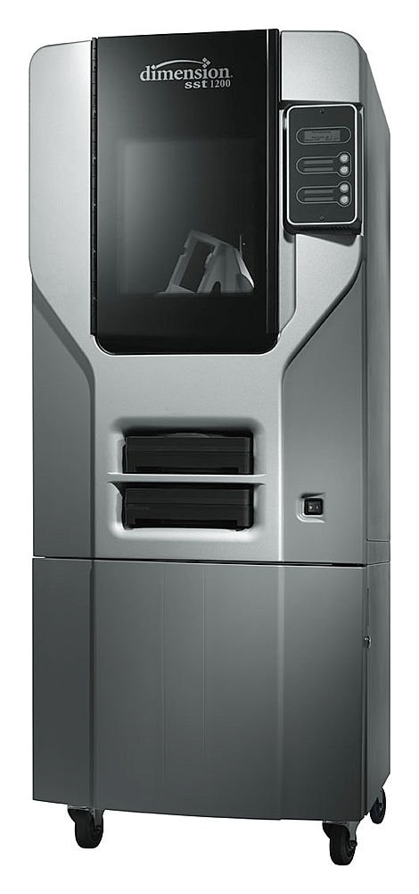
Dimension bst 1200 Rapid prototype printer
Dimension BST 1200 is an additive fabrication printer
Uses:
Inexpensive pre-production part inspection
Marketing
Concept evaluation
Tolerances .01inch in the z-direction
Located in GJ 115 Senior Design Lab
Cost*:
Lab Fee Supported Projects: $10 per cubic inch
Research and Other Independently Funded Research: $15 per cubic inch
All projects should be for University of Idaho research. Not personal use or consultant work is allowed.
Contact Russ Porter (russp@uidaho.edu) or IEW
^{*as of 6/16/2011}
University Of Idaho

Slide 2
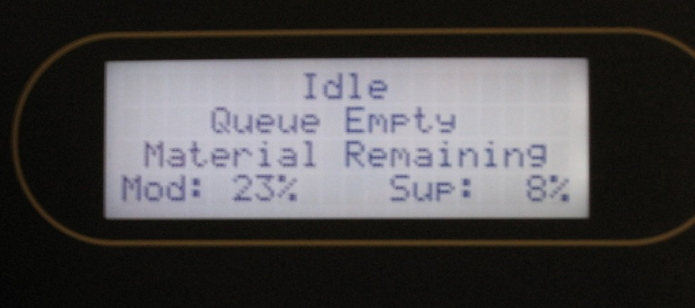
Setup Printer
Connect network cable to printer
Turn on RPM it takes 40 minutes to warm up
Switch is located on the front lower right of the printer
Printer status says “idle” when ready
New vs. Used Bases:
New bases can be purchased
Used bases can be used if cleaned properly

Slide 3
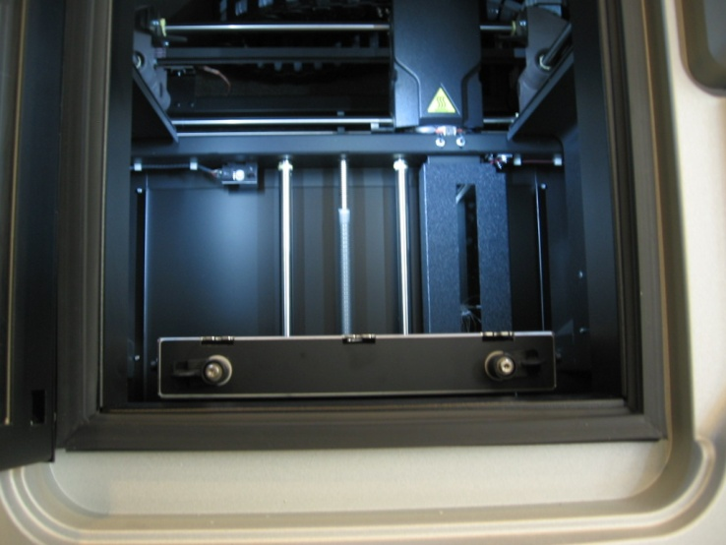
Inserting Base Plate
Place plate onto platform until it settles into place
Push the plate straight back till it stops
Lock the plate in place
Use the two rotating retainer clips

Slide 4
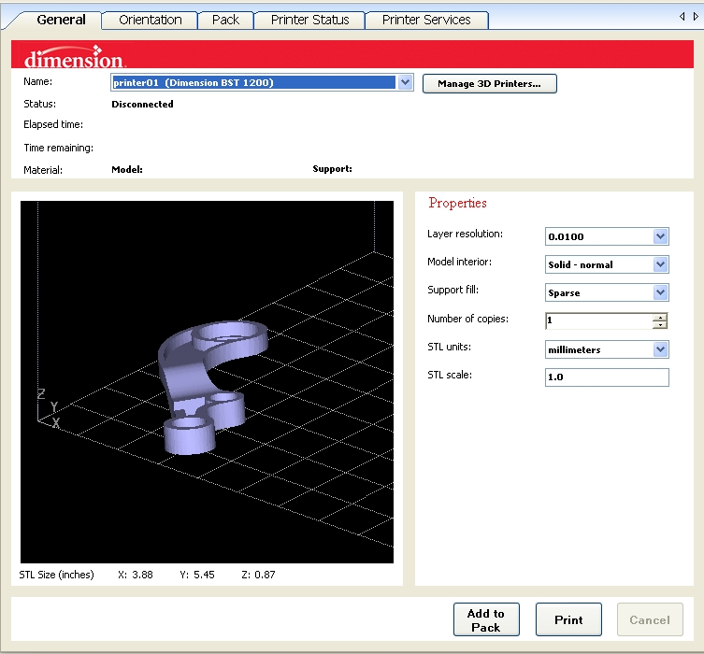
File Setup
Save part as an .stl file in parent program
Print single parts not whole assemblies
Open CatalystEX
Open the .stl file
Choose the interior and structural material setting under model interior and support fill
Check the units

Slide 5
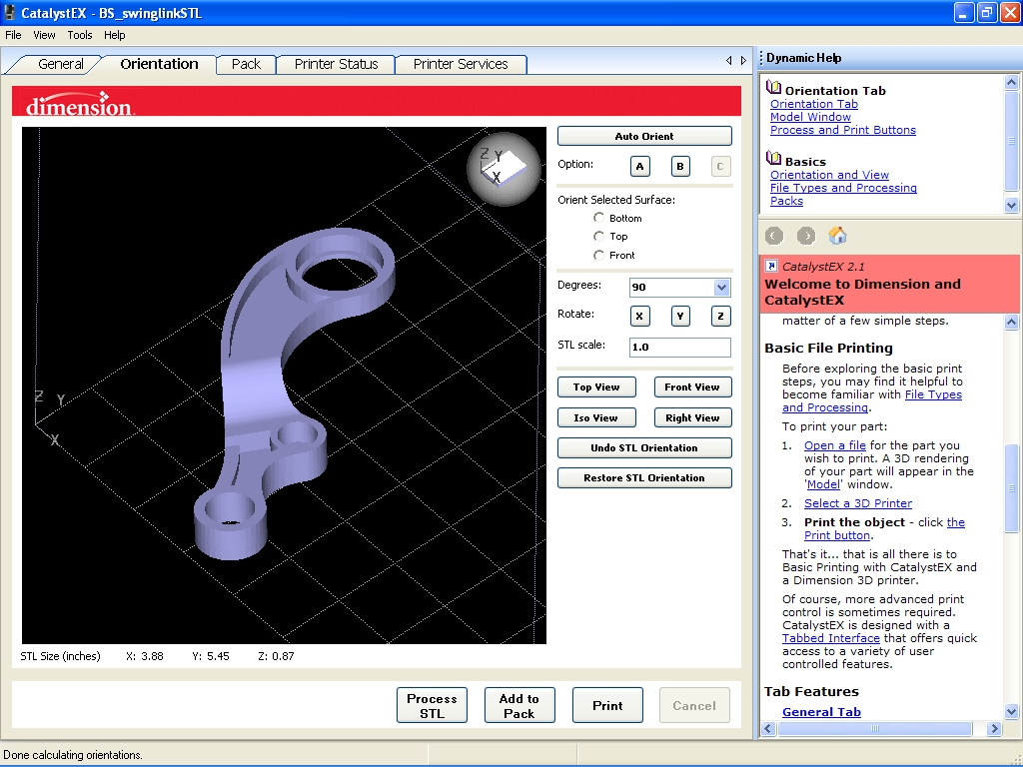
Orientation Tab
Orientation can be select by hand using the rotation button for each axis
“Auto Orient” can be selected if unsure
Once oriented select “Add to Pack”
Pack Tab
CatalystEx has a default pack set-up so that the parts do not overlap
Just click and drag part to move
Fill parts in the upper right hand corner first they will print faster
NOTE: danger of Nesting see advanced .pdf

Slide 6
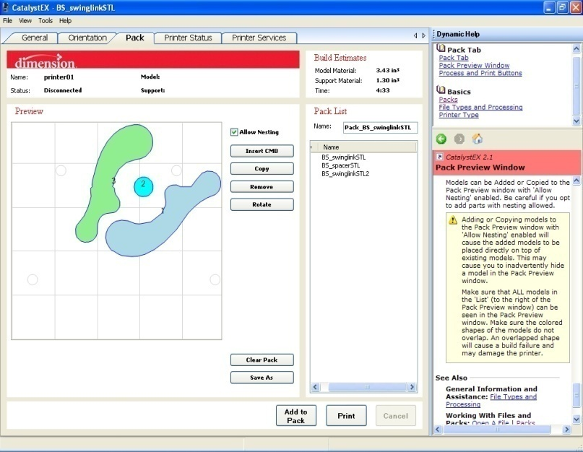
Printing
Push “Wait for Part” button on the printer after the pack is finished
Wait for prompt “Is Model Base Installed”
In CatalystEx press Print
NOTE: Cartridge contains 56.3in³ if you need more see advanced refilling the printer .pdf

Slide 7
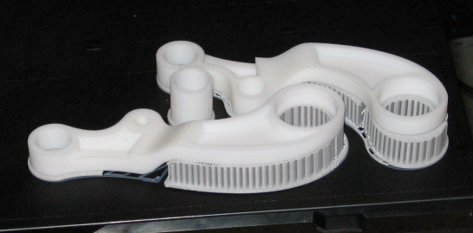
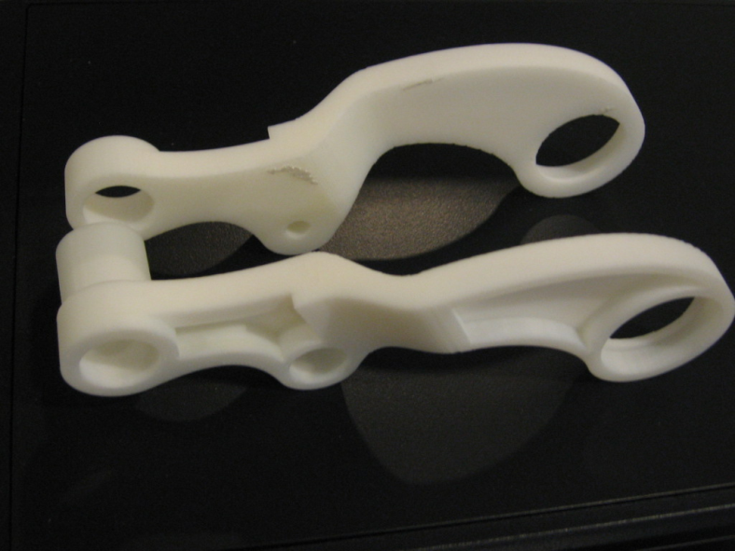
Finished Product
Remove parts while still warm
Flex the board from the two opposite corners
Remove the support material from the finished product
This can be done by hand or carefully remove with a razor blade
Return the base back to the used stack

Slide 8
Cleaning the Printer
Vacuum out the printer (shop vac)
Check printer head for debris
Empty junk cartridge
Shut down the printer

