Slide 1
Bark beetle outbreaks in North America
and climate change
These slides illustrate the extent, causes, and consequences of bark beetle-caused tree mortality in North America, with an emphasis on the role of climate change.
The focus is on my research. However, to make important points, I include reviews of others’ research and results of other studies. Of course, there are additional studies that make similar points, sometimes better.
The slides are divided into three parts: 1) extent of outbreaks; 2) causes of outbreaks, including climate change; and 3) consequences of outbreaks.
Notes below each slide provide additional information and references.
Please retain photo and figure credits.
Feel free to contact me with feedback or requests (jhicke@uidaho.edu).

Slide 2
1. Extent of outbreaks
The next slide shows “affected area”, which includes live trees and is what is commonly reported.

Slide 3
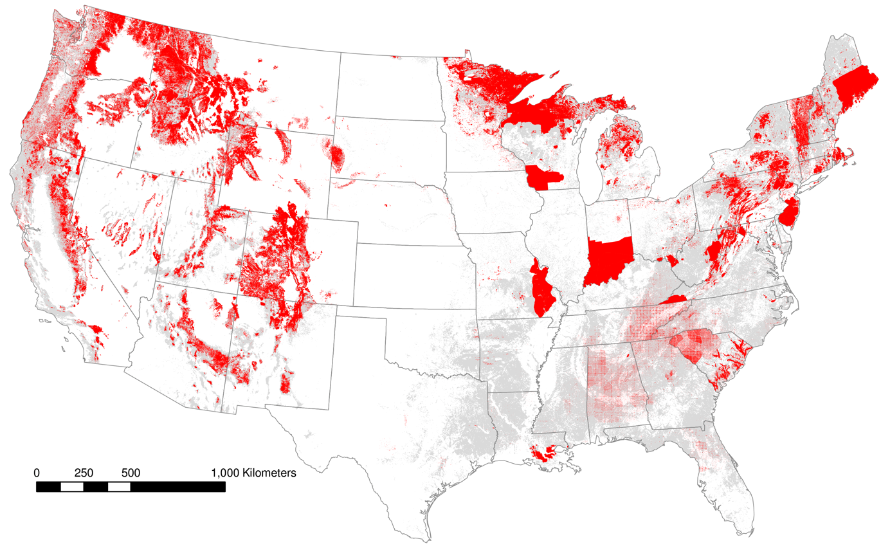
Insect outbreaks are major forest disturbances in North America
affected area reported by aerial surveys, 1997-2010
Hicke et al., Global Change Biology, 2012
Notes:
“Affected area” includes live trees and is what is commonly reported
Most forests in the West affected by some insect
Eastern forests also widely affected, but methods of documenting damage result in large polygons and more uncertainty about extent of impact

Slide 4
The next (remaining) slides show “mortality area” as developed in my lab (credit to Arjan Meddens). Mortality area is the area occupied by killed trees only, and is a better representation of the impact than affected area.

Slide 5
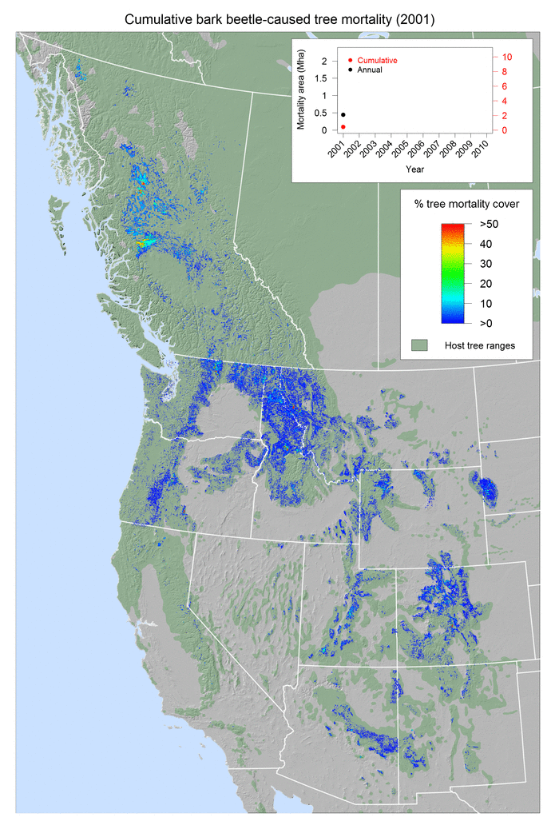
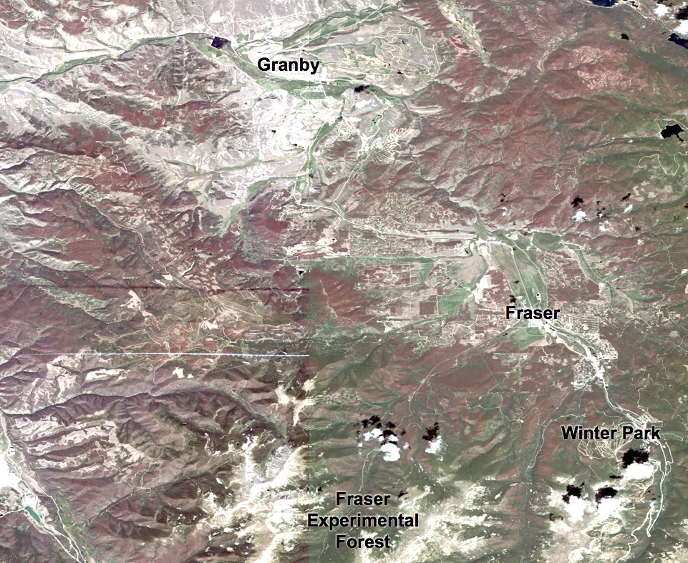
Bark beetle outbreaks are widespread and extensive in western North America
Central Colorado, 2007
Meddens et al., 2012; Hicke et al., 2016
Notes:
“Mortality area” = area occupied by killed trees only; about 25% of “affected area” reported by USFS, others
Map is an animation
6 billion trees killed by beetles and drought in the Western US, 1997-2010
comparison: CA in 2012-2016: 100 million trees
western US: 6.6 Mha/16 Macres of mortality, about 30% of the area of Idaho, about 7% of total forest area
greater than mortality by wildfires
½ of harvest
Right image from QuickBird satellite, central Colorado; all red areas are lodgepole pines killed by mountain pine beetle

Slide 6
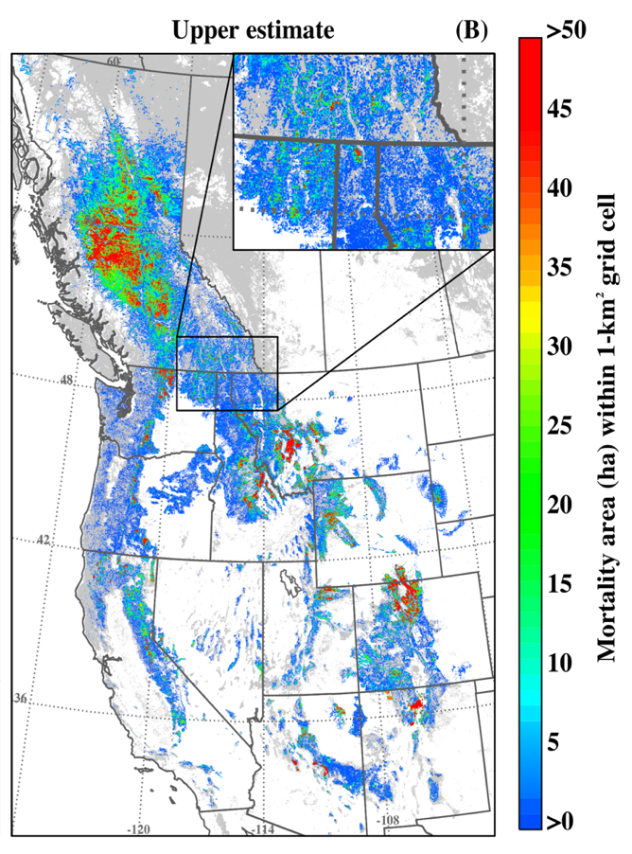
Bark beetles are significant forest disturbances
Cumulative mortality area, 1997-2010
Mortality area
Meddens et al., Ecological Applications, 2012 (updated)
Notes:
“Mortality area” = area occupied by killed trees only; about 25% of “affected area” reported by USFS, others
Map: Almost all forests (shown in gray with mortality in colors on top) are affected by beetle outbreaks (mostly low severity)
Time series:
middle estimate in US (gray line, plusses) is our most realistic estimate (because of comparisons with satellite imagery)
cumulative mortality in US almost that in BC
western US: 6.6 Mha/16 Macres of mortality, about 30% of the area of Idaho, about 7% of total forest area
greater than mortality by wildfires
½ of harvest

Slide 7
Bark beetle outbreaks are significant forest disturbances in western North America
Hicke et al., Forest Science, 2016
Notes:
“Mortality area” = area occupied by killed trees only; about 25% of “affected area” reported by USFS, others
Red arrow points to middle, most realistic estimate of beetle-caused tree mortality (out of three estimates per year)
More trees killed by beetles than wildfires

Slide 8
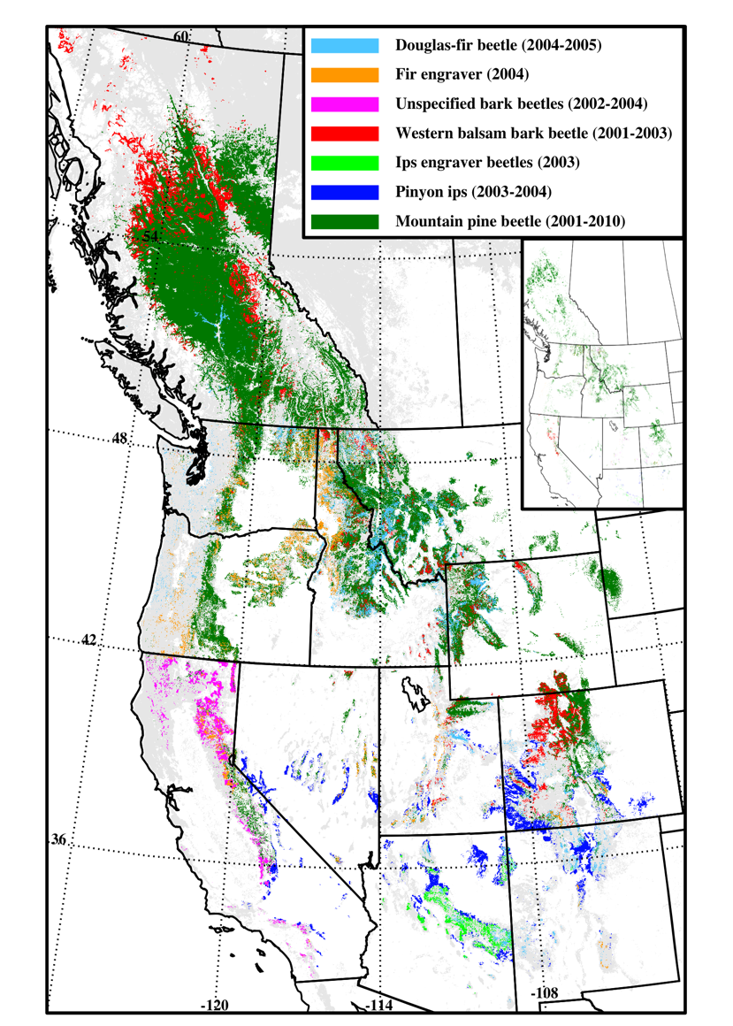
Major bark beetle outbreaks, 1997-2010
2001-2004
  pinyon ips
  engraver beetles
  Douglas-fir beetle
  unspecified bark beetles
  western balsam bark beetle
mountain pine beetle
  multiple outbreaks, 2001-2010
Meddens et al., Ecological Applications, 2012
Notes:
Map shows presence (not severity) and timing of different outbreaks; because there are multiple bark beetle species present in one grid cell sometimes, legend shows layering of different species (Doug-fir beetle drawn last, on top of fir engravers, on top of …), and inset shows second species that is covered/not visible in the larger map (usually mountain pine beetle)
A variety of beetle and tree species
Most Western forests have been affected

Slide 9
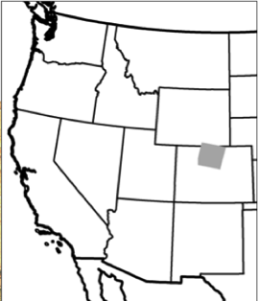
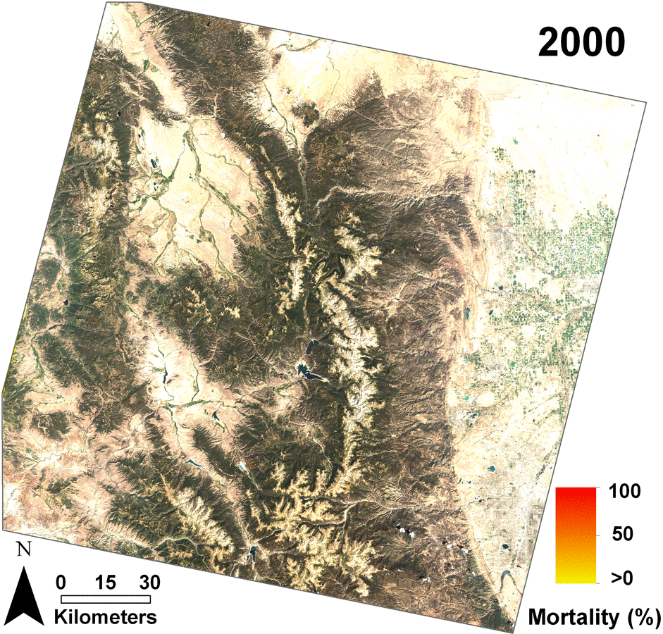
Mountain pine beetle from Landsat satellite imagery
22% of forest area killed
plot-level average:
  60% mortality within three years
Meddens et al., FEM, 2014
Notes:
Animation

Slide 10
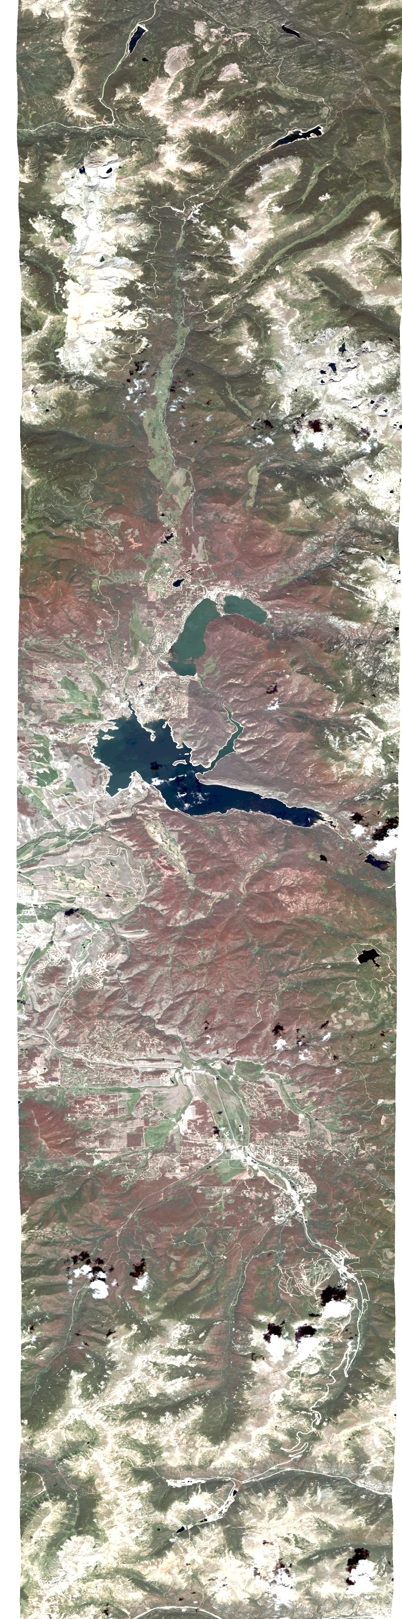
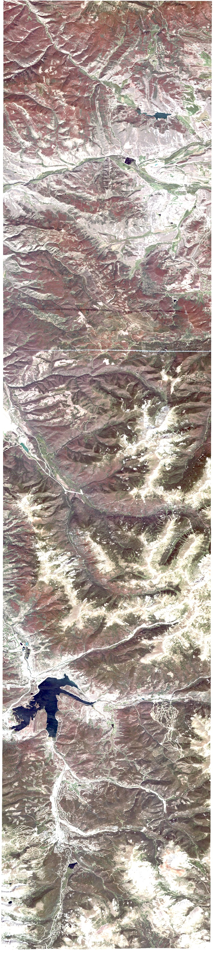
Rocky Mountain
National Park
Grand Lake
Granby
Fraser
Winter Park
Fraser Experimental Forest
Mountain pine beetle outbreak
Central Colorado
August 2007
QuickBird satellite imagery
  100 km/62 miles north-south
I70
Keystone
Mountain pine beetle outbreak
Central Colorado
August 2007
QuickBird satellite imagery
100 km/62 miles north-south
Breckenridge
Notes:
Animation showing north-to-south fly-over in central Colorado

Slide 11
2. Causes of outbreaks
Although there are many causes of and factors influencing bark beetle outbreaks (see Raffa et al., Bioscience, 2008 for more information), two main ones exist for large outbreaks: stand structure and climate.

Slide 12
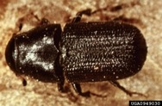
Factors influencing mountain pine beetle epidemics
Factors related to trees:
  presence of host tree species
  stem density
  stand age
  drought stress on trees
Factors related to beetles:
  nearby beetle source
  temperature effects on
    winter beetle mortality
    population synchronization/ one-year life cycles (year-round temperatures)
stand structure
climate
Photo courtesy USDA Forest Service, www.forestryimages.org
Safranyik et al. 1975; Shore and Safranyik 1992; Carroll et al. 2004; Logan and Powell 2001
Notes:
Text animates

Slide 13
Forest stand structure influences outbreaks
mountain pine beetle in lodgepole pine
USFS inventory data
47% of LPP is in a condition that would result in losses of 33% of basal area
Hicke and Jenkins, Forest Ecology and Management, 2008
Notes:
Higher values of Pine Structure Susceptibility Index shows counties with lodgepole pine in more susceptible conditions (more lodgepole trees; older, larger trees; higher stem density)

Slide 14
The next slide is for a talk that doesn’t want details, only an overview of the role of climate change and outbreaks.
Note that mountain pine beetle attacks a variety of pine species. Outbreaks in lodgepole pole have been attributed to climate change, though with less certainty given that extensive outbreaks were recorded early in the 1900s. Outbreaks in high-elevation whitebark pine seem to be a good signal of recent warming.

Slide 15
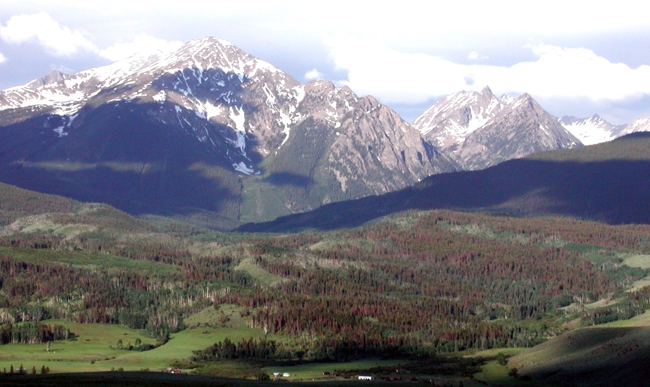
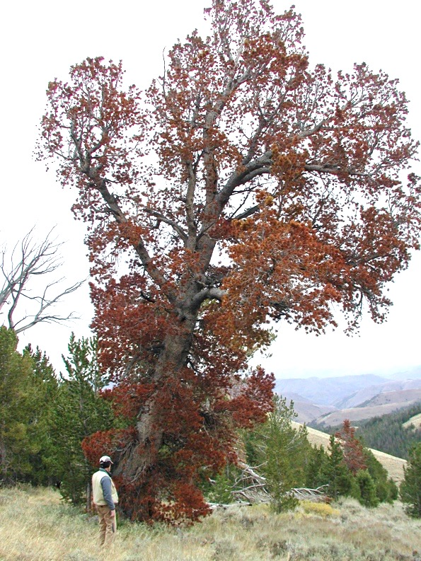
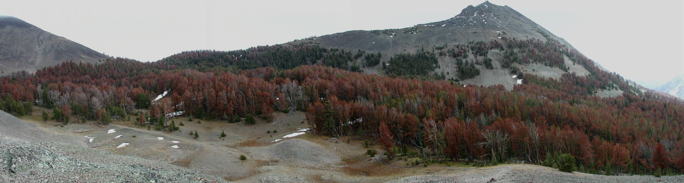
Roles of climate in recent outbreaks of mountain pine beetle: warming, drought
Photos by J. Hicke
Notes:
Warmer winters have resulted in decreased beetle mortality
Higher year-round temperatures have promoted successful mass attacks by beetles on host trees and shortened life cycles in some places from two years to one year
Drought in the 2000s stressed host trees and left them susceptible to attack
References: Bentz et al., BioScience, 2010; Preisler et al., Ecology, 2012; Weed et al., Ecological Monographs, 2013; Creeden et al., FEM, 2014; Buotte et al., Ecological Applications, 2016

Slide 16
The following slides illustrate several clear cases of the role of recent warming causing bark beetle outbreaks in North America:
mountain pine beetle in high-elevation whitebark pine
spruce beetle in Alaska
northward range expansion of southern pine beetle in New Jersey
a hotter drought in the Southwestern US in the early 2000s that, coupled with bark beetle outbreaks, killed lots of pinyon pines and other tree species
other cases not covered here:
  northward range expansion of mountain pine beetle in BC, Alberta
  recent California drought and bark beetles

Slide 17
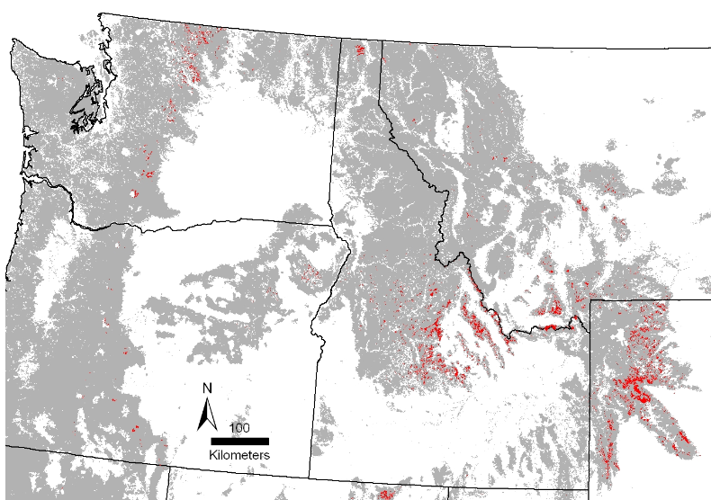
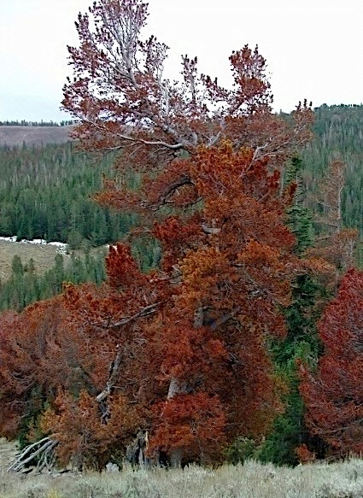
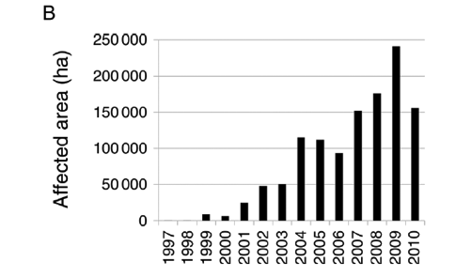
Whitebark pine mortality from beetles 1997-2010: Winter warming, drought in early 2000s
red = mortality
Photo Jeff Hicke
Weed et al., Ecol. Monographs, 2013; Buotte et al., Ecol. Apps., 2016

Slide 18
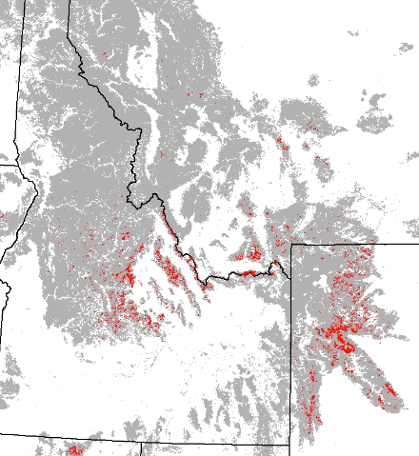

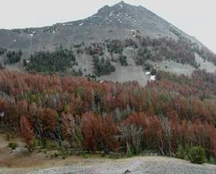
Future projection of climate suitability for mountain pine beetle outbreaks in whitebark pine
Suitability of winters for beetles in Greater Yellowstone Ecosystem
Weed et al., Ecol. Monographs, 2013
J. Hicke
Buotte et al., Ecol. Applications, 2016
Notes:
Colors indicate fraction of years within time periods that are suitable for mountain pine beetle outbreaks in whitebark pine stands in the GYE based on winter temperatures
Warming makes more of GYE suitable for beetles

Slide 19
Warm, dry summers promoted spruce beetle outbreaks in southern Alaska
Weed et al., Ecological Monographs, 2013
Notes:
This map is from a review of climate change effects on biotic disturbances in NA forests
Key references: Berg et al., FEM, 2006; Sherriff et al., Ecology, 2011

Slide 20
Warming winters facilitate range expansion of southern pine beetle into New Jersey
Weed et al., Ecological Monographs, 2013

Slide 21
Hotter drought caused extensive tree mortality in Southwestern US
Bark beetles were present and amplified mortality, but exact role unknown
Meddens et al., New Phytologist, 2015
Notes:
This map is from a review of drivers of pinyon pine mortality
Key reference: Breshears et al., PNAS, 2005

Slide 22
3. Consequences of outbreaks

Slide 23
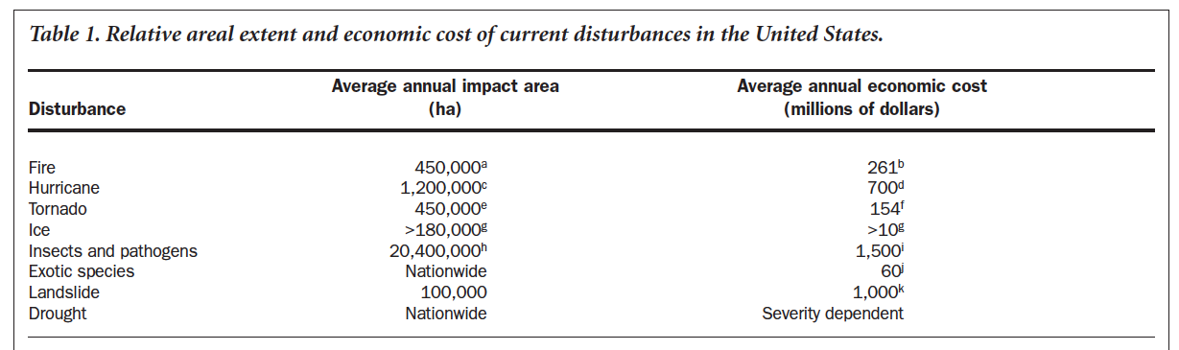
Economic impacts of forest disturbances
“Climate Change and Forest Disturbances”
Dale et al., BioScience, 2001

Slide 24
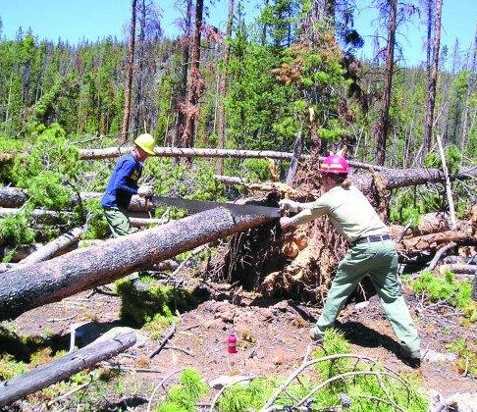
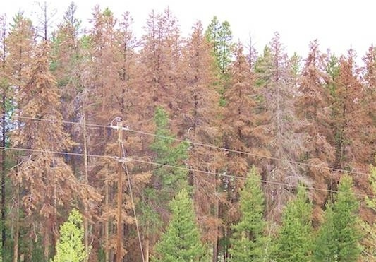
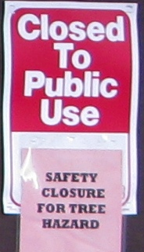
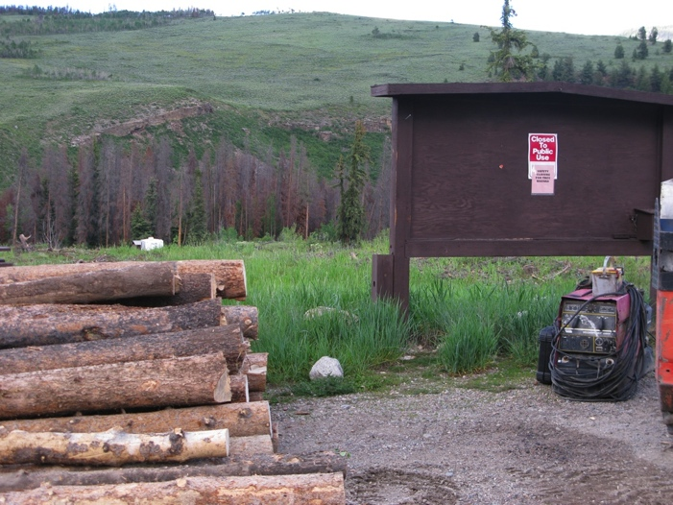
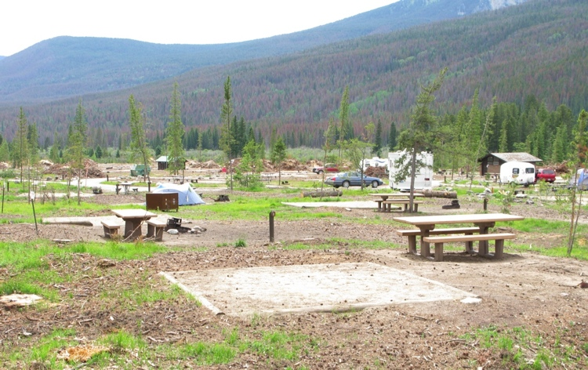
Trees killed by bark beetles:
impacts on infrastructure, recreation
www.realvail.com
trib.com
J. Hicke
J. Hicke
“Every day across the West, an estimated 100,000 lodgepole pines fall in the forest…” USFS

Slide 25
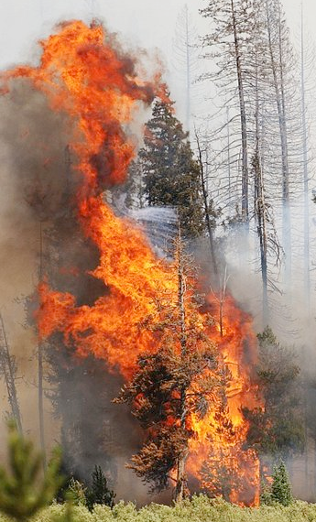
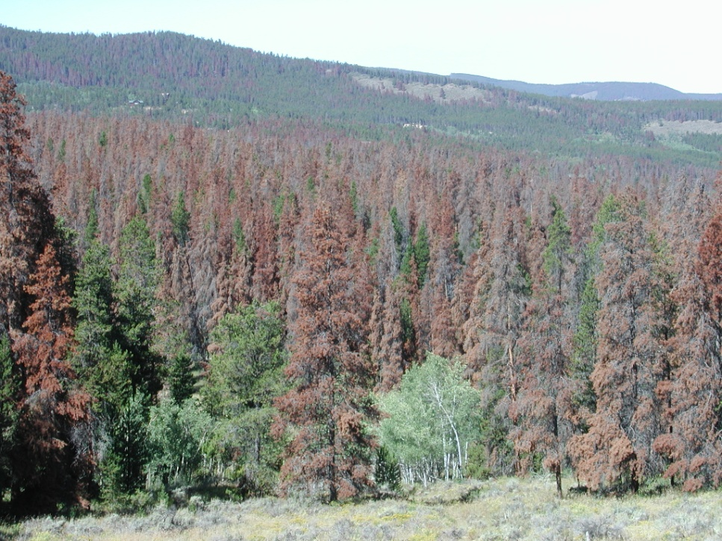
Do beetle-killed trees affect forest fires?
J. Hicke
Photo by Matt Stensland
www.steamboatpilot.com/news/2008/aug/17/dying_forests_increase_wildfire_danger_across_west

Slide 26

Conceptual framework of effects of beetle outbreaks on subsequent wildfire
Fuel characteristics
Fire characteristics
Hicke et al., Forest Ecology and Management, 2012

Slide 27
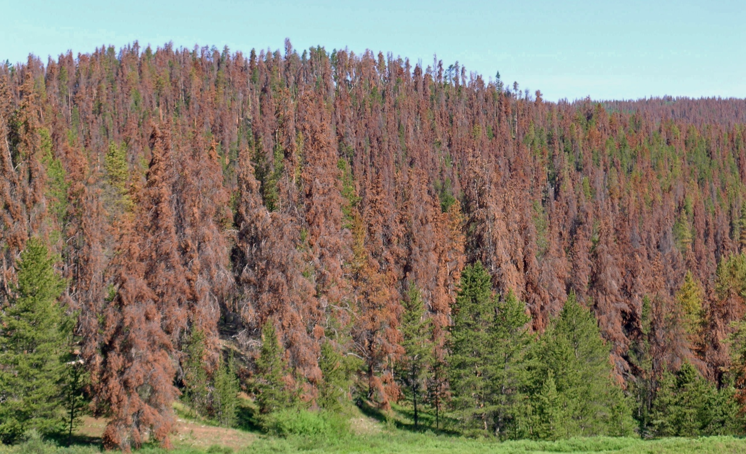
Fuel characteristics
Effects of bark beetle-caused tree mortality on wildfire
1-4 yr: red phase
Fire characteristics
J. Hicke
Hicke et al., Forest Ecology and Management, 2012
Notes:
red phase: drier needles, higher torching and active crown fire potential

Slide 28
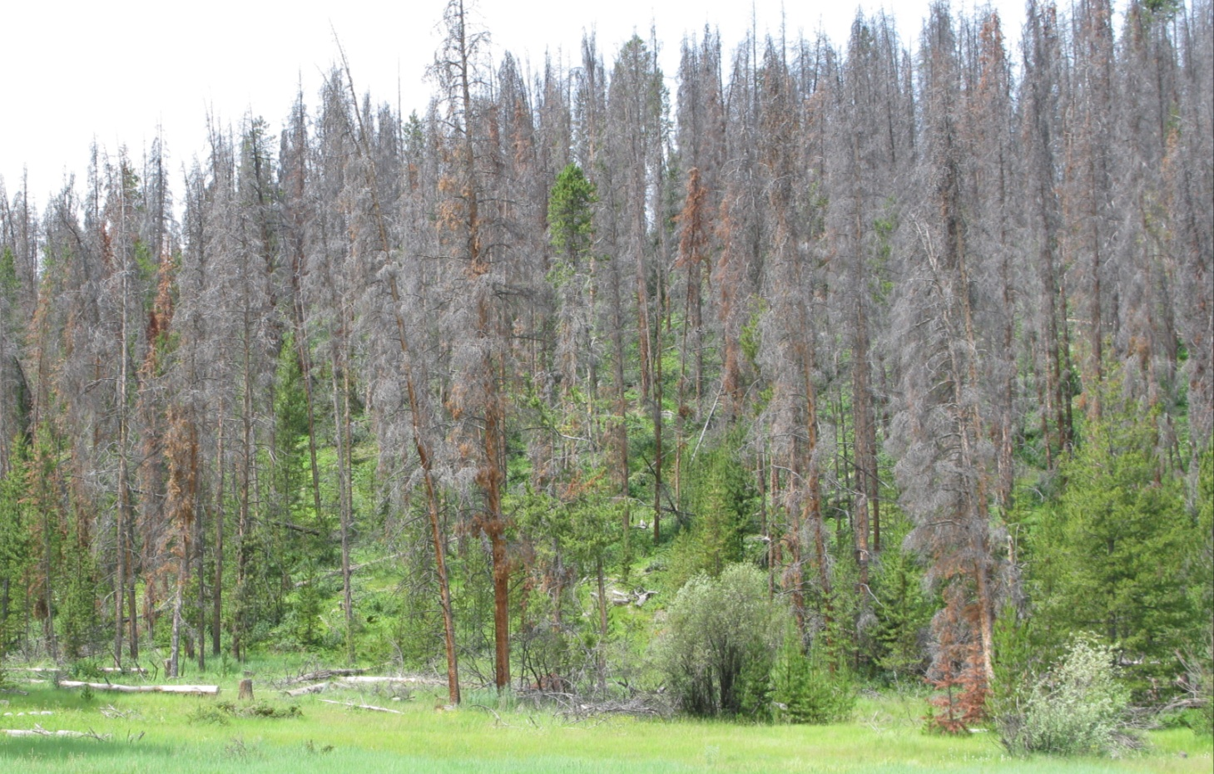
Fuel characteristics
Effects of bark beetle-caused tree mortality on wildfire
5-10 yr: gray phase
Fire characteristics
J. Hicke
Hicke et al., Forest Ecology and Management, 2012
Notes:
gray phase: needles have dropped to forest floor; less fuels in canopy lead to reduced crown fire potential; more surface fuels lead to increased surface fire intensity

Slide 29
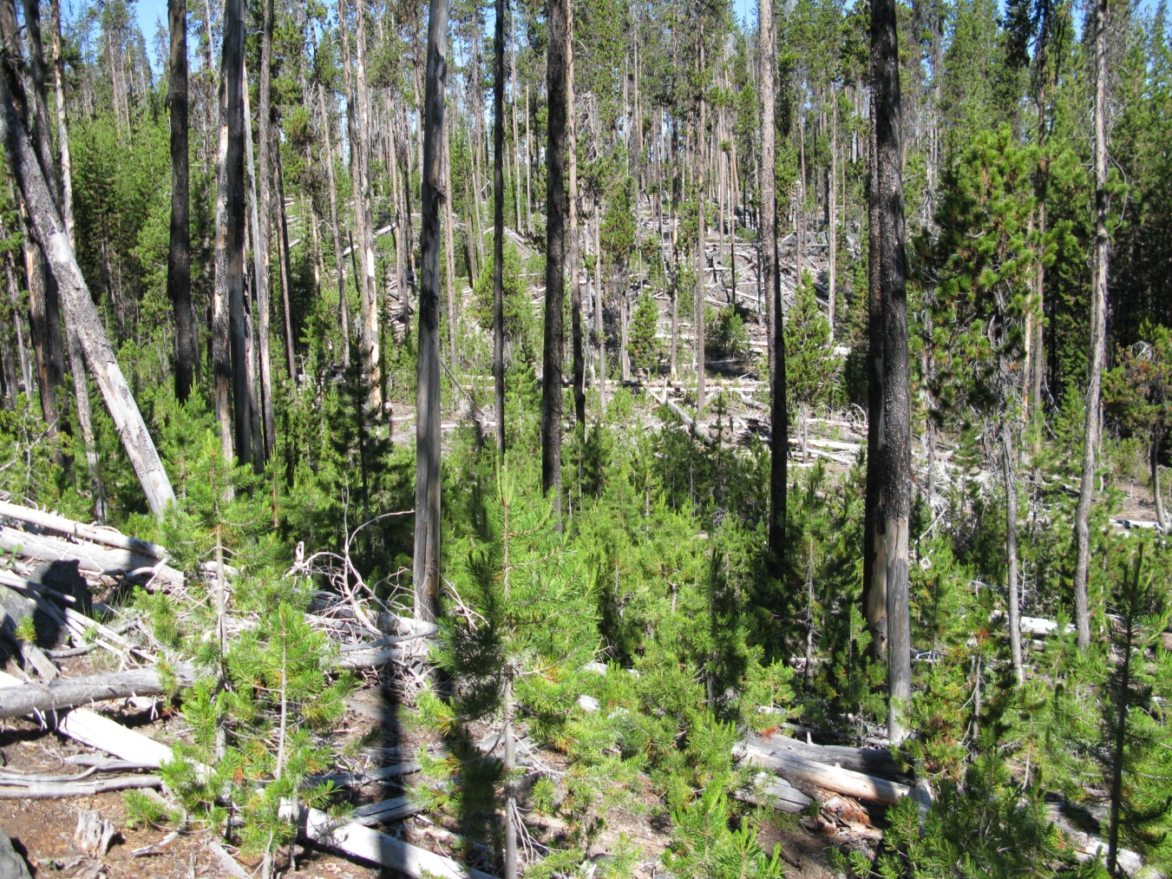
Fuel characteristics
Effects of bark beetle-caused tree mortality on wildfire
decades: old phase
Fire characteristics
J. Hicke
Hicke et al., Forest Ecology and Management, 2012
Notes:
old phase: snags have fallen; less fuels in canopy lead to reduced crown fire potential; more surface fuels lead to increased surface fire intensity

Slide 30
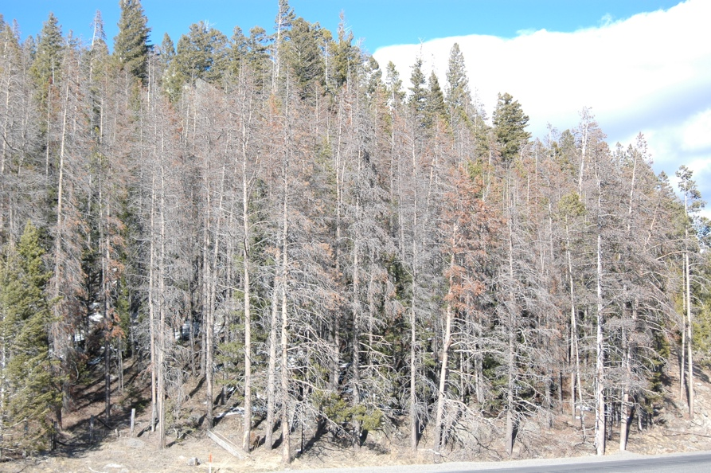
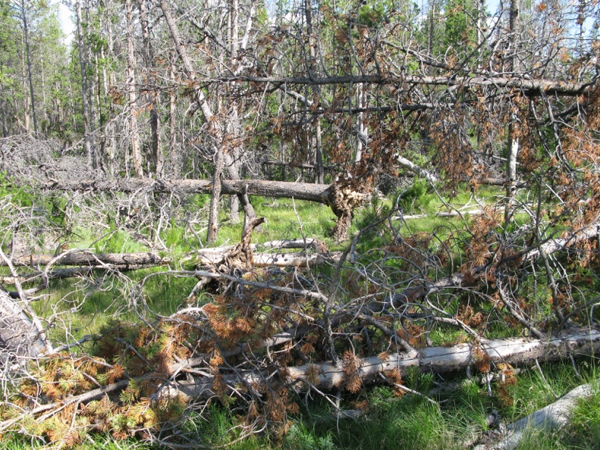
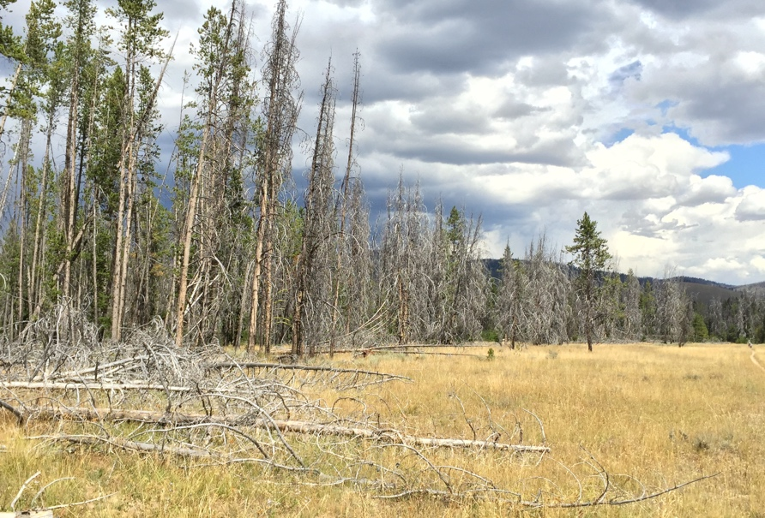
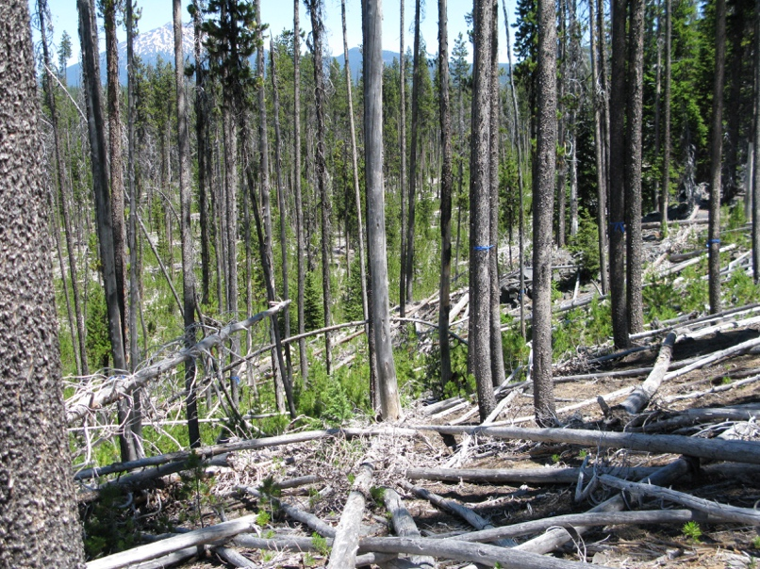
Consequences of tree mortality:
future climate change via carbon cycle feedbacks
J. Hicke
Notes:
western US: 289 Tg C in trees killed by beetles, 1997-2010 (5% of carbon in trees across entire western US)
US GHG emissions per year: 1873 Tg C (so C in WUS trees killed by beetles is 15%; but note that this compares the annual emissions (fluxes) to C stocks, and the C in killed trees will take decades to decompose and reach the atmosphere)
Kurz et al. (Nature, 2008) example; MPB affected Canada’s carbon policy because of the large emission of C from outbreak caused managed forests to be a C source, not sink as expected; amount of C released to atmosphere estimate to be equivalent to 5 years of emissions from Canada’s transportation sector

Slide 31
Forest carbon stocks affected by beetle outbreaks
%C in trees killed by beetles (by ecoregion)
1997-2010
bark beetles: 289 Tg C
wildfires: 197 Tg C
BB+fires ≈ harvest
Hicke et al., ERL, 2013
Notes:
Trees killed by beetles, 1997-2010, contained 5% of carbon in all of forests of western US
US GHG emissions per year: 1873 Tg C (so C in WUS trees killed by beetles is 15%; but note that this compares the annual emissions (fluxes) to C stocks, and the C in killed trees will take decades to decompose and reach the atmosphere)

