Slide 1
Hicke’s Tips/Thoughts on Presentations
Here are some tips and my thoughts/preferences about giving presentations. Most of these suggestions are applicable to classroom presentations, shorter talks at scientific meetings, or longer seminars.
Preferences vary, but there is typically a rationale behind these suggestions…and the main idea is to convey your messages to your audience in the simplest, easiest, and quickest way possible.
Jeff Hicke
University of Idaho
jhicke@uidaho.edu
November 1, 2016 (updated 3/4/24)

Slide 2
Preparation
You should be the expert in the topic of your presentation, and that should show in your presentation style, delivery, and answers to questions
  know the background
  know your study well
    for example: why did you choose your methods? how do they compare with other methods?
  can you extrapolate your conclusions to other systems/locations?
  know your limits
    don’t try to fool people

Slide 3
Time (length) of presentation
know the time limit, and pay careful attention to it when developing your talk
do not go over limit (rude and inconsiderate!)
  so practice!
count on an average of 1 slide per minute
  will vary depending on your style
too many slides too fast will anger your audience
often: leave 5 minutes for questions`

Slide 4
Text should be able to be read quickly
use lists, bullets, phrases
animate text when in a list (like a summary/conclusions)
limit amount of text on a slide
  capture the key point(s) only; provide more details when speaking
don’t assume your audience knows your acronyms

Slide 5
Slide layout should allow for
quick grasp of key idea(s)
slide title can convey key idea
minimal text and figures
if you have text on top of pictures or figures, ensure it can be read easily
  use contrasting color
  use text “glow”
figures/pictures should not be pixelated
lots of horizontal and vertical whitespace
I find PowerPoint’s defaults boring

Slide 6
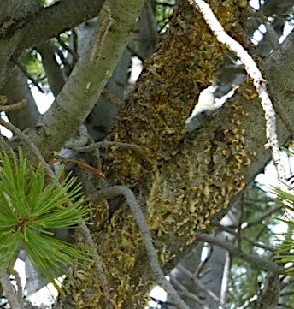
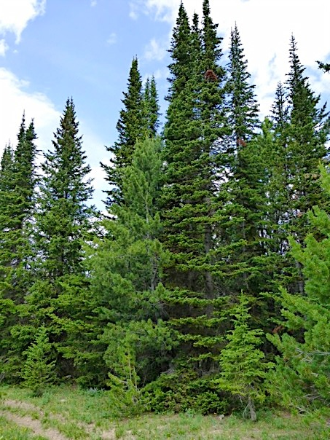
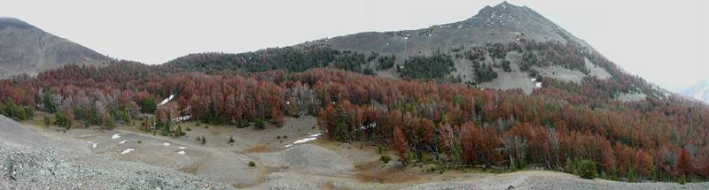
Whitebark pine: recommended as threatened/endangered
climate
white pine blister rust
fire suppression
Photo: P. Buotte
Photo P. Buotte
Warwell et al., 2007
mountain pine beetles
Photo Jeff Hicke

Slide 7
Content
Outline
  for a longer talk (45 minutes), use an outline that you keep coming back to
  for a short talk (10-15 minutes), not necessary?
  number sections to provide guidance

Slide 8
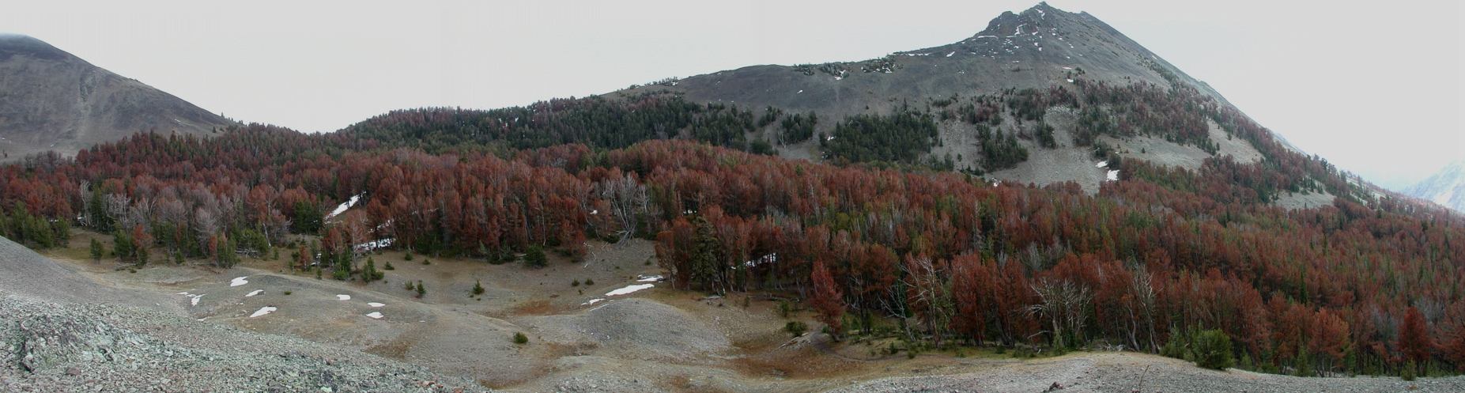
Study questions
What were climate-beetle relationships?
What were the most important drivers of mountain pine beetle outbreaks in whitebark pine stands in the GYE?
What are projections of future outbreaks given expected climate change?
J. Hicke

Slide 9
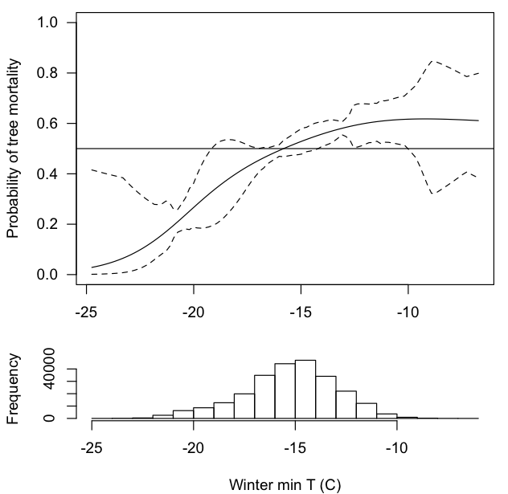
1. Climate-beetle relationships
winter mortality
Probability of tree mortality
beetle survival increases
Winter minimum temp (C)
Buotte et al., Ecol. App., in press

Slide 10
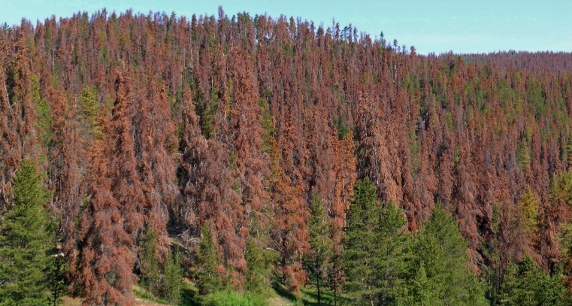
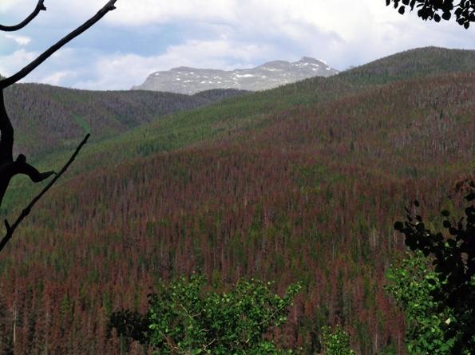
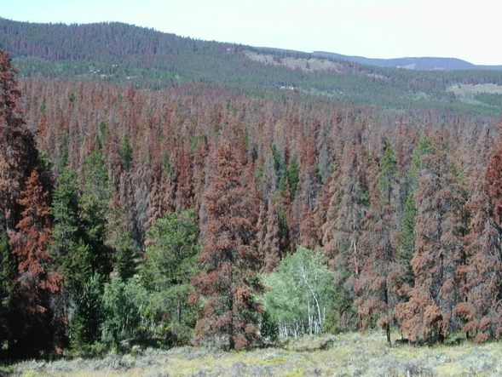
Outline
extent and severity
causes
impacts
management options
Photos by J. Hicke
Outline

Slide 11
Outline
extent and severity
causes
impacts
management options
Photos by J. Hicke
Outline

Slide 12
Content
some people prefer listening to you instead of reading a slide
  see TED style
  style may be for public; scientists want to see the data
  as a listener, I like best having key points on figure and/or text with reinforcement/additional explanation from speaker

Slide 13
Bark beetle outbreaks are significant forest disturbances in western North America
Hicke et al., Forest Science, 2016

Slide 14
Content
Title slide
  large text
  list all coauthors and affiliations
  underline yourself so listeners can find you quickly
  add some eye candy relevant to your study (pictures)

Slide 15
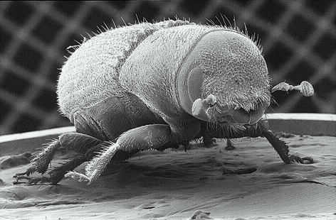
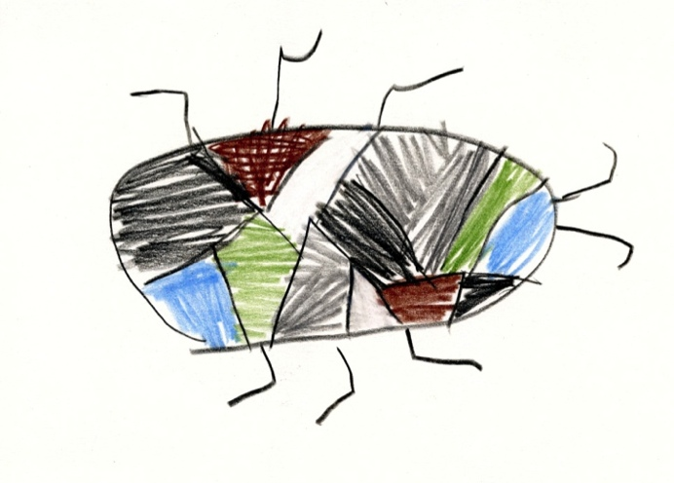
Climate Change and Bark Beetle Outbreaks in Whitebark Pine Stands of the Western United States
Jeffrey A. Hicke, U. Idaho
Polly Buotte*, U. Idaho
Haiganoush Preisler, USDA Forest Service
Kenneth Raffa, U. Wisconsin
Jesse Logan, USDA Forest Service (retired)
John Abatzoglou, U. Idaho
Funding: USGS NWCSC, USDA NIFA (FMEC)
Mountain pine beetle, electron microscope
Leslie Manning, Canadian Forest Service
Mountain pine beetle, colored pencil
Ava H., Age 6

Slide 16
Content
only include slides/figures that support your 3-5 main points (see summary/conclusions)
  for short talks, don’t include extraneous slides or slides that don’t support your main messages
  for longer talks, can afford to deviate somewhat
use arrows/boxes/etc. to indicate what you want the audience to focus on

Slide 17
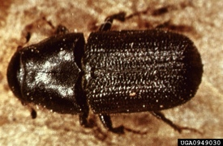
Factors influencing mountain pine beetle epidemics
Factors related to trees:
  presence of host tree species
  stem density
  stand age
  drought stress on trees
Factors related to beetles:
  nearby beetle source
  temperature effects on
    winter beetle mortality
    population synchronization/ one-year life cycles (year-round temperatures)
stand structure
climate
Photo courtesy USDA Forest Service, www.forestryimages.org
Safranyik et al. 1975; Shore and Safranyik 1992; Carroll et al. 2004; Logan and Powell 2001

Slide 18
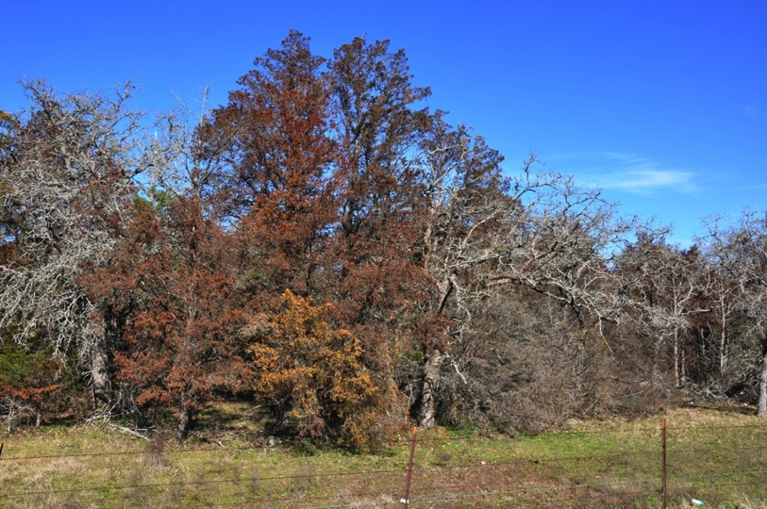
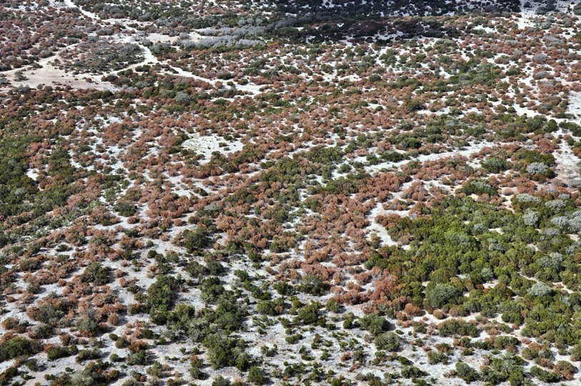
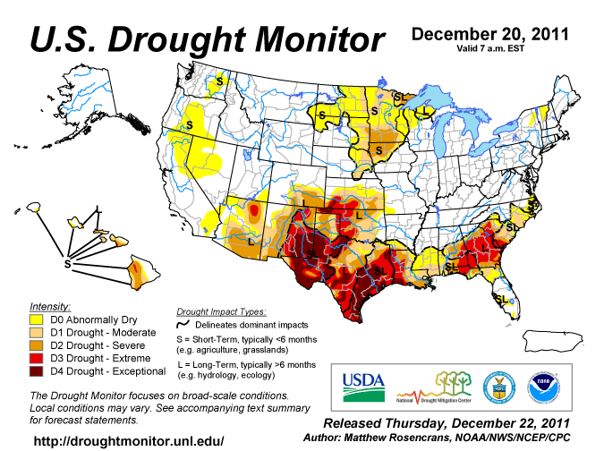
Drought: Tree mortality in Texas
“Texas may have lost 10% of its trees”, Texas Statesman, 2011
Hoerling et al., 2013
Photo credits: Dr. Ron Billings, Texas Forest Service

Slide 19
Content
Summary/conclusions
  provide a summary (consider reminding audience of your methods if special) and conclusion
  what are the 3-5 main points of your talk that you want the audience to remember

Slide 20
Summary
warming winters, drought contributed to recent outbreak in Greater Yellowstone Ecosystem
  clear example of climate change impacts
continued/increased climate suitability in future
likely similar outcomes in related systems, with some differences
J. Hicke

Slide 21
Content
Acknowledgements
  include those who have helped (but not coauthors) and funding sources
  some (most) have acknowledgements on the last slide
    I prefer to leave my conclusions up during questions, so I put mine in first or second slide

Slide 22
Climate Change and Bark Beetle Outbreaks in Whitebark Pine Stands of the Western United States
Jeffrey A. Hicke, U. Idaho
Polly Buotte*, U. Idaho
Haiganoush Preisler, USDA Forest Service
Kenneth Raffa, U. Wisconsin
Jesse Logan, USDA Forest Service (retired)
John Abatzoglou, U. Idaho
Funding: USGS NWCSC, USDA NIFA (FMEC)
Mountain pine beetle, electron microscope
Leslie Manning, Canadian Forest Service
Mountain pine beetle, colored pencil
Ava H., Age 6

Slide 23
Summary
warming winters, drought contributed to recent outbreak in Greater Yellowstone Ecosystem
  clear example of climate change impacts
continued/increased climate suitability in future
likely similar outcomes in related systems, with some differences
J. Hicke

Slide 24
Content
beware of unusual content (e.g., videos)
  presentation computers are different from yours
  if you’d like to show these, ensure you test beforehand
beware of Mac-to-PC or version transitions
  PowerPoint files created on a Mac and used on a PC, or on an earlier or later version of PowerPoint, can introduce errors
    beware of numbered lists

Slide 25
Content
Citations
  cite all statements not from your own study
    see other guide about citations and plagiarism
  cite all figures that are not your own
  cite all photos/images/figures (not doing so is plagiarism!)
  cite quotations and use quotes

Slide 26
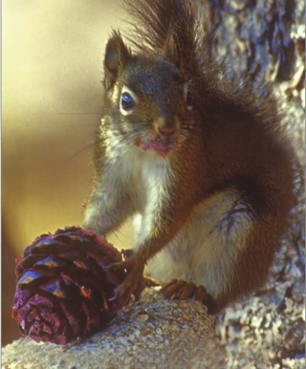
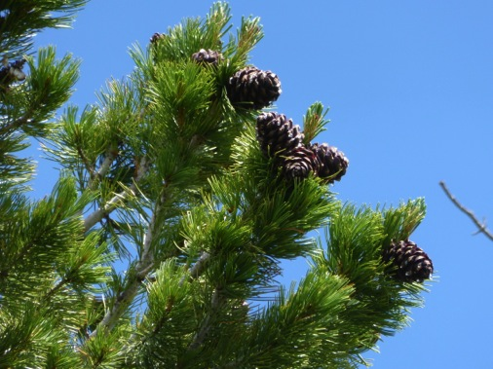
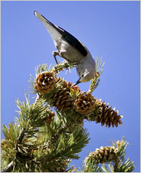
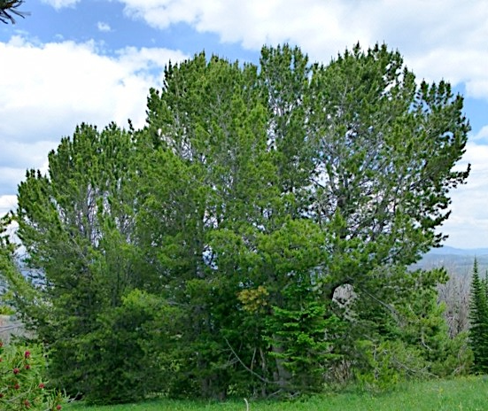
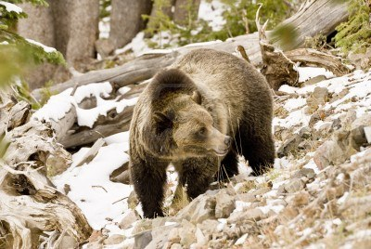
Whitebark pine: Ecologically important
A keystone and foundation species
fineartamerica.com/featured/red-squirrel-with-pine-cone-gary-beeler.html
Photo P. Buotte
Photo Richard Perry
Photo P. Buotte
Photo James Mattil

Slide 27
Colors should inform and highlight
but not distract
be aware of color blindness, especially red-green
yellow lines/text on white background is usually challenging to read
background
  dark (black, dark blue) is easiest to read

Slide 28
Figures preparation
(mostly) same rules as when creating a figures for a paper:
  clear, simple, labeled
  but figures in talks need to be clearer than in a paper: audience doesn’t have time to study it
    if you have a complicated figure, you can introduce the figure (go over axes, what is plotted, etc.) in a slide or two, perhaps clipping out parts of the figure you eventually show
  color figures are easier to read

Slide 29
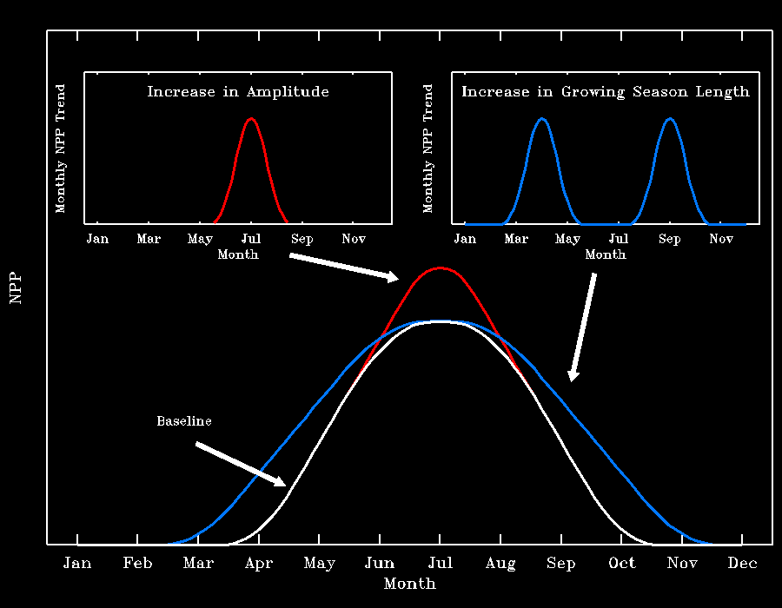
Color figures are easier to understand
(but take more work)
Hicke et al., 2002

Slide 30
Text: Colors/font should inform and highlight but not distract
color/font can highlight important ideas
color/font can be used to distinguish different sets of text

Slide 31
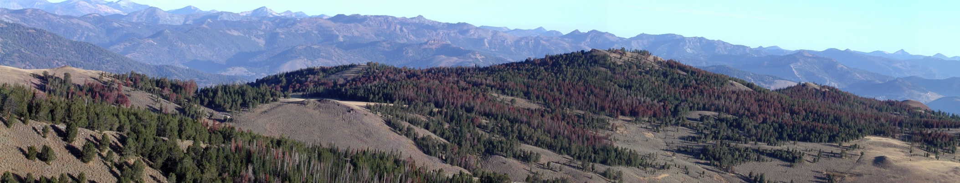

Recent bark beetle outbreaks
Mountain pine beetle: High-elevation whitebark pine
September 2005, Railroad Ridge, ID
October 2004, Sylvan Pass, Yellowstone NP
Photos: J. Hicke

Slide 32
Size: everything should be readable
from back of room
text
  title: larger (32 pt font?)
  main text: 24-28 pt
  citations: small (12-16 pt) and not distracting
figures
  large enough to be able to read all text
    if necessary, add text that duplicates the labels but is larger
  the fewer per slide the better
figure out the same aspect ratio between sitting in the back of a large seminar room and sitting at your desk; for me, I need to sit back far enough that my hand covers the display
  then review your slides at this distance

Slide 33
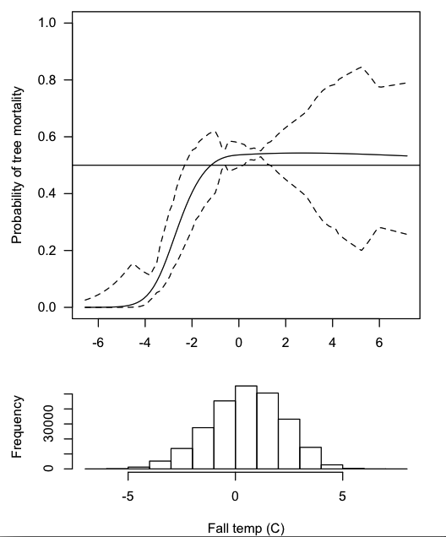
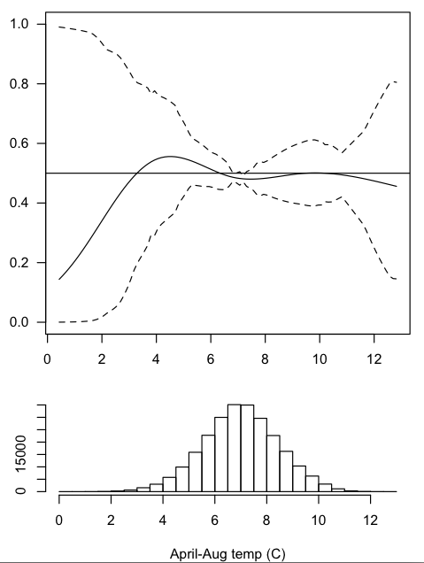
1. Climate-beetle relationships
year-round temperatures
Buotte et al., Ecol. App., in press

Slide 34
1. Climate-beetle relationships
year-round temperatures
frequency Probability of tree mortality
Fall temp (C) April-Aug temp (C)
Buotte et al., Ecol. App., in press

Slide 35
Delivery
don’t read text (from notes or the slides)
  if you really need to, adopt a style that mimics conversation (e.g., don’t talk in a monotone)
look at audience
  if possible, avoid looking back at screen (unless using pointer)
  make eye contact
  focus on positive listeners (builds confidence)
  review body language tips by Amy Cuddy (TED talk)
avoid fancy slide transitions, which can be distracting
  use simple animations like “appear” and “disappear”

Slide 36
Practice makes perfect
do not read from notes unless absolutely necessary; you should know your material well enough
you should practice enough times that you don’t have to stall, stutter, and figure out what’s on the slide at beginning of showing a slide
  you should have slide order memorized
you need not have the words come out the same every time (although that’s not bad)
  but the words should come out smooth

Slide 37
Practice makes perfect
practice in front of an audience
  most valuable is an interested, engaged audience who can give you feedback
when most of your talk is smooth (because you have practiced so much), focus your practice on the slides/figures/sentences that still give you trouble

Slide 38
Your actual presentation
if you are nervous
  practice, practice, practice
  review body language tips by Amy Cuddy (TED talk)
dress
  dress appropriately (find out from organizer or previous attendee, etc.)
  if in doubt, dress up (more formal)

Slide 39
Your actual presentation
(Well) Before your talk
  test microphone if possible
  learn the laser point/slide changer
  introduce yourself to the moderator
  know how to change slides in PowerPoint (backward as well)
  after loading onto presentation computer, go through your slides (critical!!!)
    well in advance of your talk to allow you to respond to a problem

Slide 40
Your actual presentation
pay attention to previous speakers
  are they hard to hear? why?
  are they having trouble with the computer/pointer/slide changer?
ensure you talk loudly enough to be heard (but don’t shout!)
  tricky to test, but at least be aware (use audience cues)
at start of talk, ensure microphone is adjusted
there might not be a laser pointer
  you may speak in a room with two screens…then what?
  use computer mouse and cursor
  practice so that you don’t need a pointer
  add arrows to figures to illustrate main points if helpful

Slide 41
Your actual presentation
Questions
  repeat question if faint or there’s a recording
  be honest: say “I don’t know” if you don’t
    but better:
      “I’m not sure, but I suspect that…”, or
      “Good point; I’ll have to investigate that”, or
      “I’d like to talk to you further about that” (and follow up!)
  don’t devolve into an extended one-on-one discussion; okay to say “let’s talk afterward”

Slide 42
File considerations
start file names with your last name to make finding or sorting by moderator/organizer (and you!) easier
  name your file with meeting name and date
compress figures with PowerPoint option to minimize file size (but not too much so that figures are pixelated/fuzzy)
have multiple backups (thumb drive, cloud storage, accessible email, phone, etc.)

