Slide 1
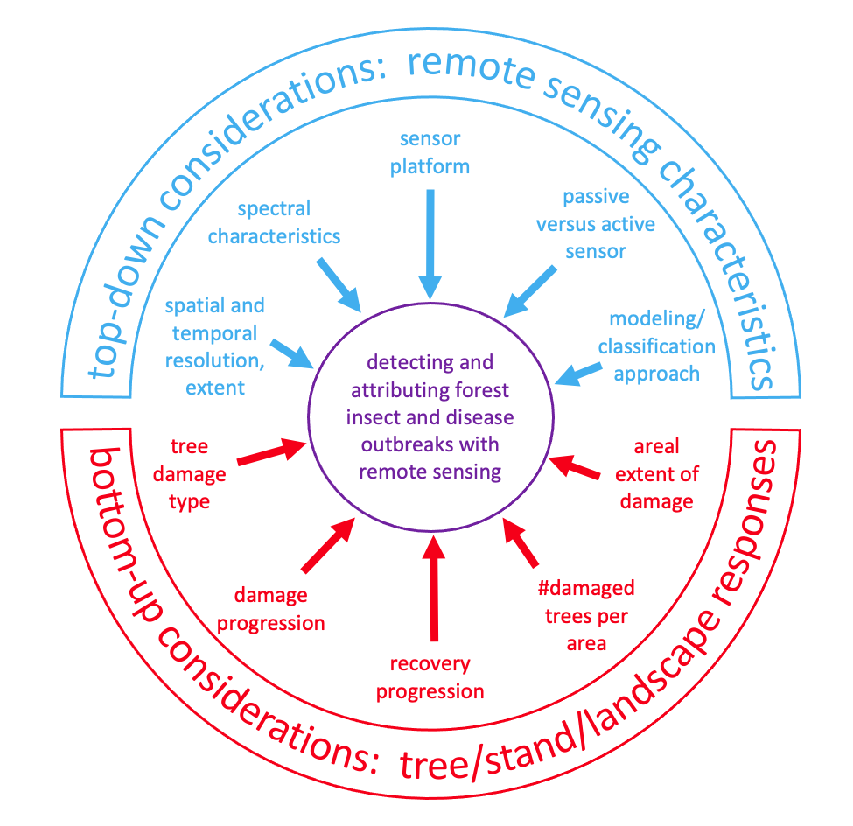
A review of remote sensing of forest insect and disease outbreaks: Bottom-up and top-down considerations for detection and attribution
J. A. Hicke, B. C. Bright, R. P. Hanavan, A. T. Hudak, A. J. H. Meddens, A. Shrestha, A. T. Stahl
submitted to Remote Sensing of Environment

Slide 2
Described remote sensing-related signatures of insects and diseases in western US
including variability within and among agents

Slide 3
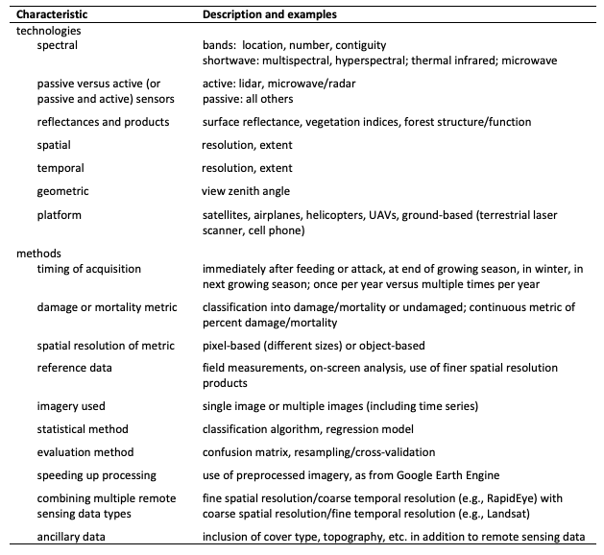
Reviewed remote sensing technologies and methods for detecting and attributing insects and diseases

Slide 4
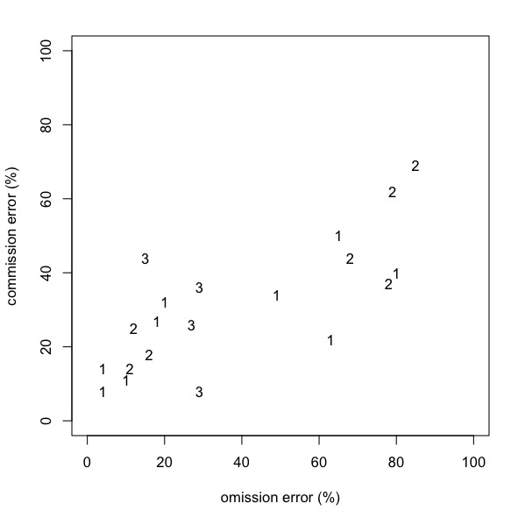
Characterized attribution studies
large errors: challenging to do!
Study Types based on level of attribution:
  Type 1: studies that lump insects with other disturbance types into one class (9 studies)
  Type 2: studies that separate one insect guild/species class from other disturbance types (7 studies)
  Type 3: studies that separate >1 insect guild/species (2 studies)

Slide 5
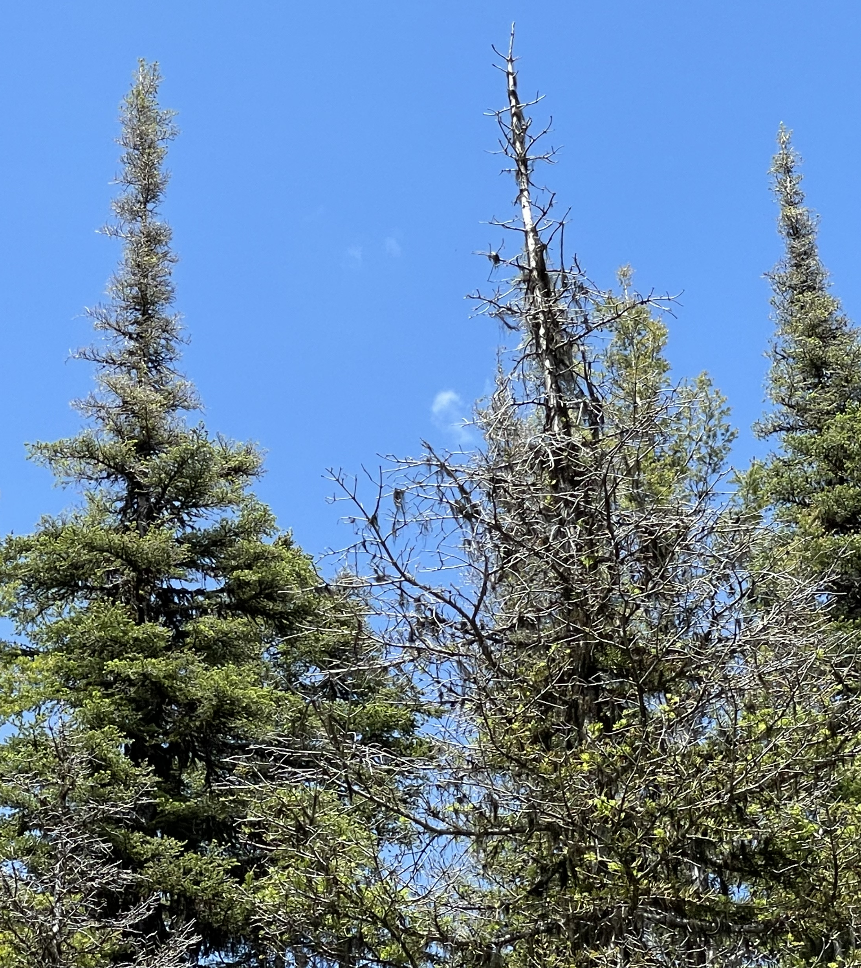
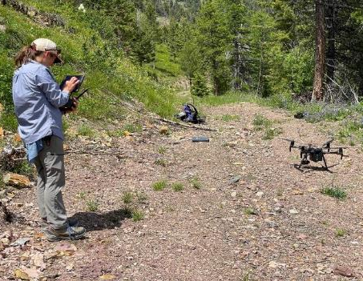
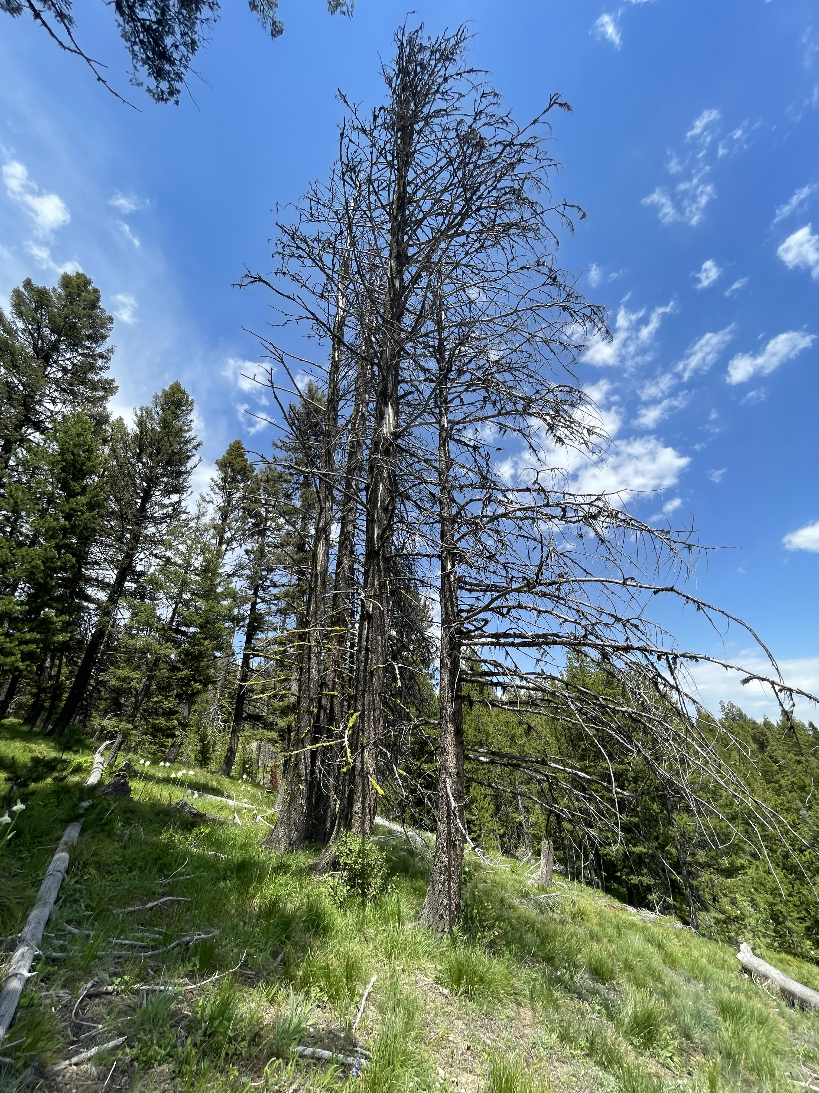
Combining reflectances and three-dimensional data from drone imagery to detect forest insect damage: An evaluation in the northern Rocky Mountains
Abhinav Shrestha, Jeffrey A. Hicke, Arjan J. H. Meddens, Jason Karl, Amanda Stahl

Slide 6
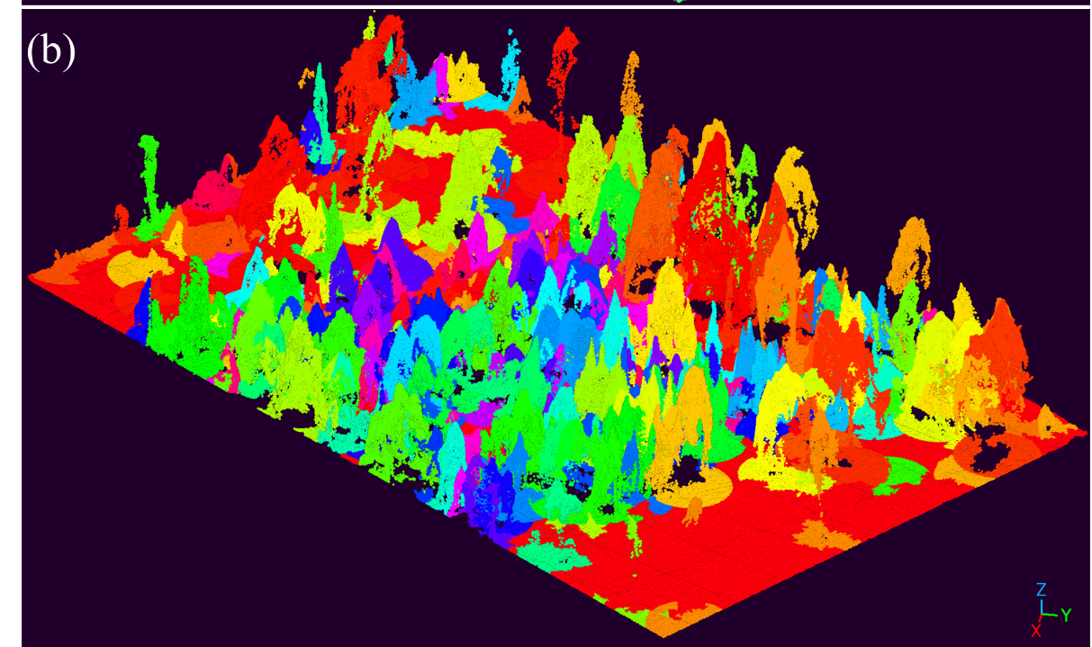
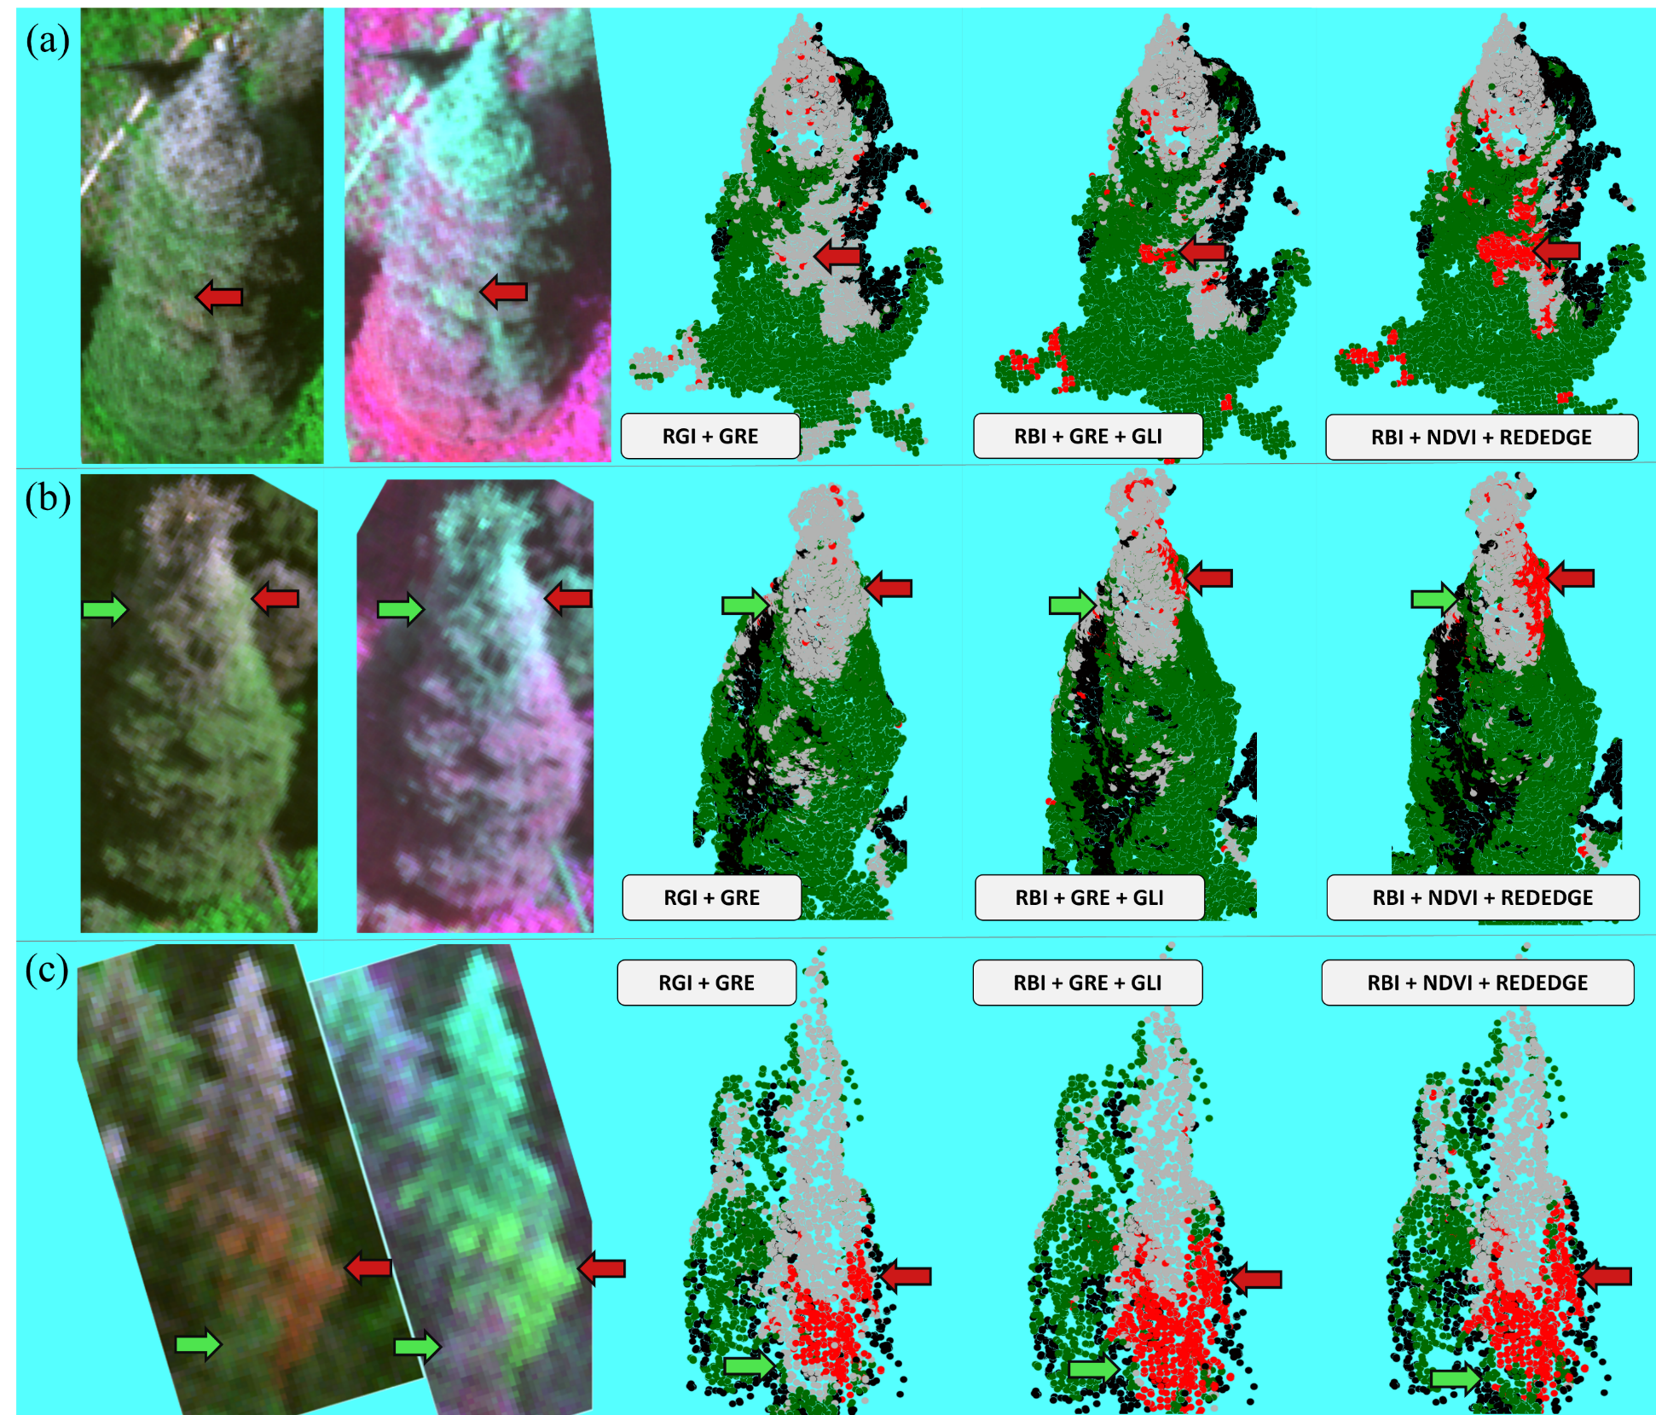
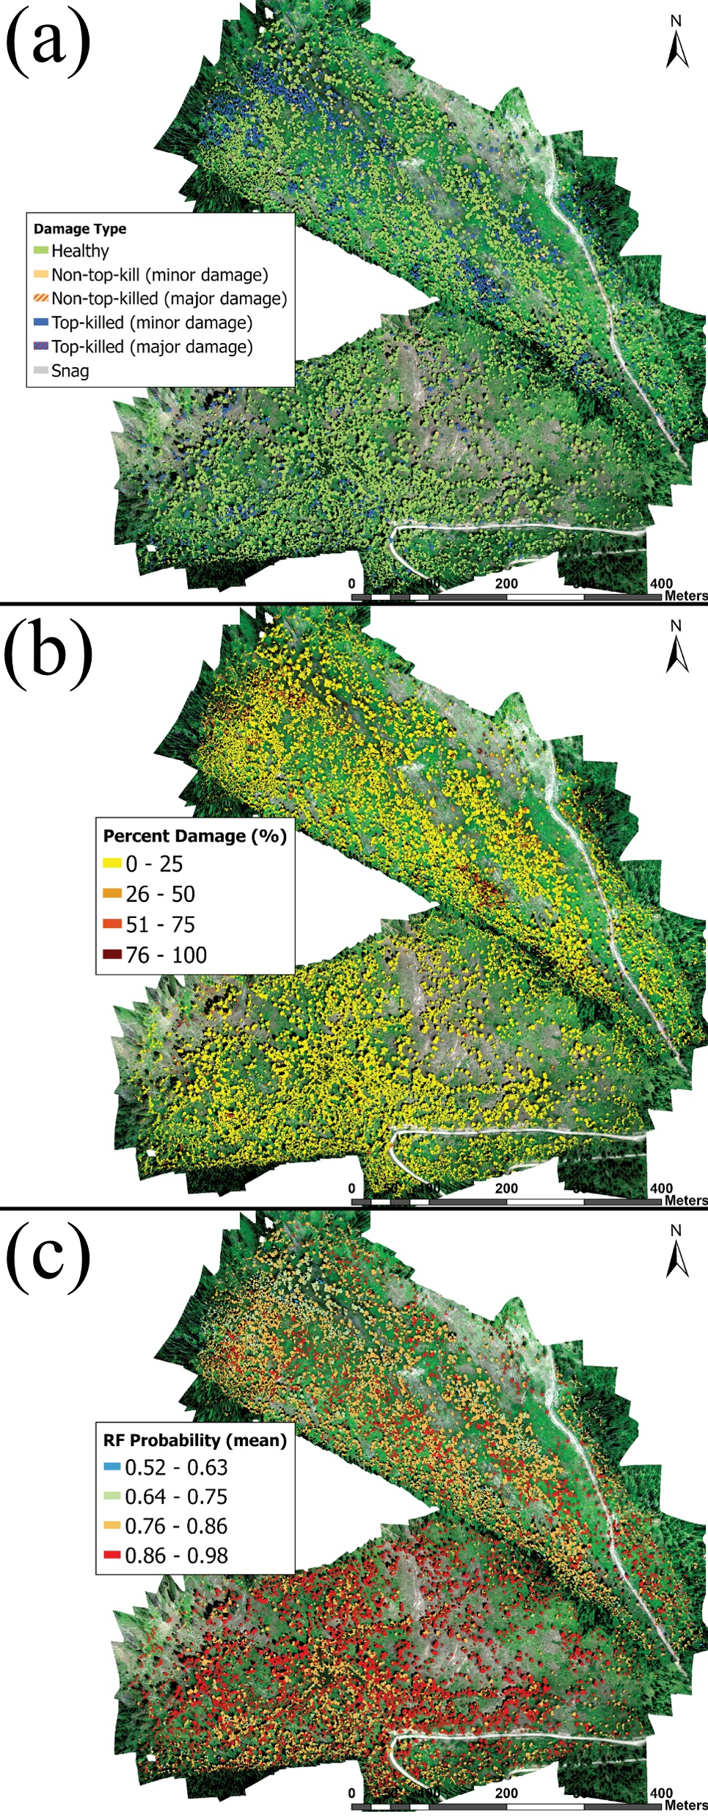
Objectives
segment study area into tree objects
classify points in 3D space
estimate tree-level damage metrics

Slide 7
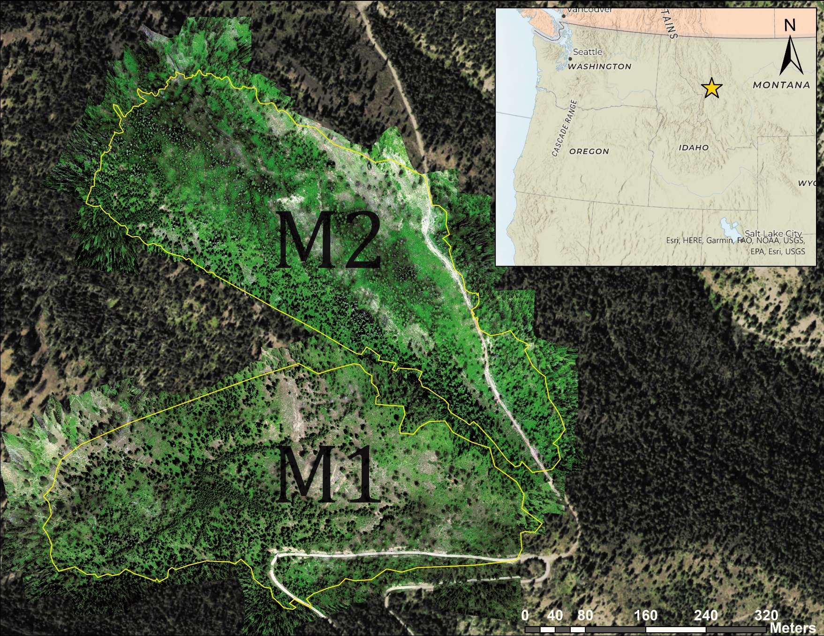
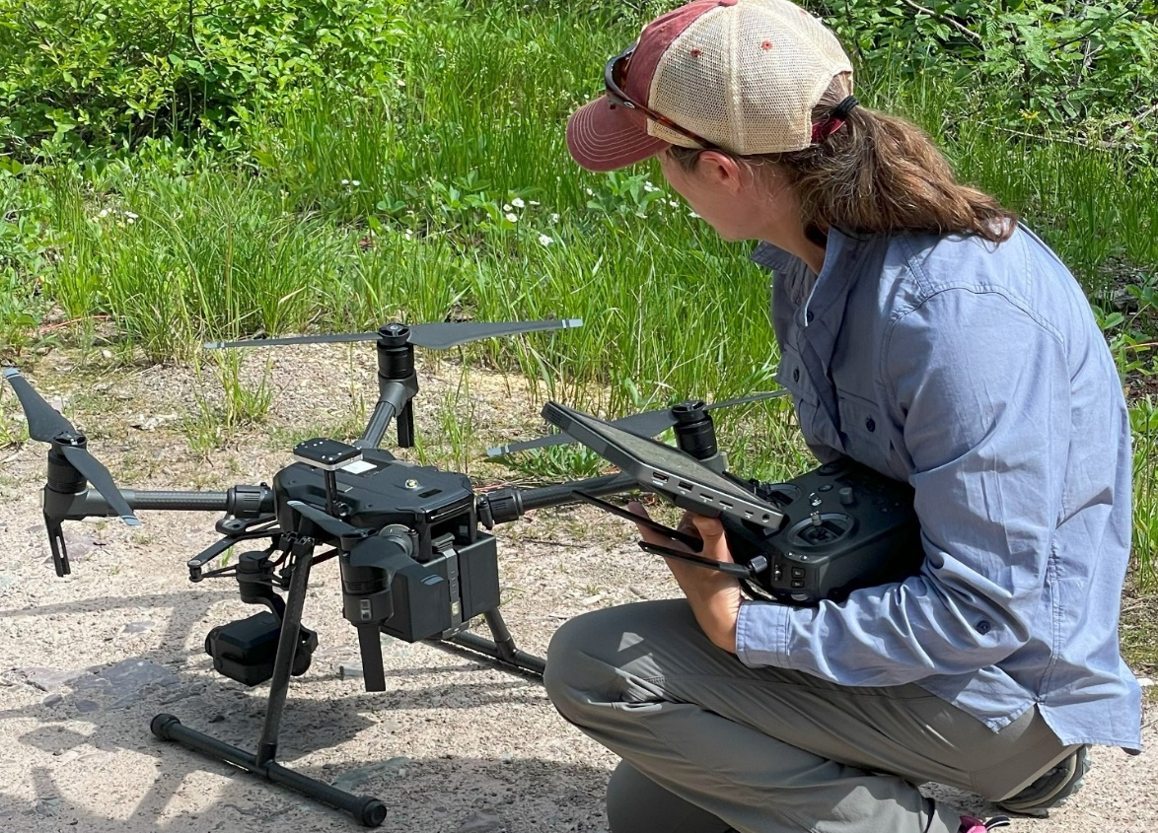
Study area and drone mission
DJI Matrice-210 drone
  MicaSense MX-RedEdge sensor (5-band calibrated sensor)
  Zenmuse XT2 RGB and thermal cameras
Ground control points across study area
Notes:
elevation of around 1676 meters
GCP markers across M1 and M2, GPS data recorded with Trimble

Slide 8
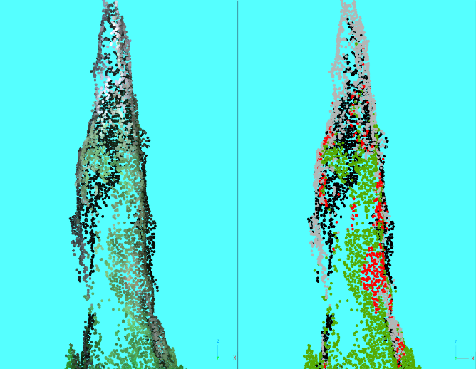
Final model for classification of 3D points
Classes
  green=healthy foliage
  red=dead foliage
  gray=no foliage (twigs, branches)
  black=shadow
Variables: RBI, NDVI, Red edge
overall accuracy: 98.6%
true color
classification

Slide 9
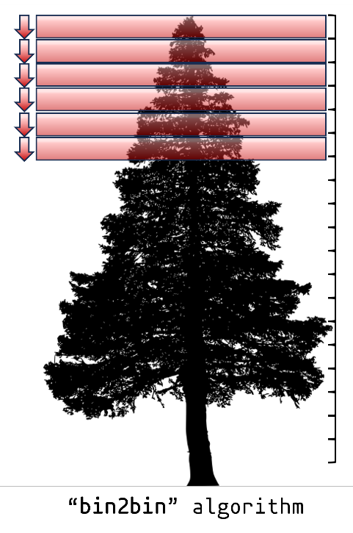
Tree-level damage metrics
%points in damage classes:
  major damage:
    red trees, gray trees, red+gray trees
  minor and moderate damage
top-kill
  presence
  length
  live crown ratio
top-kill algorithm

Slide 10
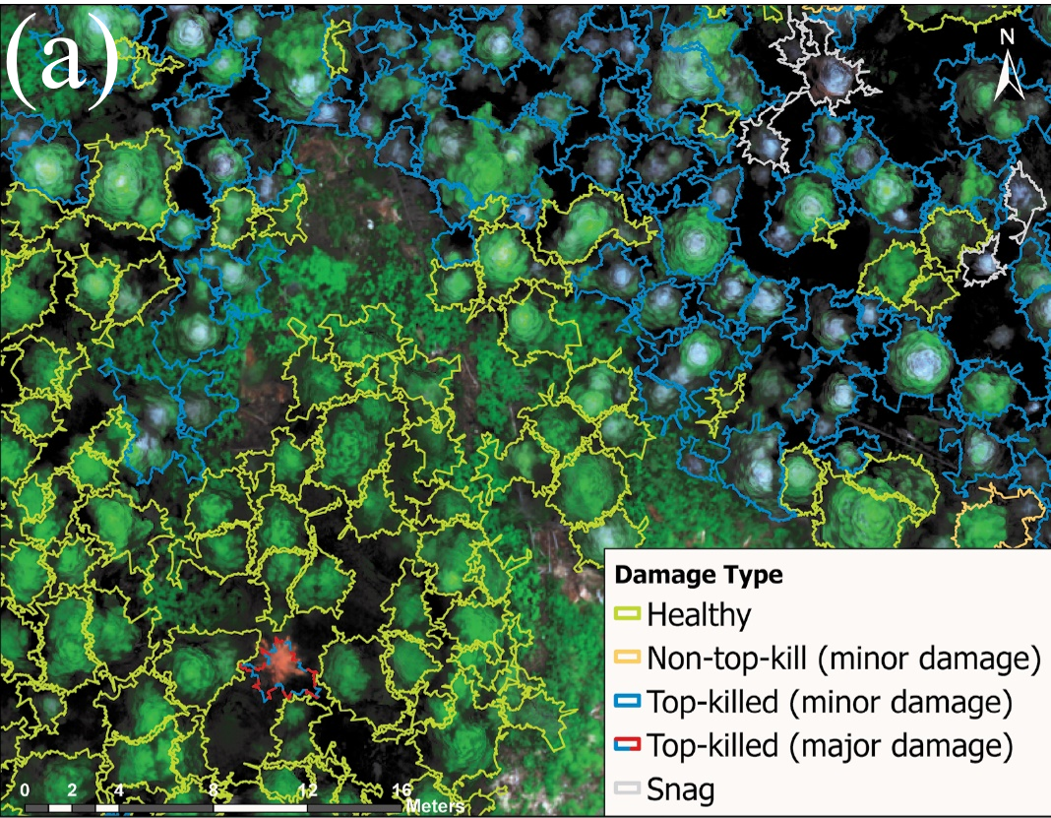
Tree damage map (zoom)
gray
top-kill
red

Slide 11
Tree damage map for study site
mostly healthy trees (78% of 15,513)
damaged trees were mostly top-kill (84%)
average length of top-kill: 25% of tree height

